Slide 1
Space environmental testing and other activities at
DAE FME CTU
Jaroslav Kousal
Department of Aerospace Engineering
Faculty of Mechanical Engineering
Czech Technical University in Prague

Slide 2
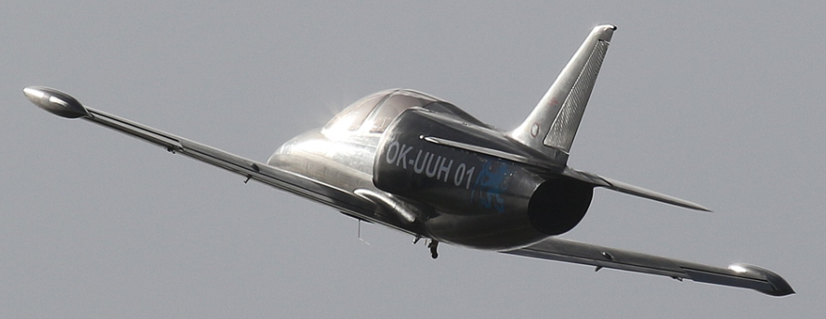
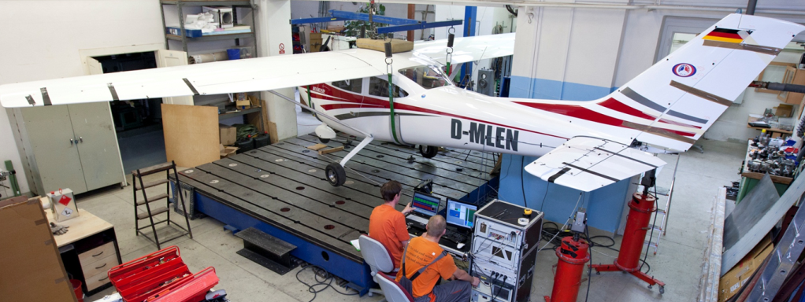
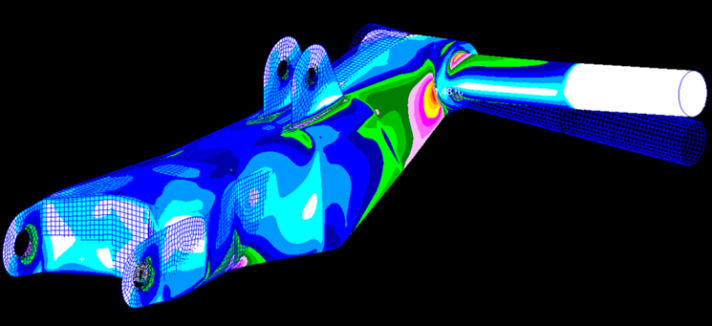
Department of Aerospace Engineering
FME CTU in Prague
Established 1976
Typically 10-25 students/year
Projects of aircrafts and drive units
Safety and reliability of aircraft structures
Aeroelasticity, flutter certificates
Composite materials
Unmanned systems UAV
Destructive and non-destructive testing
Recent years:
  Space technologies

Slide 3
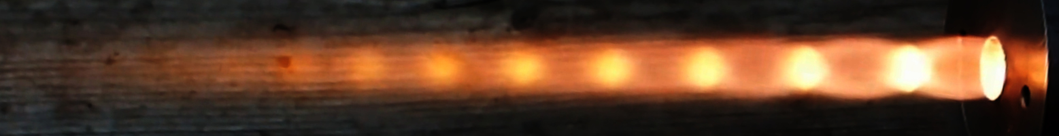
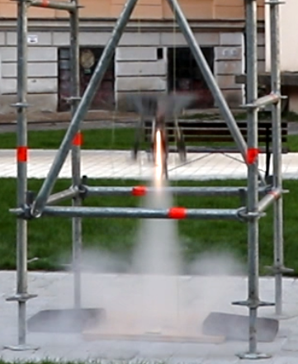
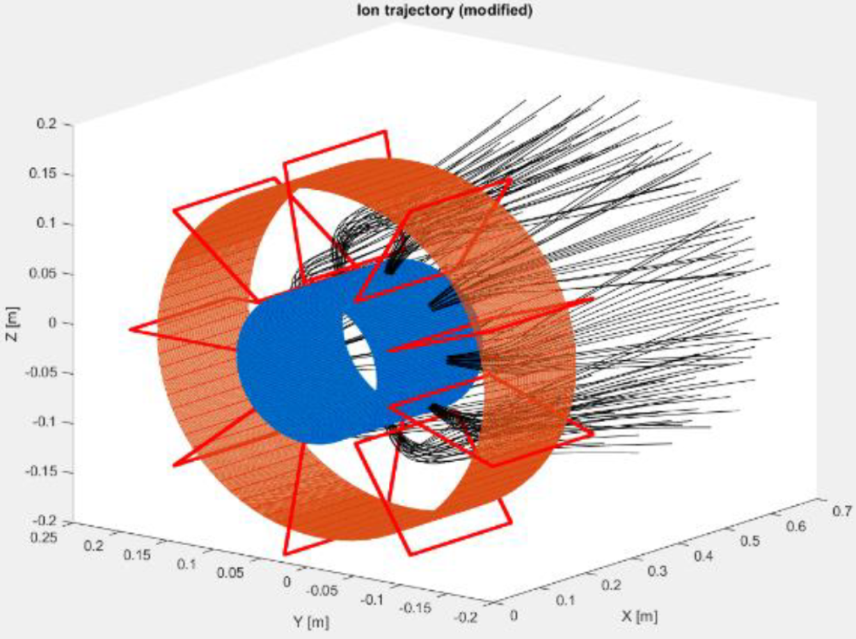
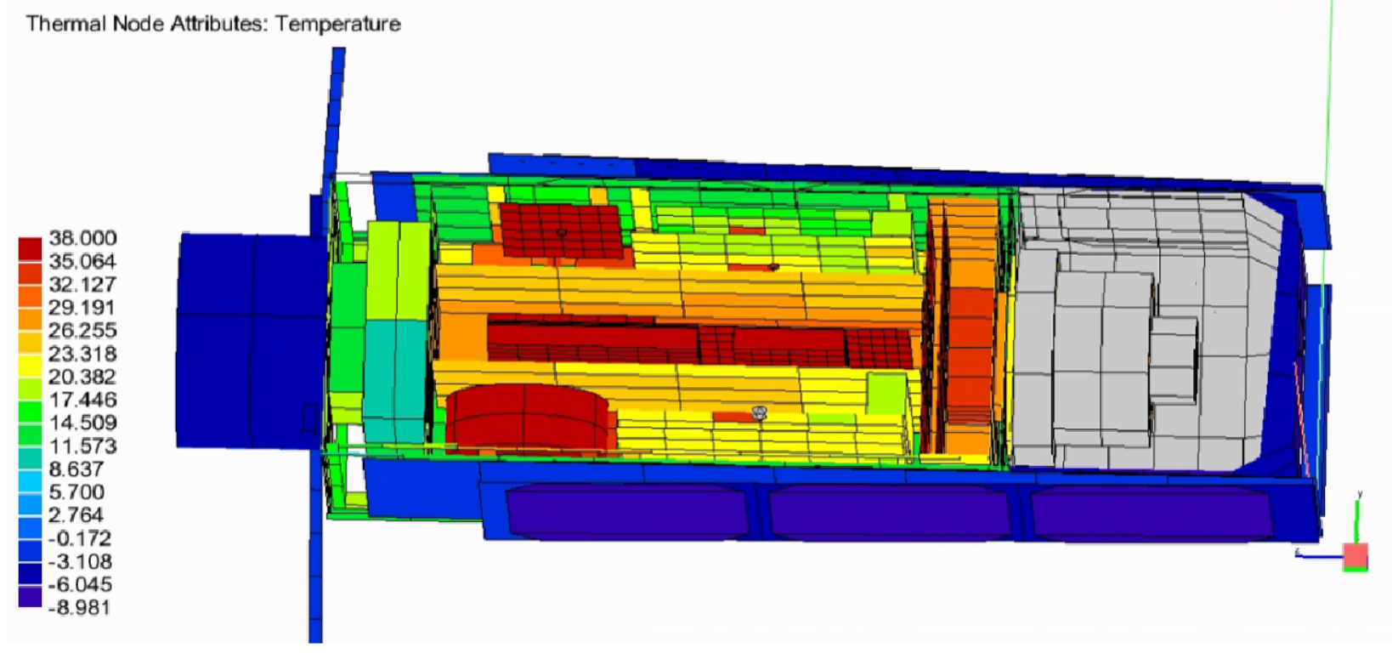
Space Technology - Education
2007 – first space technology subject
2016 – Space Technology specialization
  6 subject dedicated solely to the specialization
  + shared subjects, "team project" etc.
  >20 master degree students graduated
  (now in SAB, ESA, CAS, VZLÚ...)

Slide 4
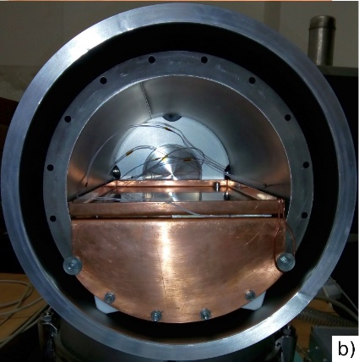
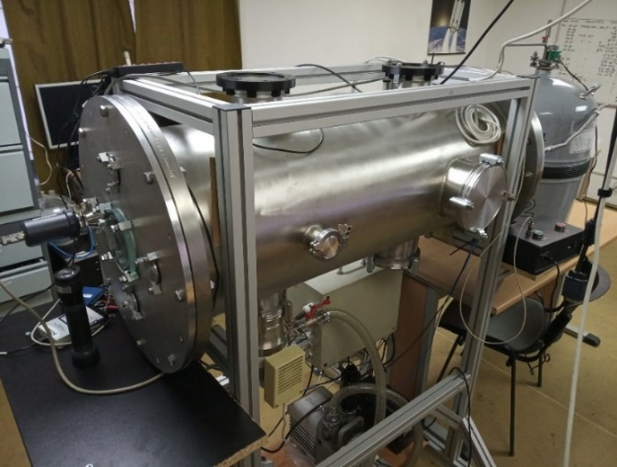
"Space – SPELL"
Space Structures, Propulsion, Environment and Loads Laboratory
Thermal vacuum testing
  2 thermal vacuum chambers
    25 l (∅260 x 420 mm)
    140 l (∅400 x 1100 mm)
  -150°C to +150°C contact cooling/heating
    radiative shield for 25 l chamber available
  pressure <10⁻³ Pa
  multi-purpose
    micropropulsion thrust stand in development

Slide 5
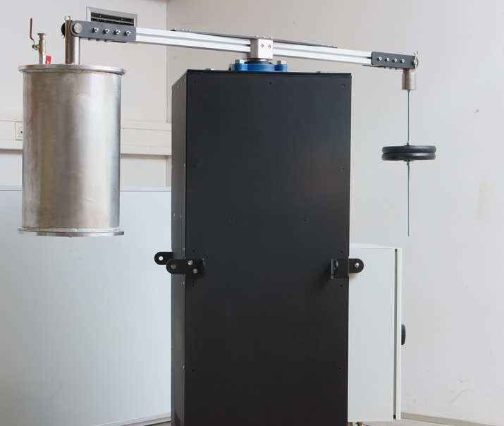
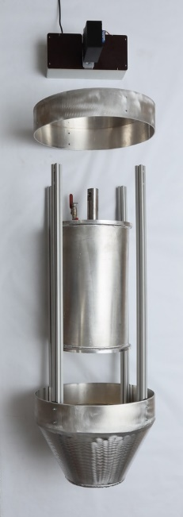
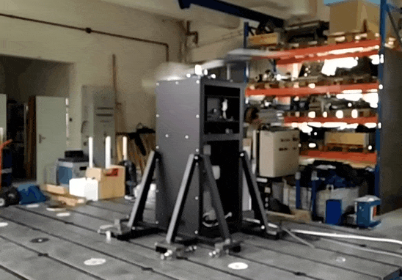

"Space – SPELL"
Space Structures, Propulsion, Environment and Loads Laboratory
Hyper-g/micro-g equipment
  Available for experiments from autumn 2022
  Centrifuge + drop shield + shared capsule
    Experiment mass 2 – 5 kg, ∅ 300 mm
    0g (drop; 1s, later 2s)
    1 – 20g (centrifuge)

Slide 6
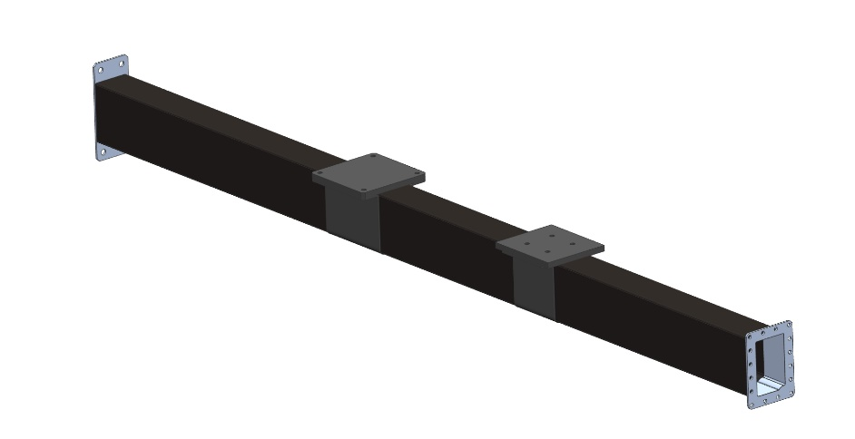
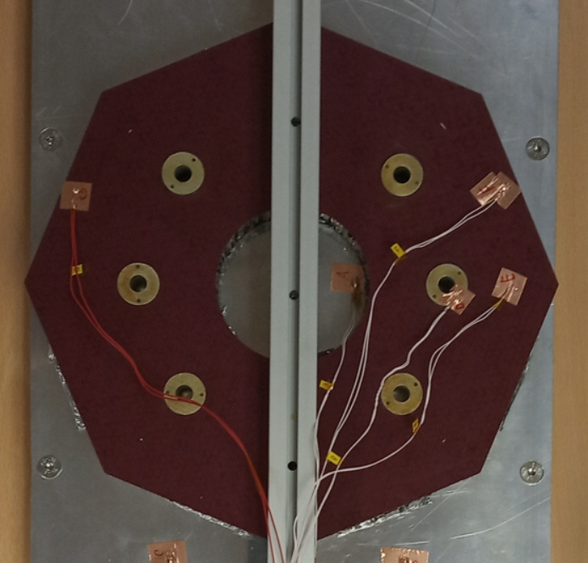
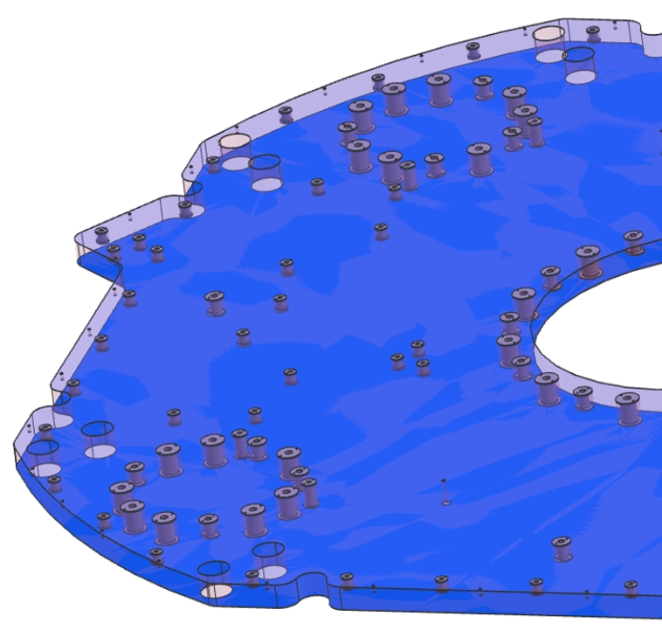
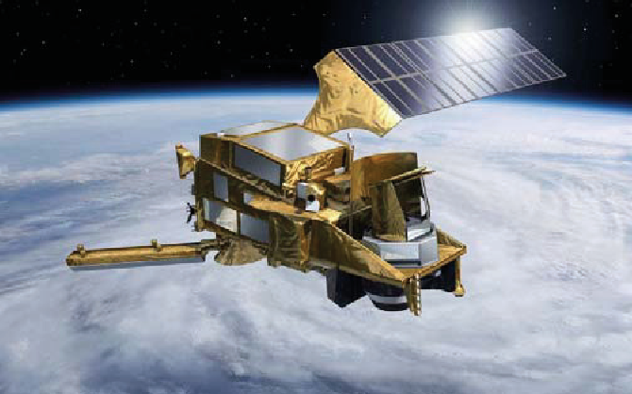
MPO TRIO FV10400
"Development of processes applicable to development and production of components for the space industry"
  With LA composite, s.r.o and University of West Bohemia
  Composite satellite structures (booms, sandwiches)
    Technology development
    Mechanical and thermal-vacuum testing
  Descendant – parts for MetOp-SG

Slide 7
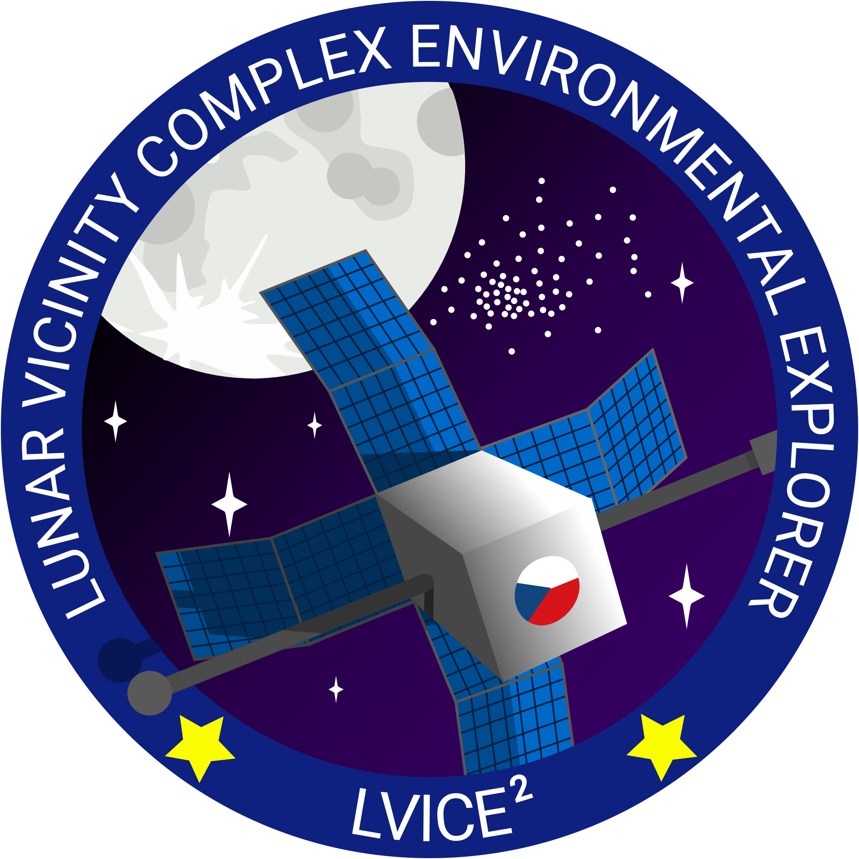
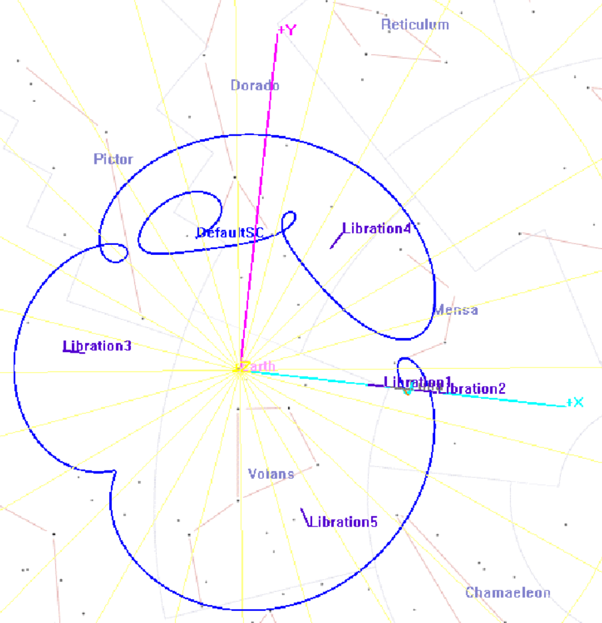
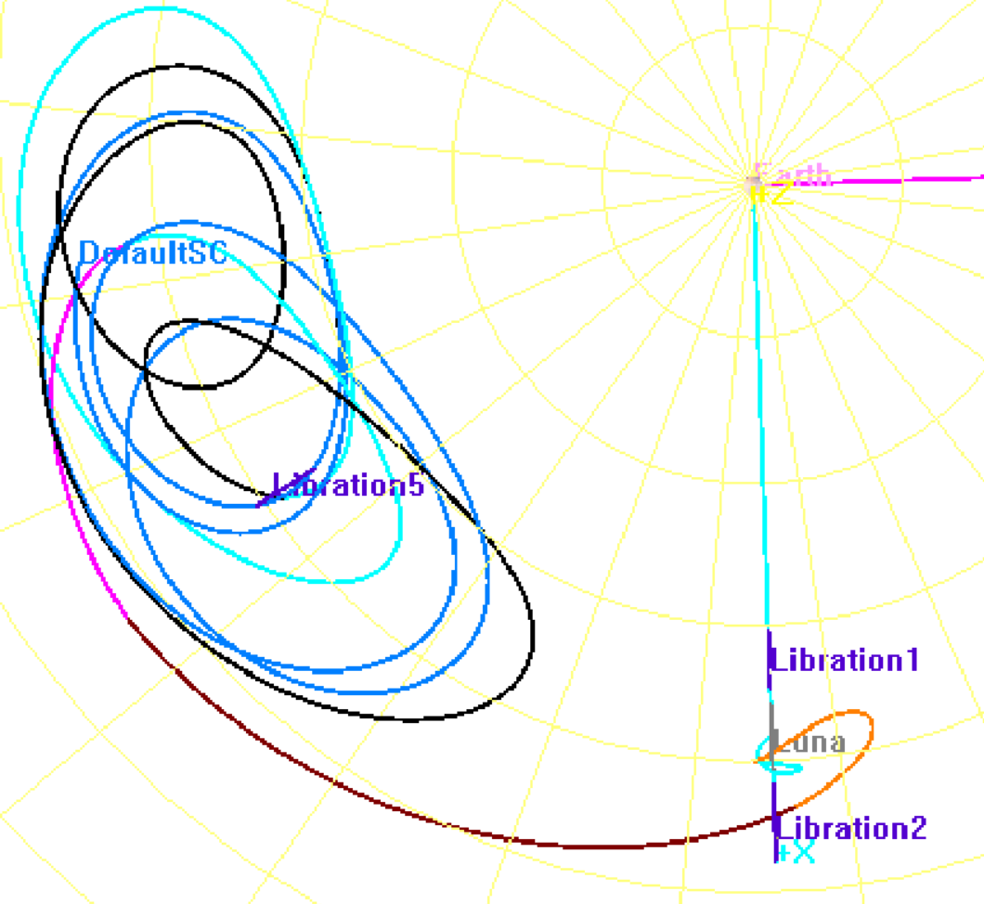
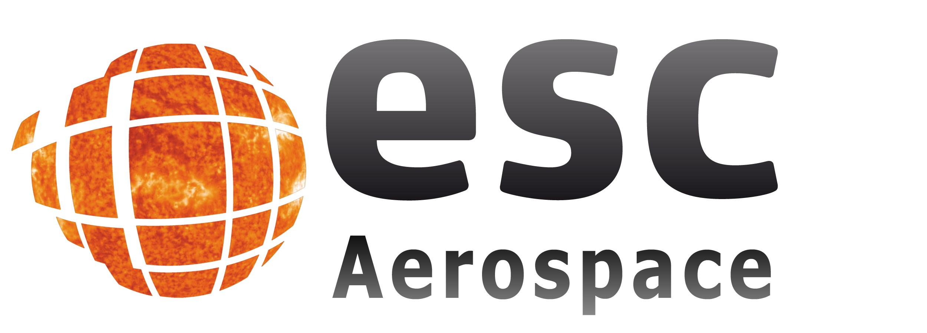




LVICE²
Lunar VIcinity Complex
Environmental Explorer
Aims/Objectives:
  Observation of Kordylewski clouds
  Solar wind turbulence in interplanetary space / lunar wake
  Energetic particle spectra during the solar maximum
  "Full" solar wind monitoring using CubeSat (12U)
DAE FME CTU – Trajectory/maneuvers calculations

Slide 8
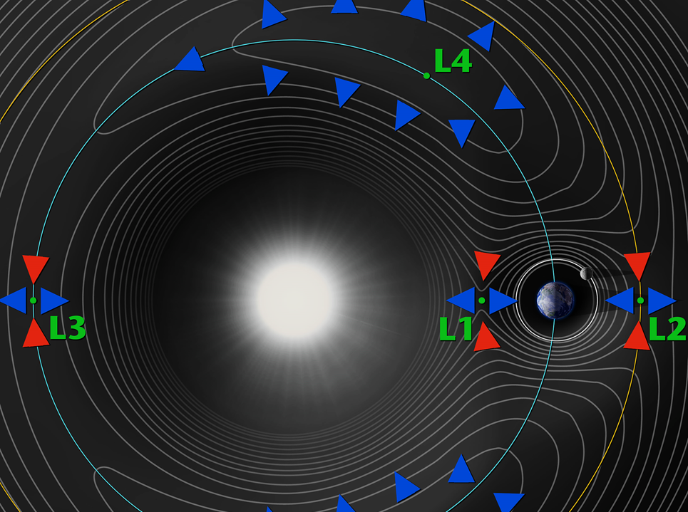

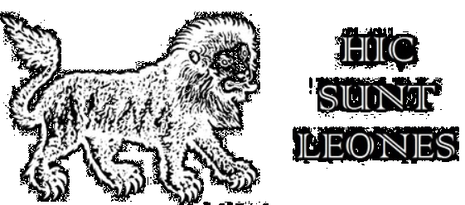
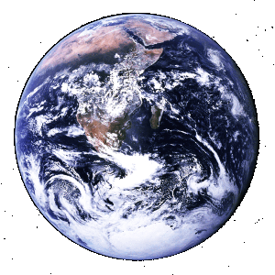
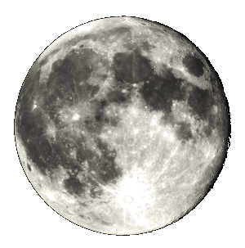
HIC
EST
LEAENA

