Slide 1
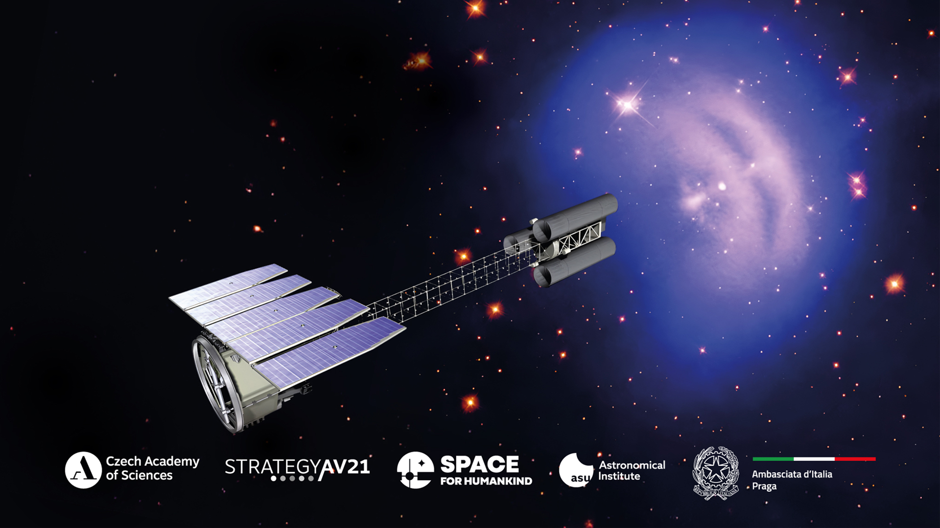
Czech-Italian Collaboration
in Space-Based High-Energy Astronomy
13:00 Conference on Czech-Italian Collaboration in Space Projects
15:15 Award Ceremony:
Ernst Mach Medal for Prof. Enrico Costa
A journey to the X-ray Polarimetry

Slide 2
Brief overview of the Czech participation in ESA space projects
Jiří Svoboda
Astronomical Institute of the Czech Academy of Sciences
Czech-Italian Collaboration in Space-Based High-Energy Astronomy
Czech Academy of Sciences, 24th November 2025

Slide 3
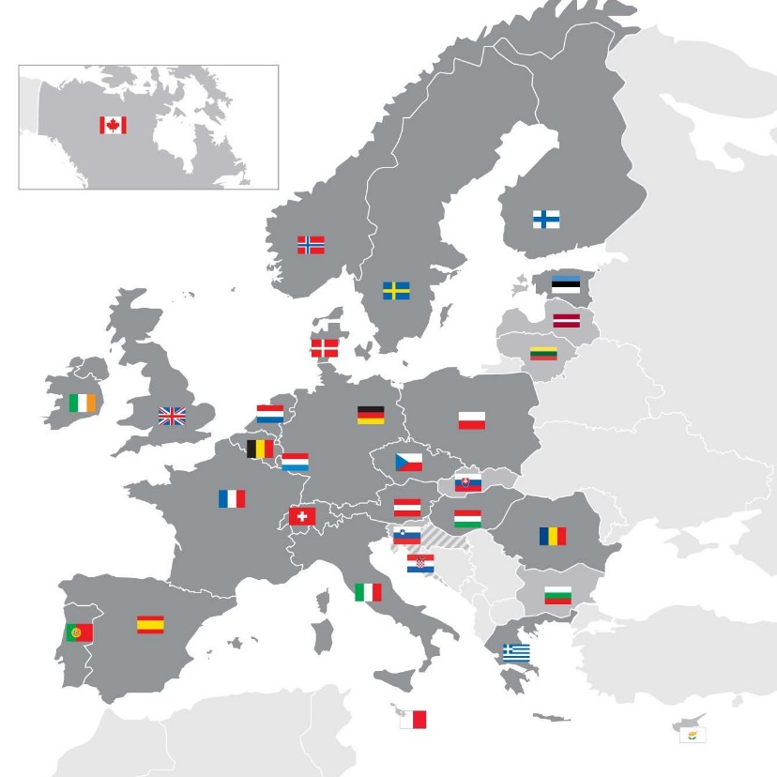


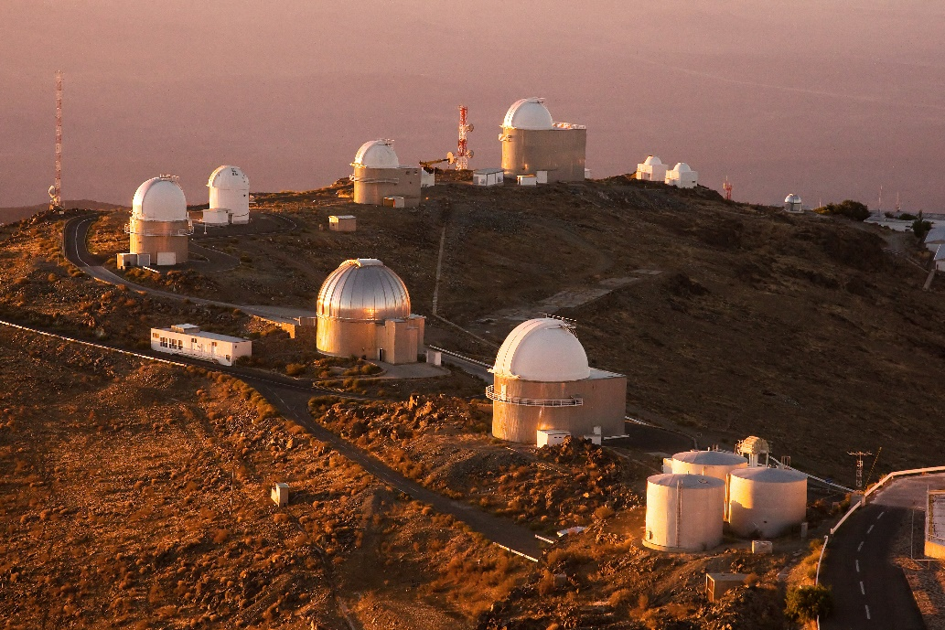
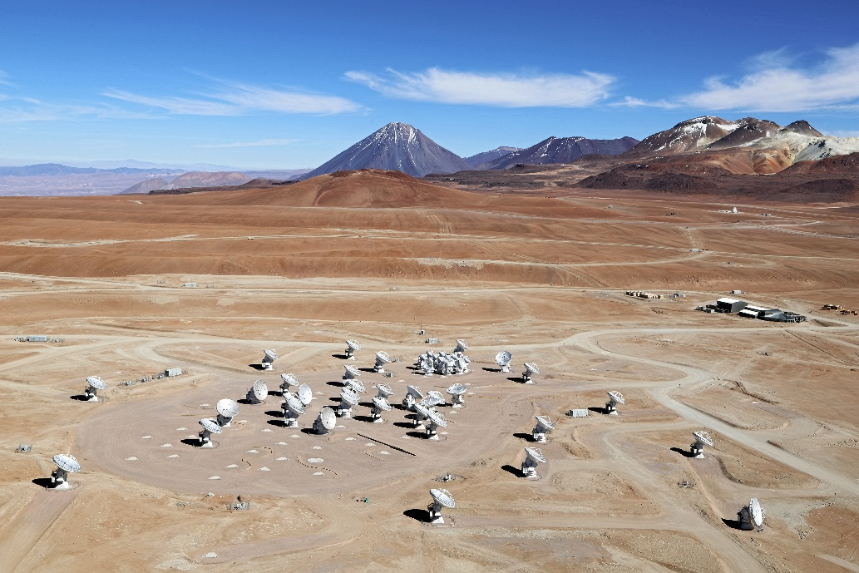
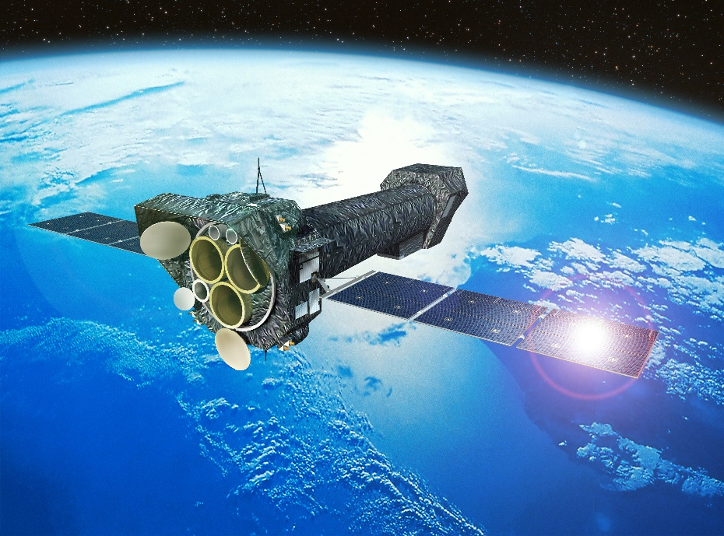
International collaboration in space projects
Ground-based observatories
Space missions
European Southern Observatory (ESO)
European Space Agency (ESA)

Slide 4
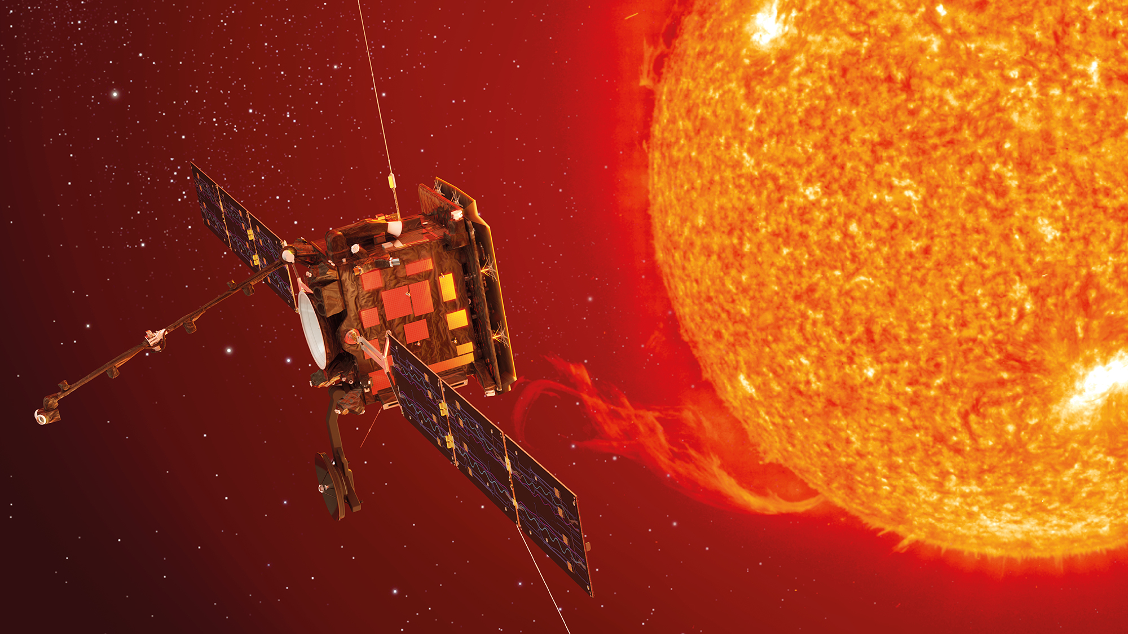
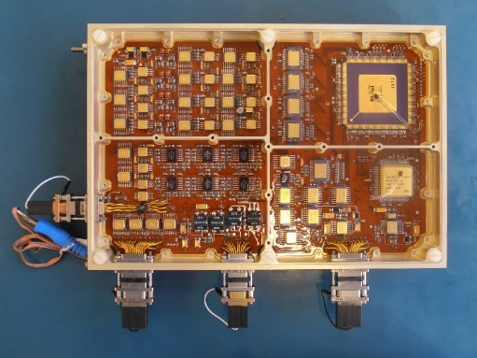
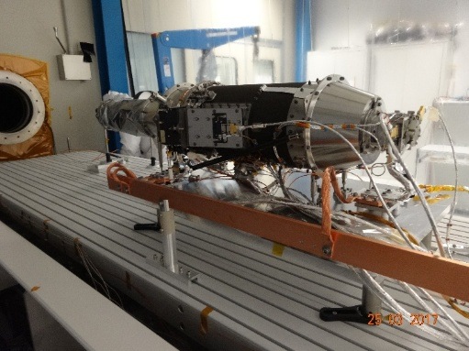
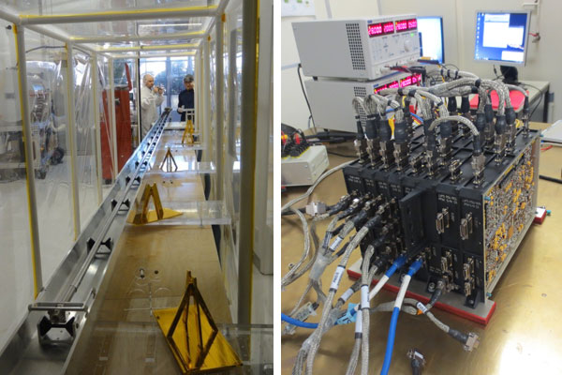
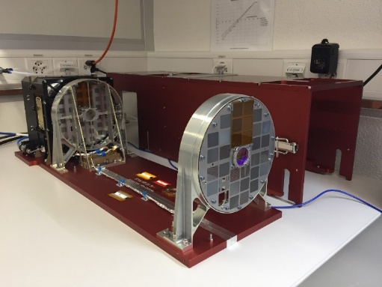
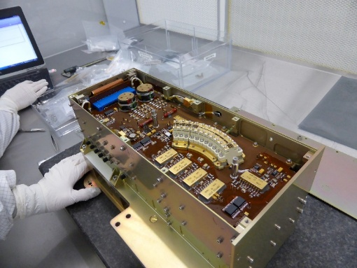
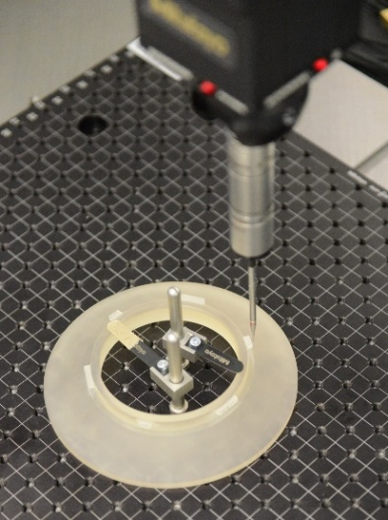
Solar Orbiter
hardware contribution to 4/10 scientific instruments
electronics, precise mechanics, on-board software, precise optics
successfully launched on 10.2.2020
the first ESA mission with significant Czech contribution
METIS
Italian-Czech coronograph

Slide 5
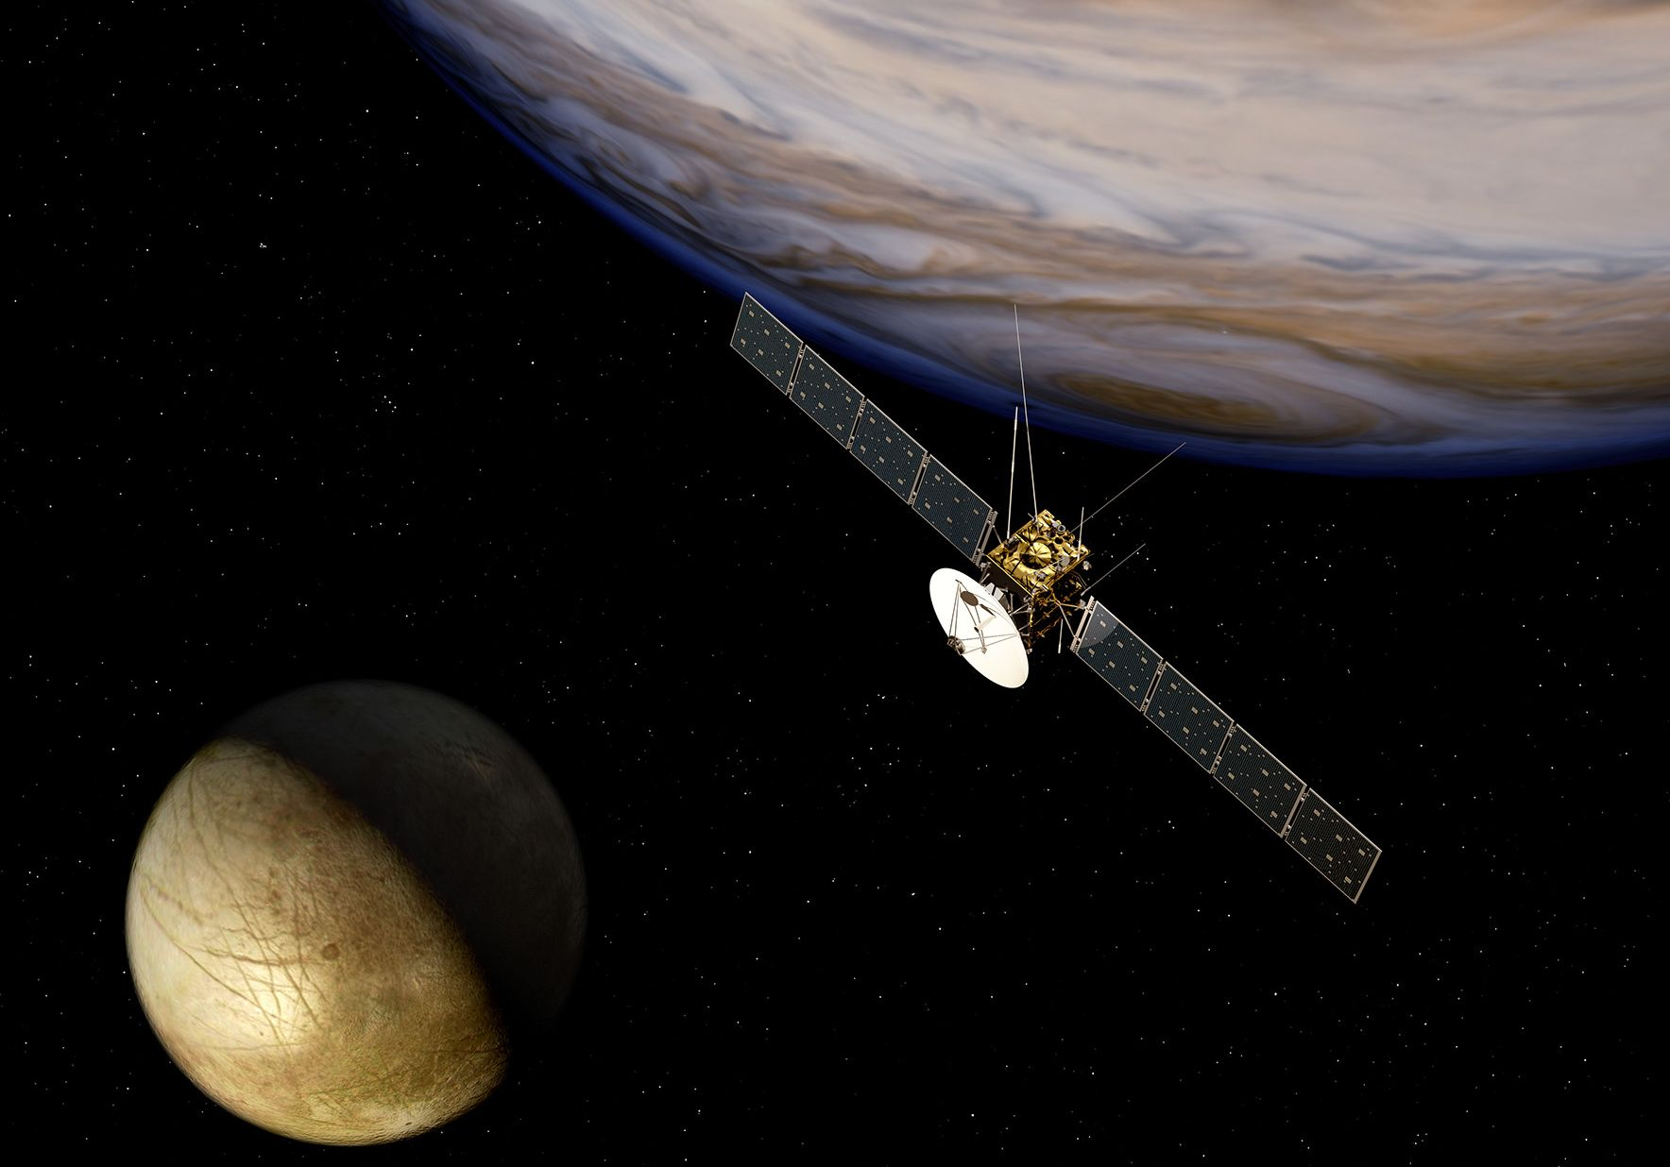
JUICE

Slide 6
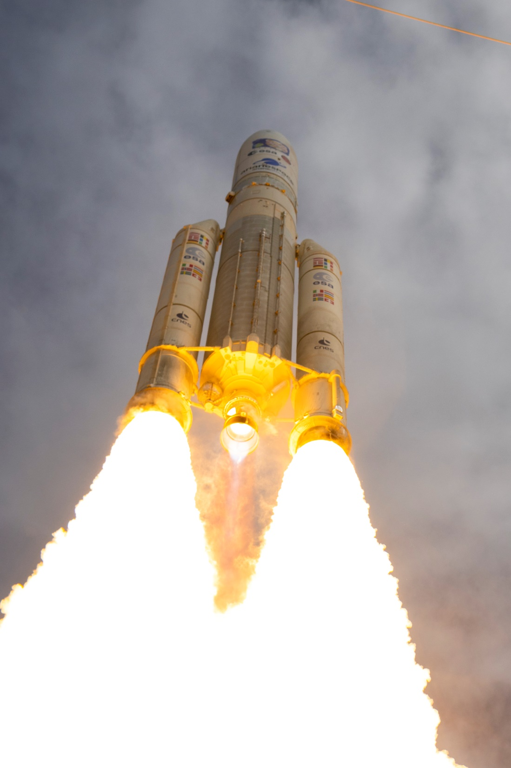
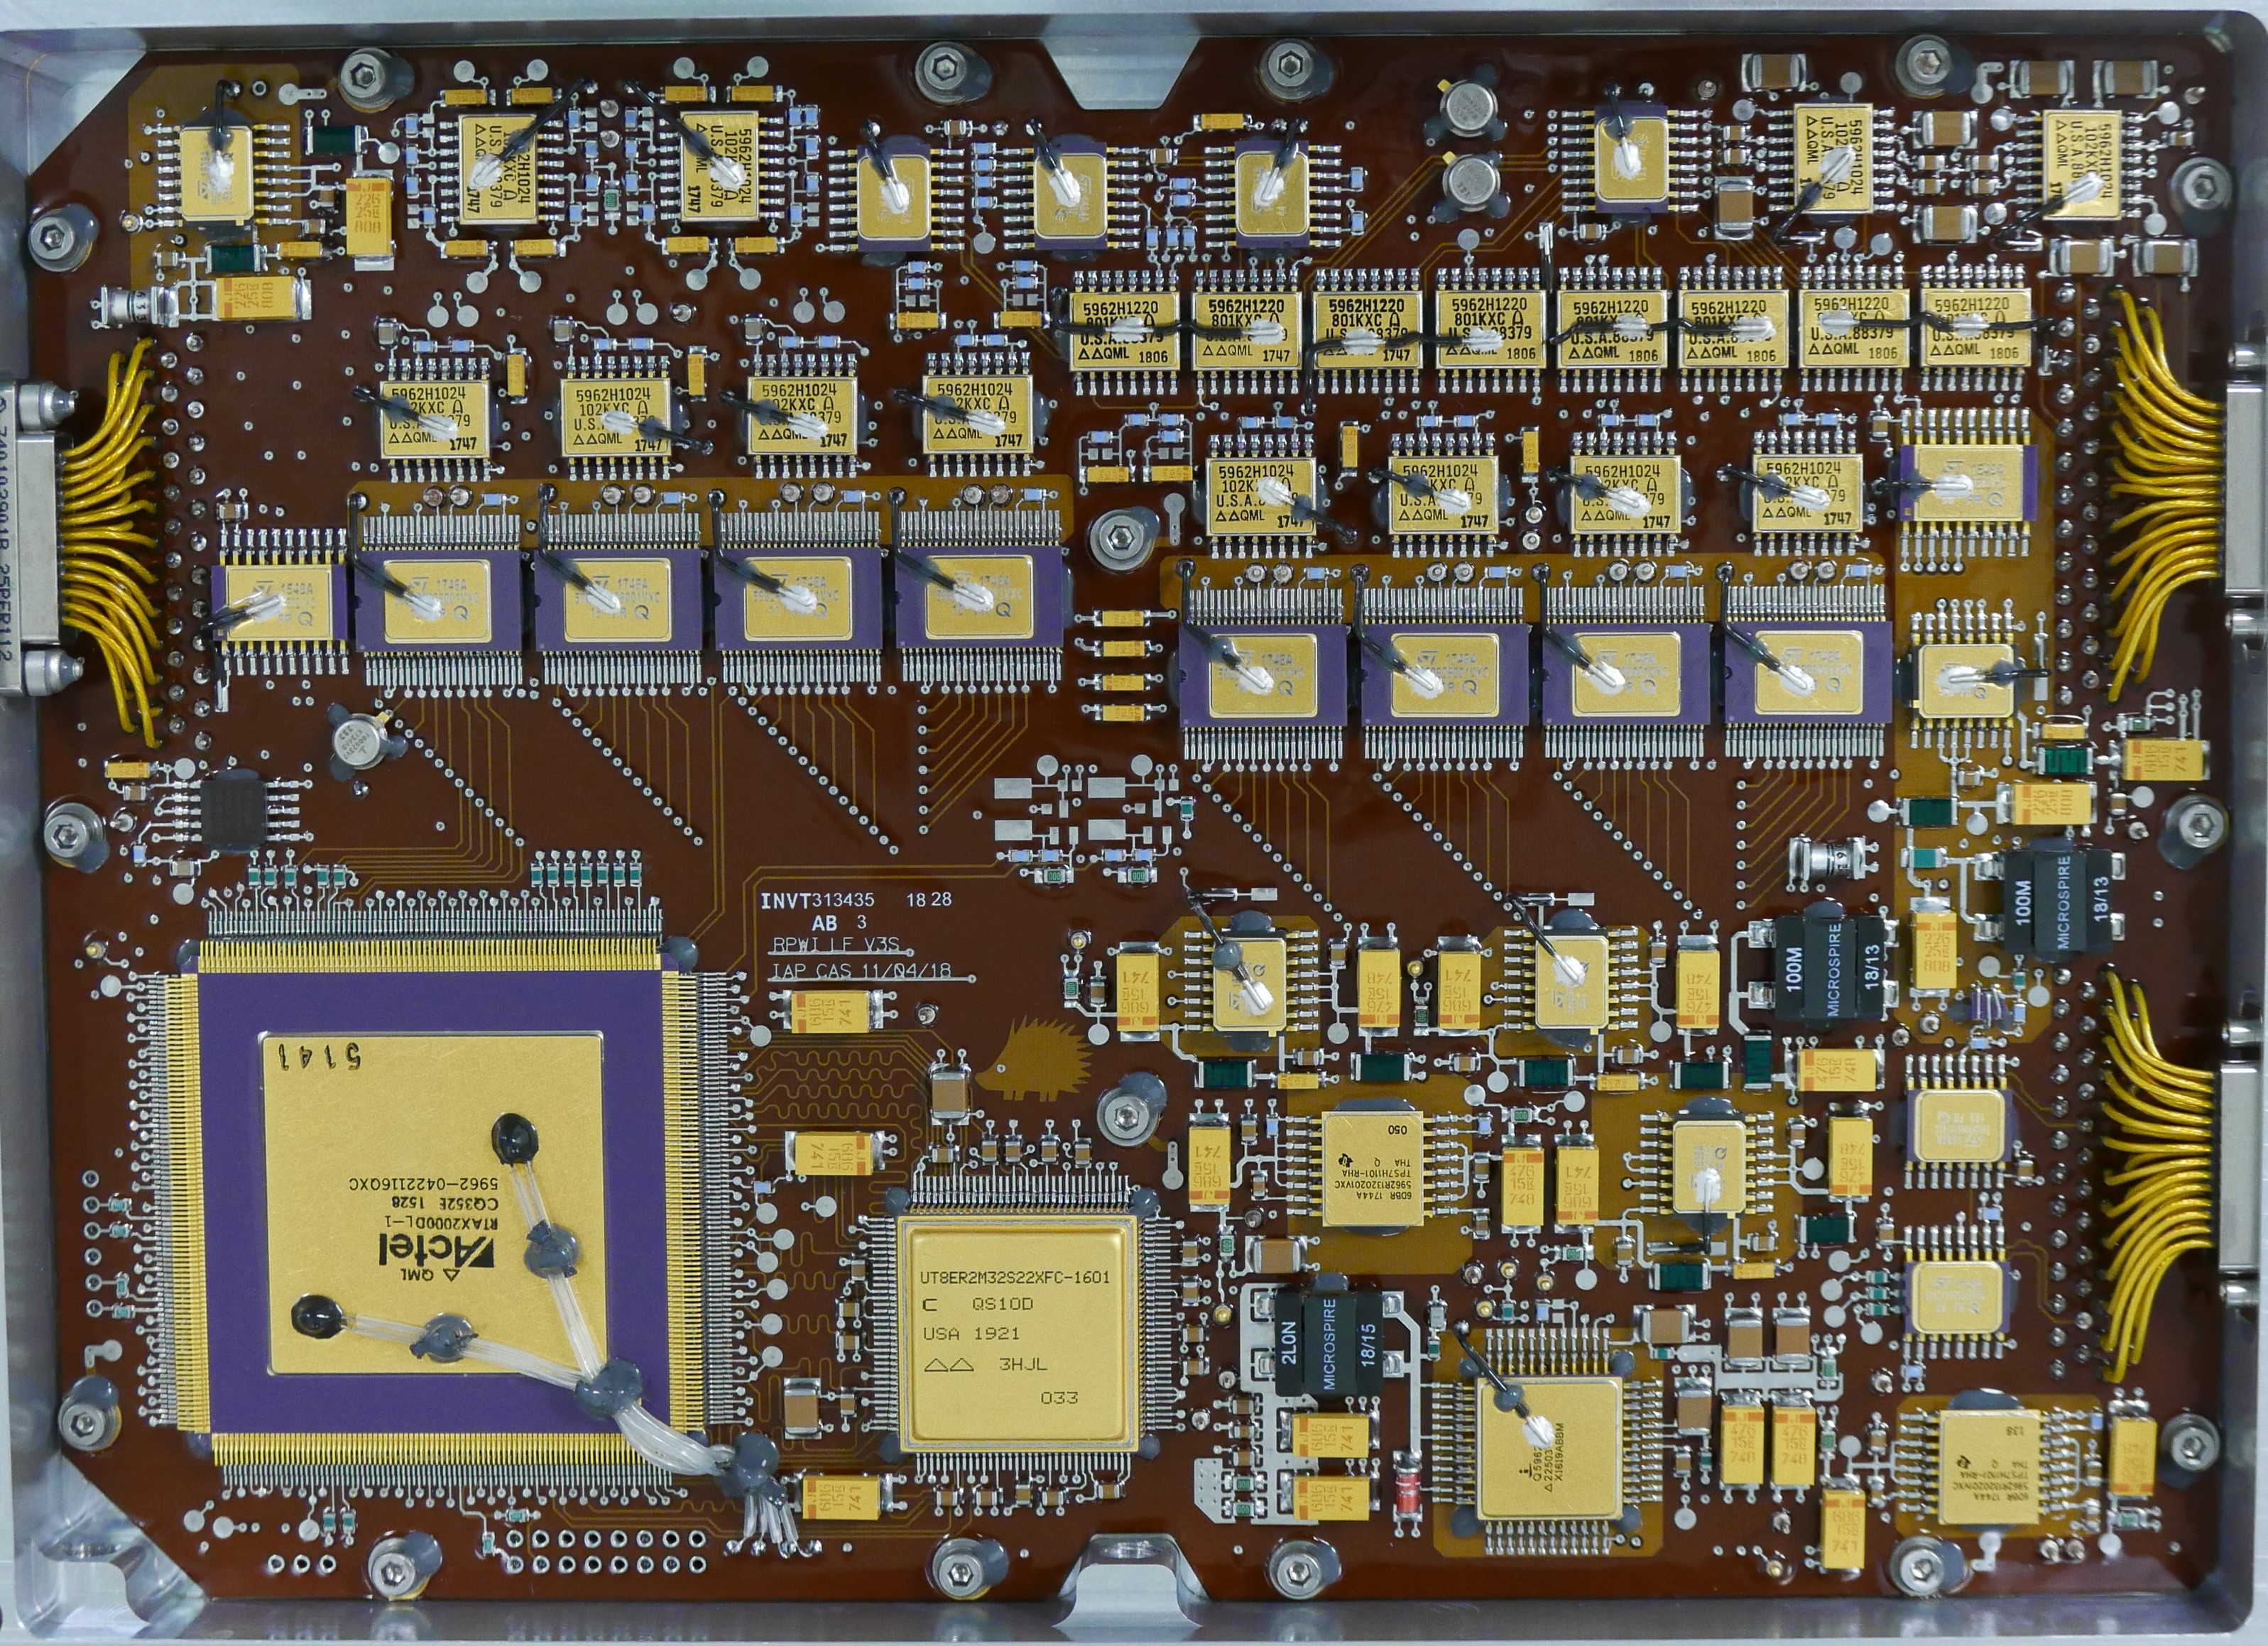

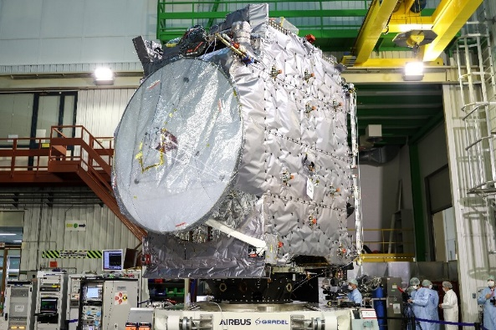
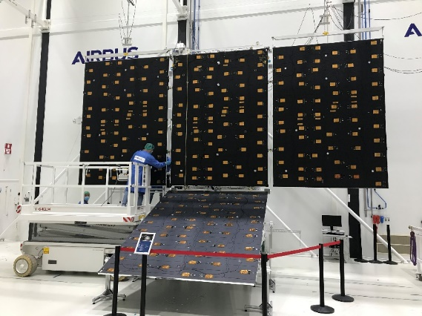
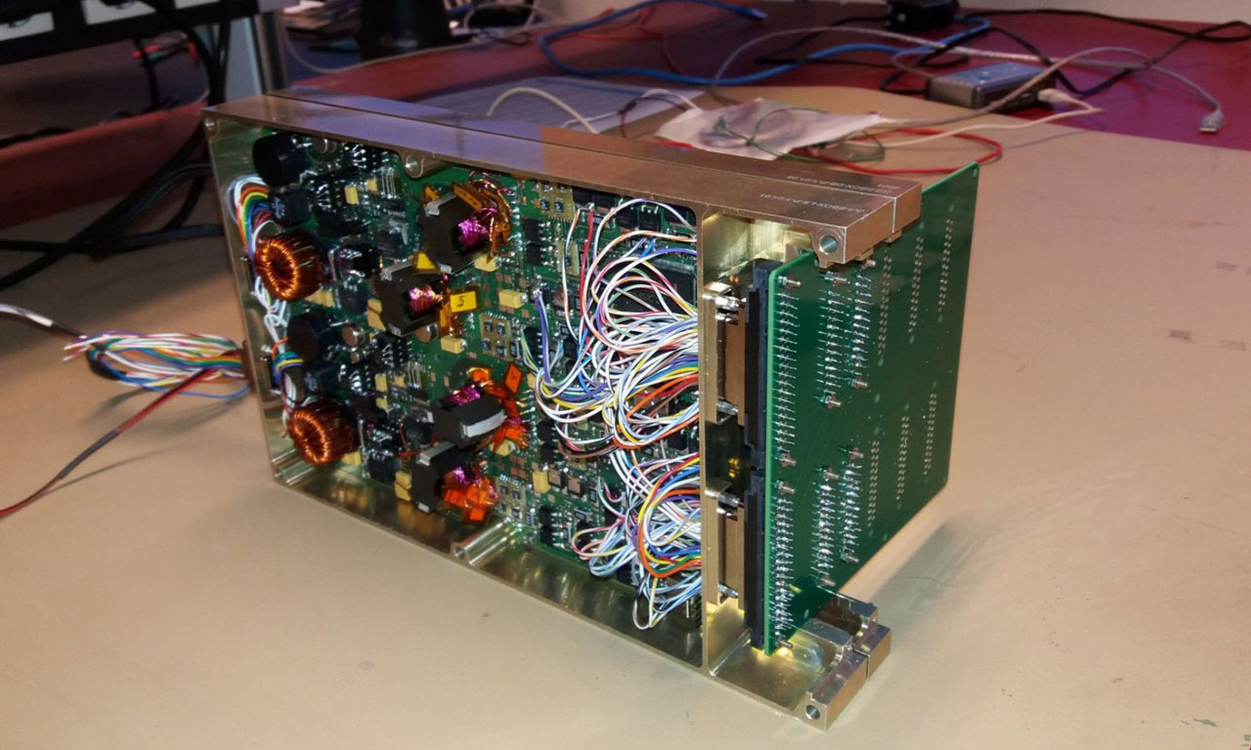

Start JUICE, 14th April 2023
Kourou, ESA, French Guyana
Flight model of the Low-Frequency Analyser
Low-Voltage Power Supply

Slide 7
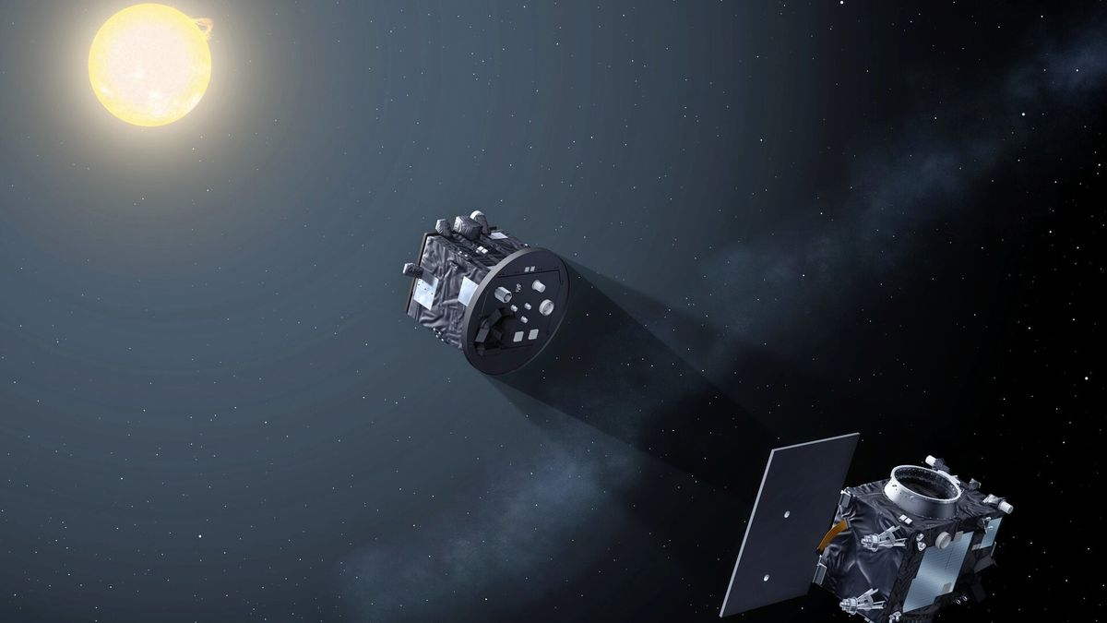
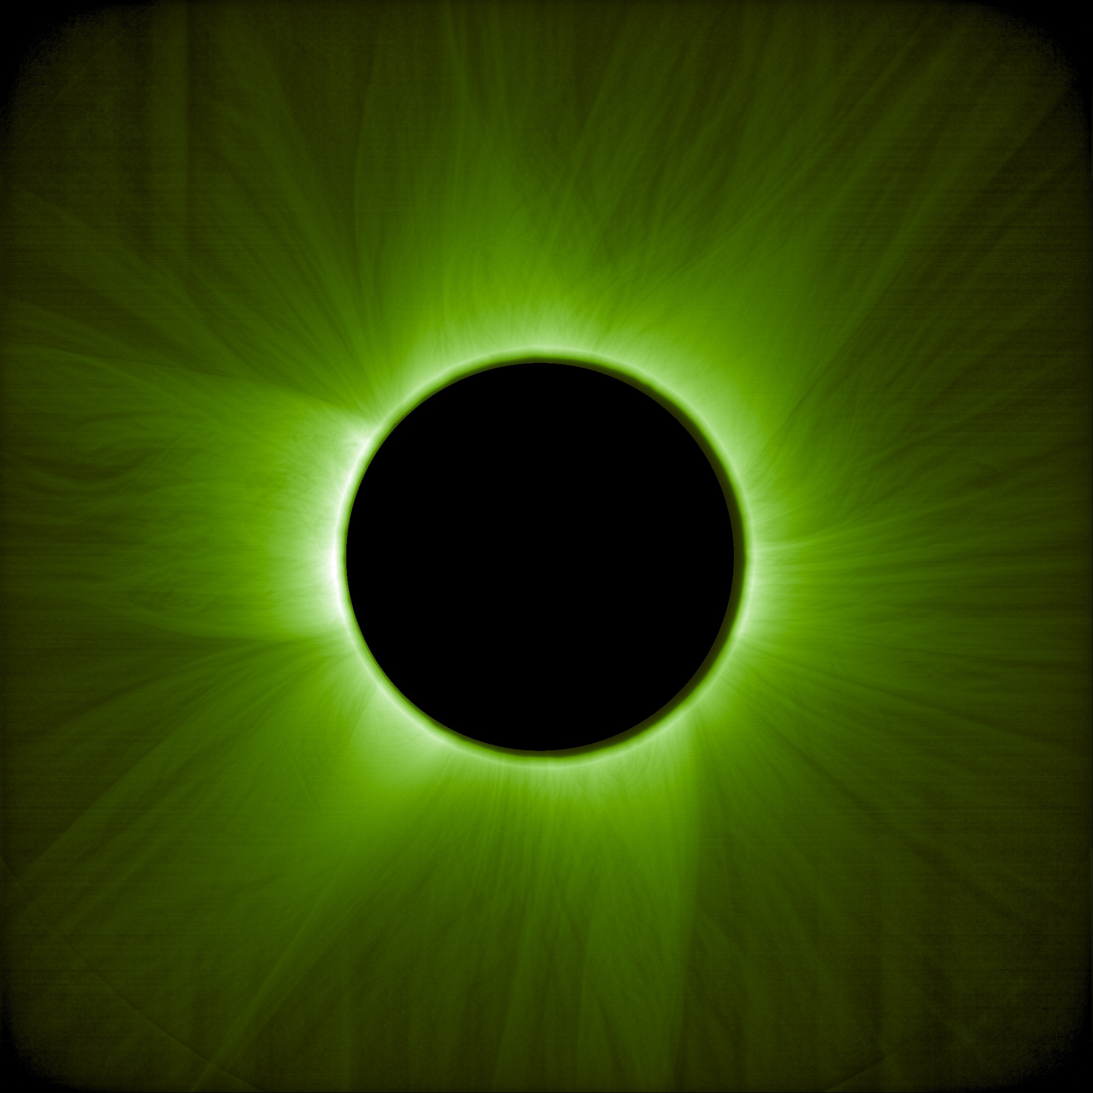
First image from the coronograph
June 2025
PROBA-3
Coronograf ASPIICS (CZE: mirrors, door, IT: filters)
launched 5th Dec 2024

Slide 8
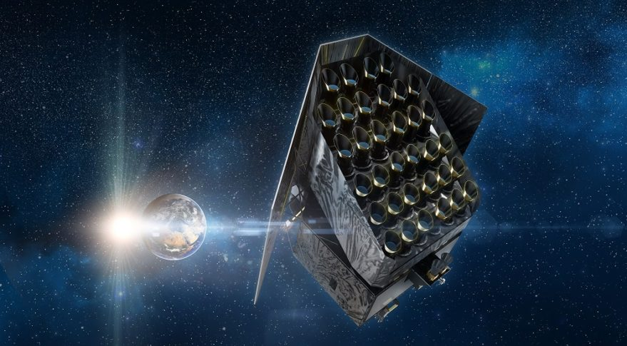
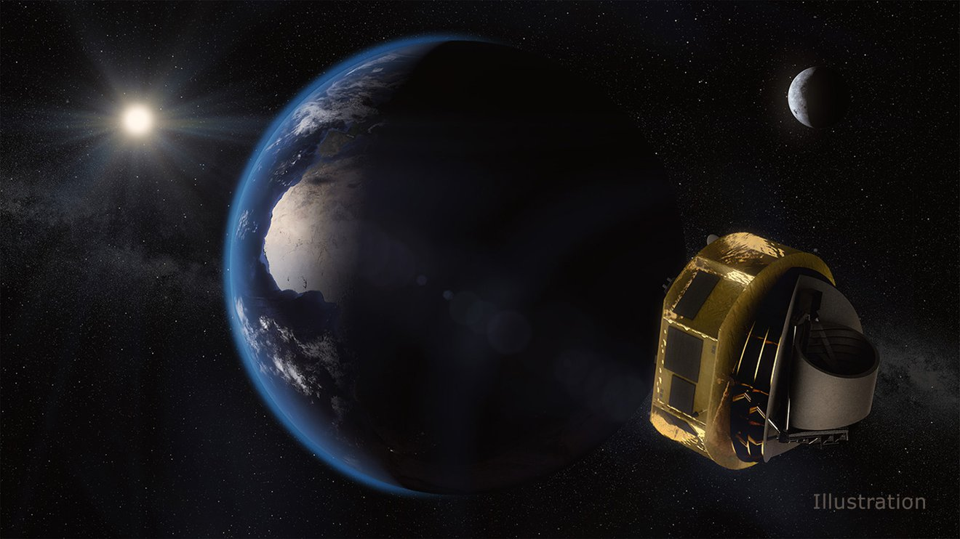
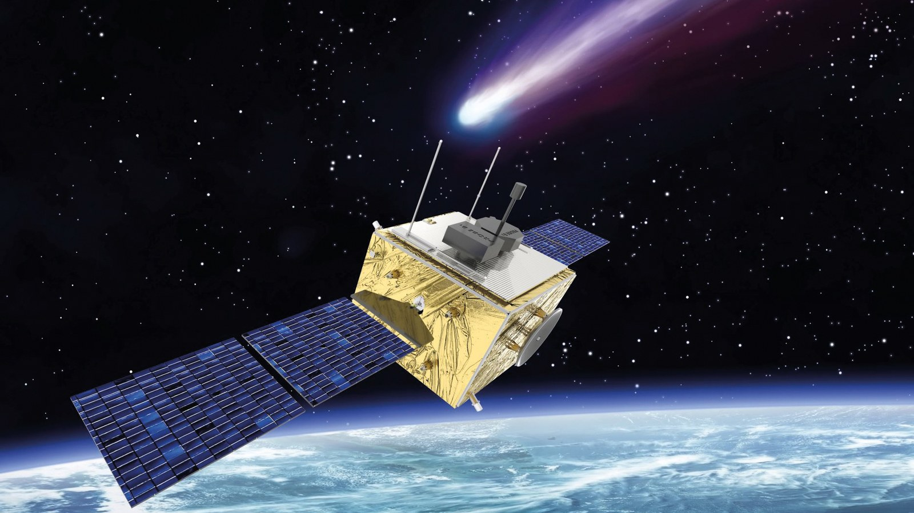
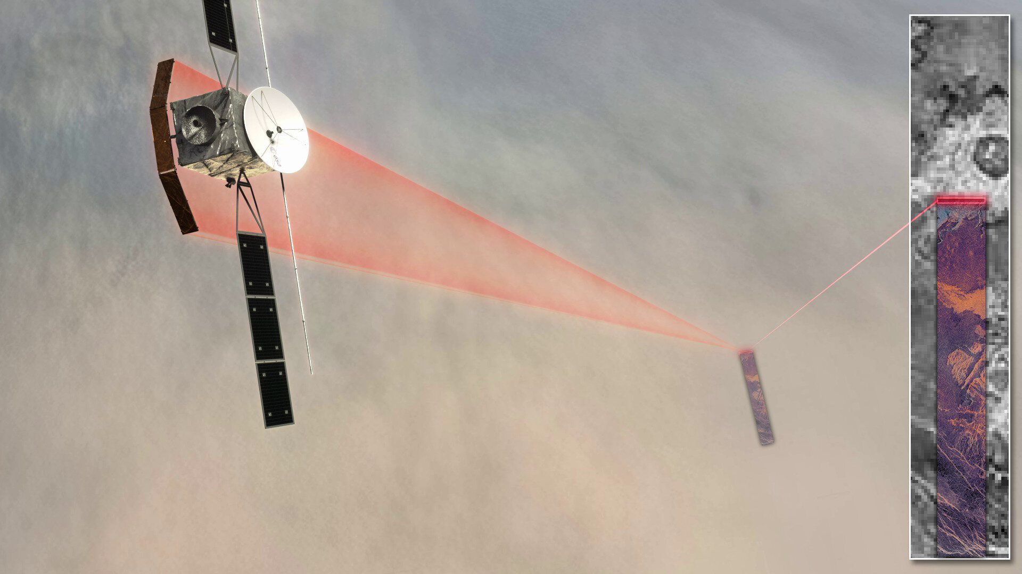
PLATO
*2026
*2029
ARIEL
Comet Interceptor
*2029
EnVision
*2031

Slide 9
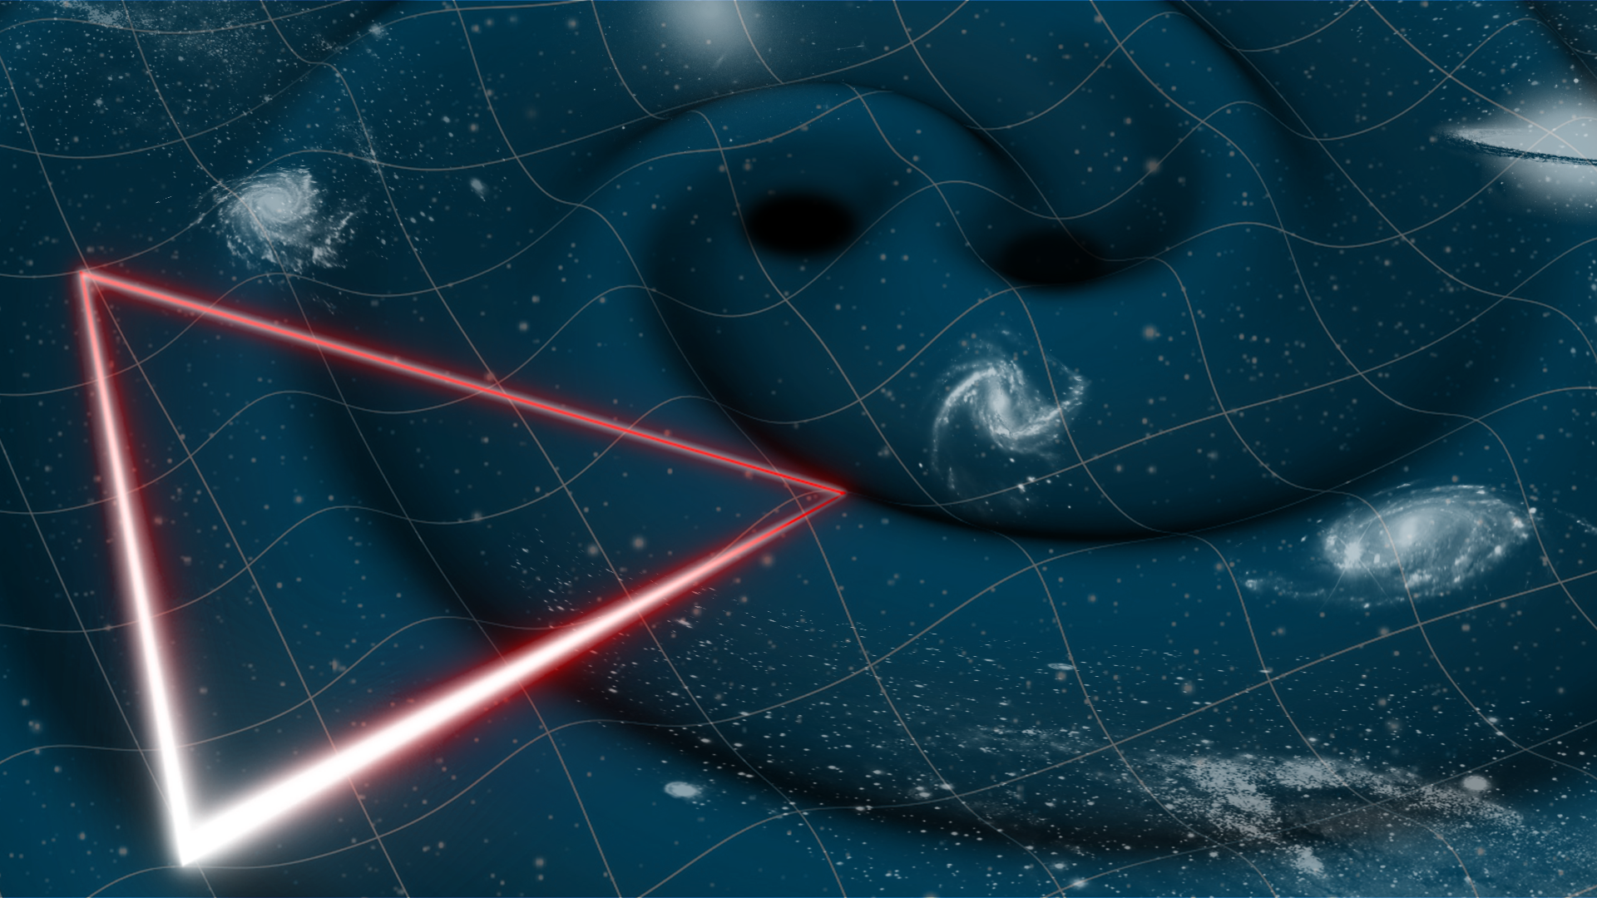
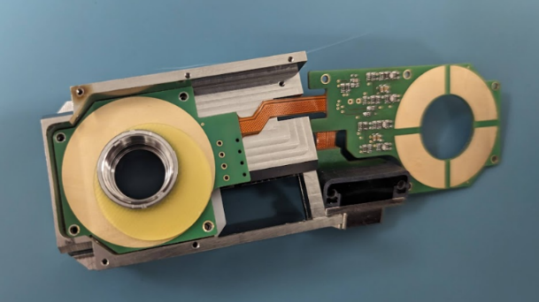
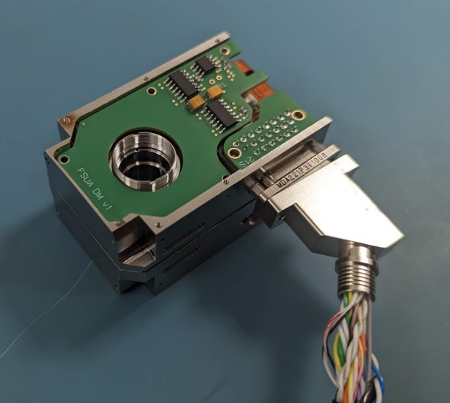
LISA (Laser Interferometer Space Antenna)
*2035
Czech contribution:
Fibre Switch Unit Actuator

Slide 10
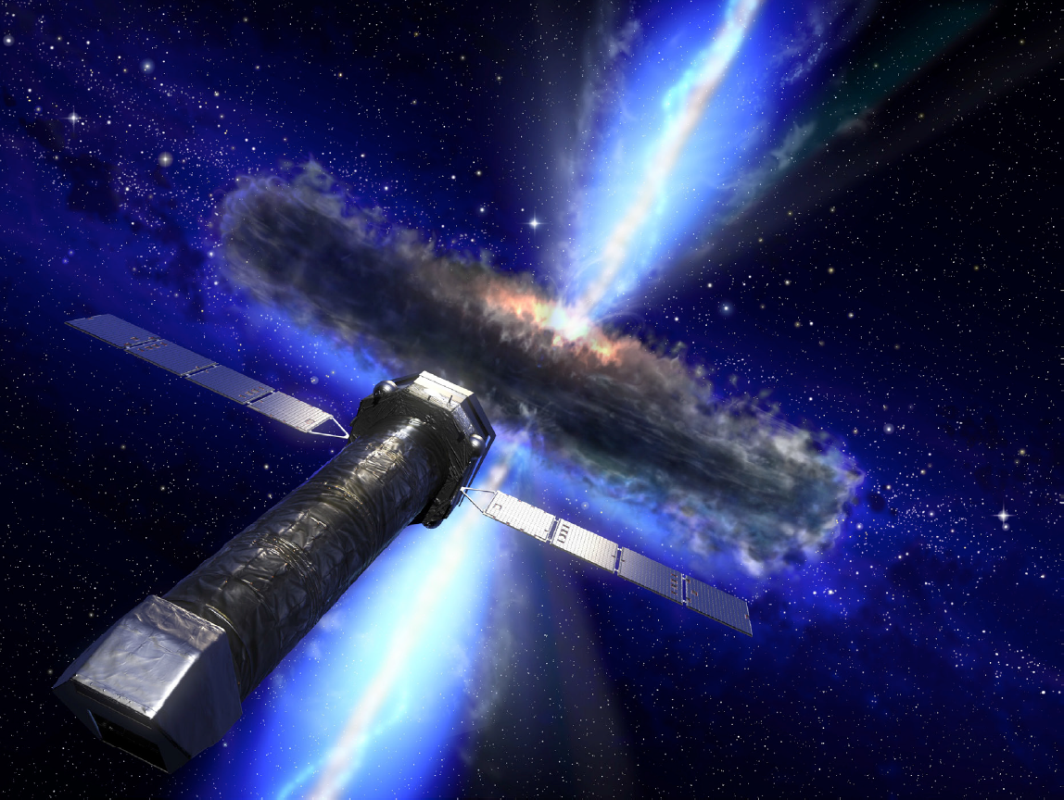
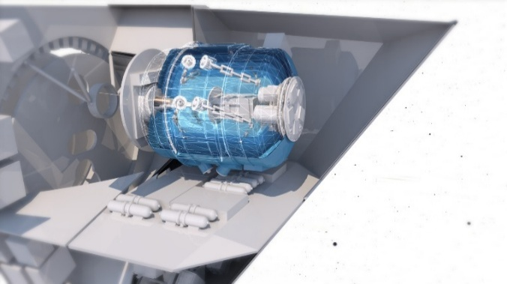
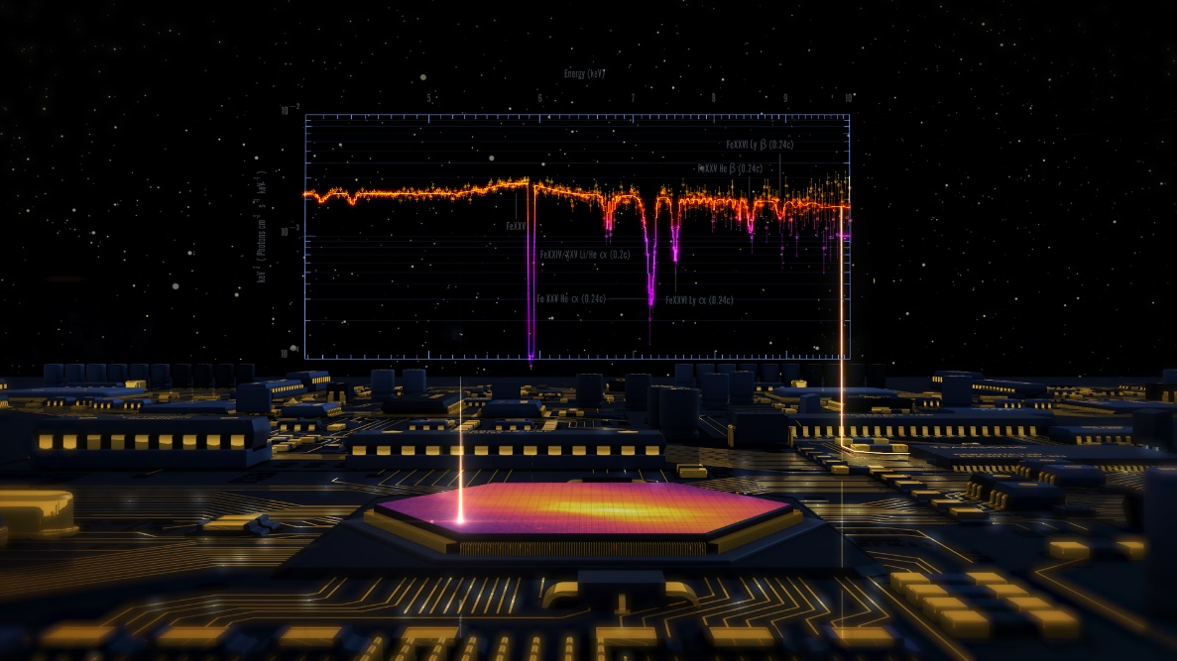
newATHENA
(Advanced Telescope for High Energy Astronomy)
*2037
ESA planned large X-ray Observatory to study Hot and Energetic Universe
see Matteo Guainazzi’s talk
Instrument X-ray Integral Field Unit (X-IFU) for
high-resolution X-ray spectroscopy
Czech contribution to read-out electronics

Slide 11
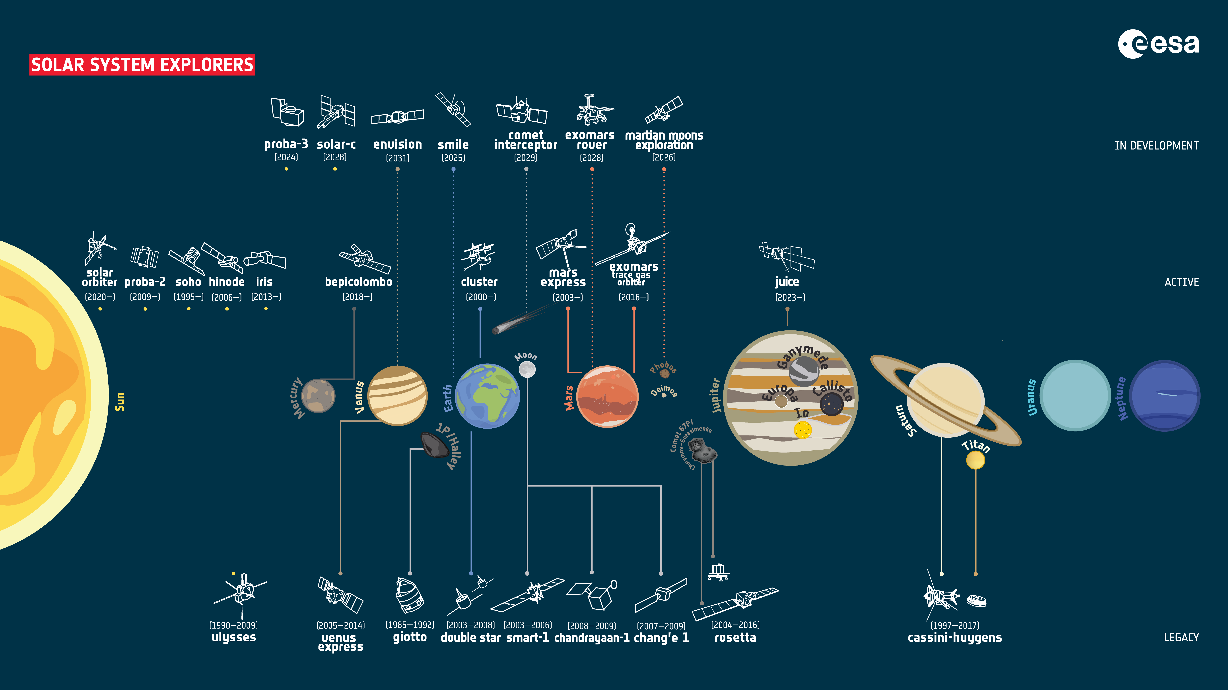
future
now

Slide 12
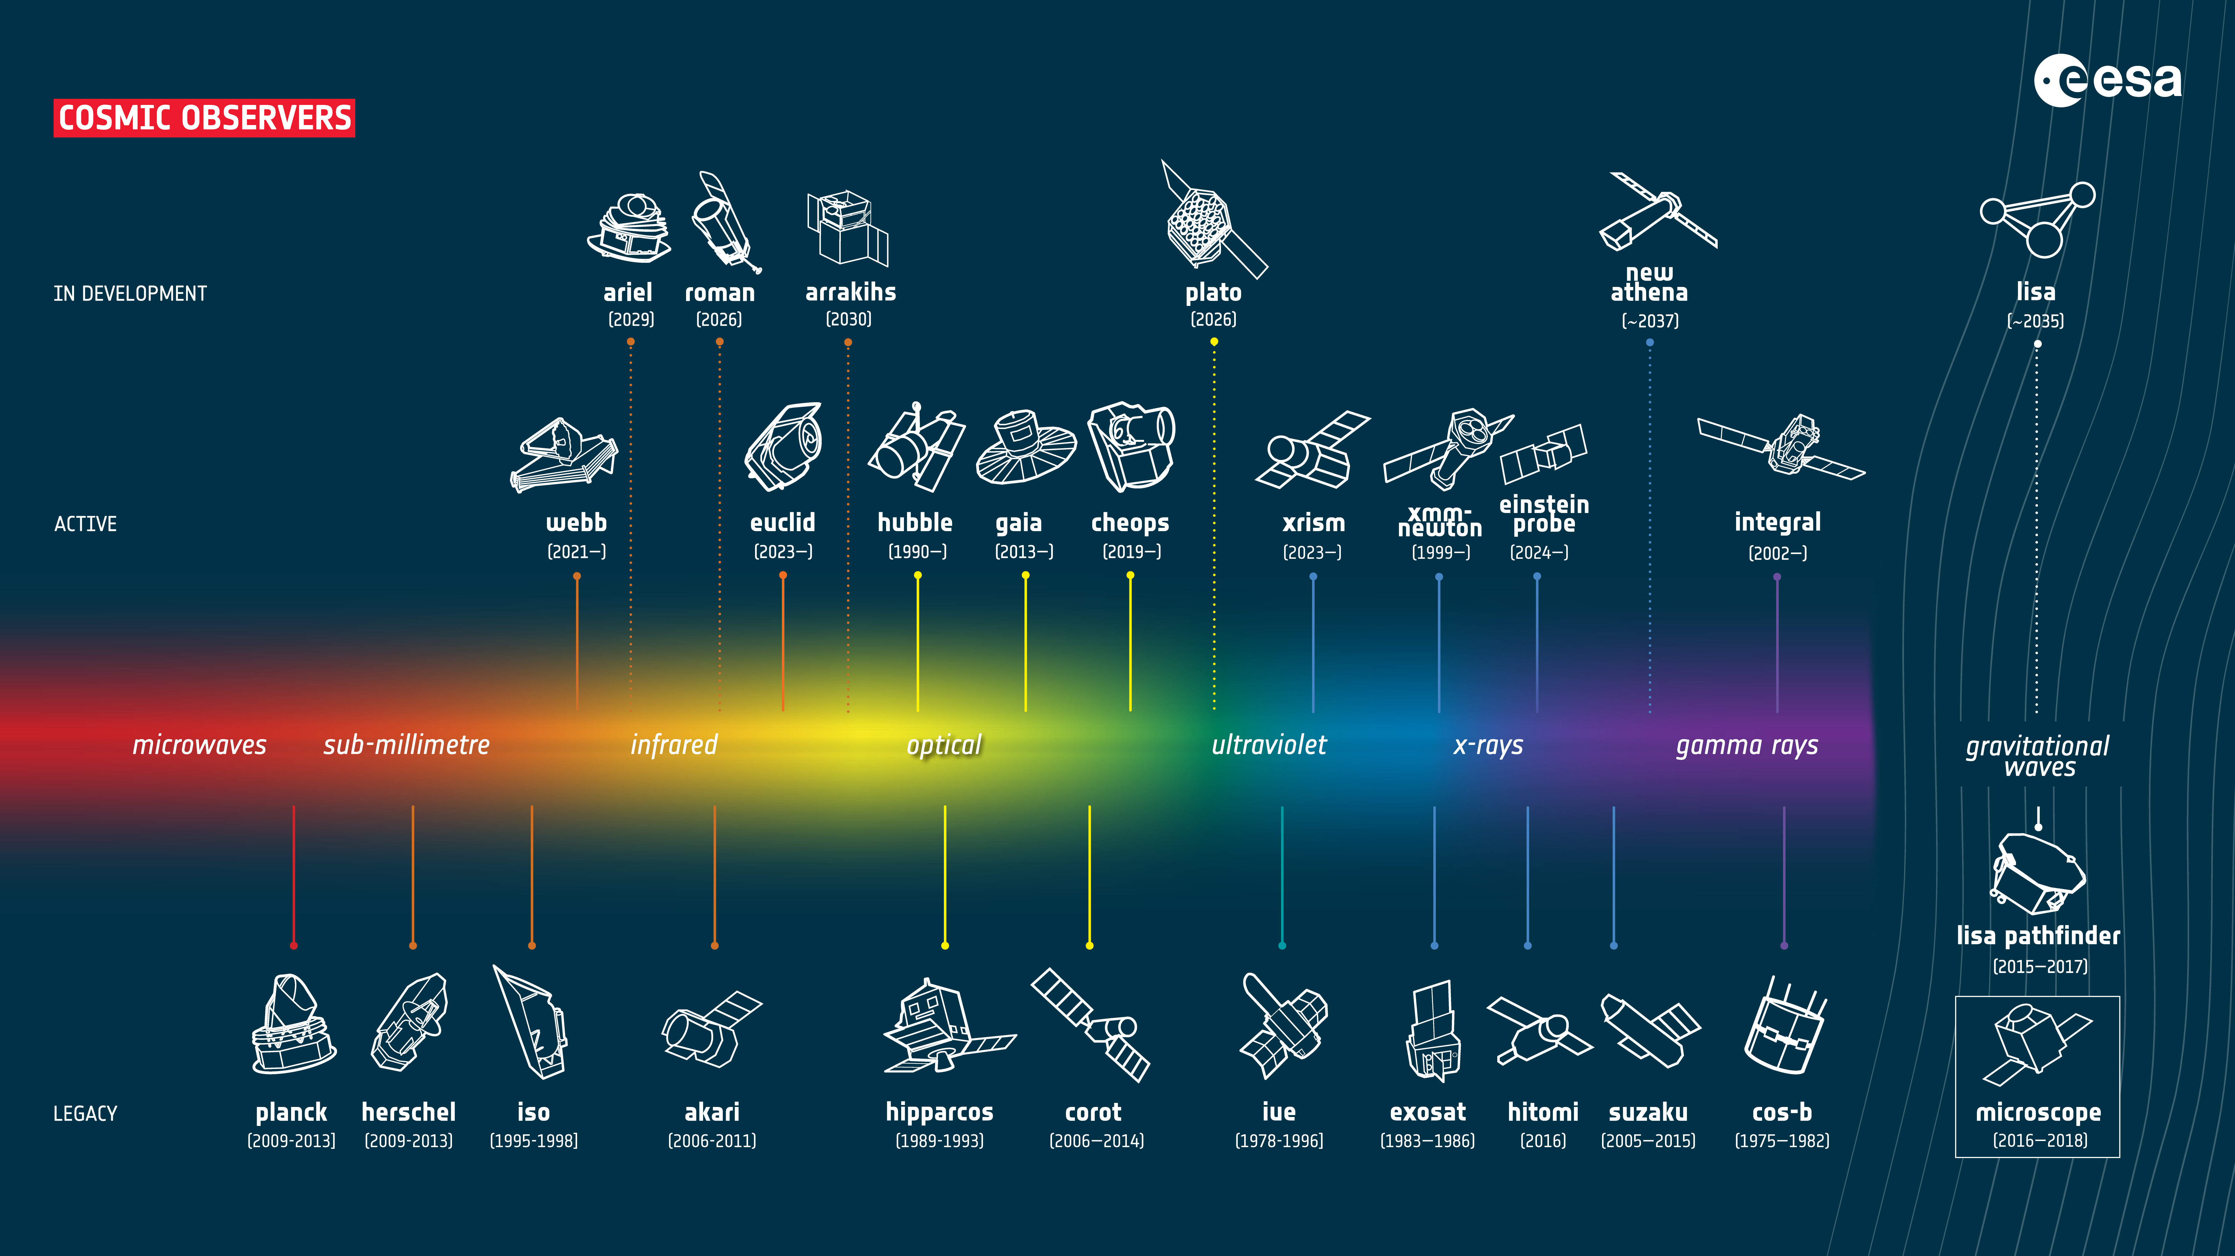
future
now

Slide 13
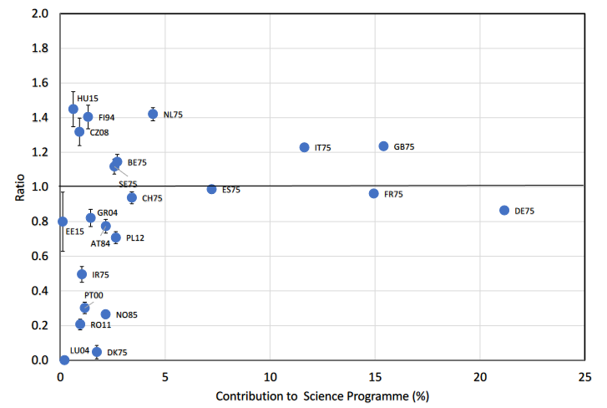
Data Exploitation of ESA missions in scientific publications
Effectiveness/costs:
Czechia on the 4th place!
more publish / less pay
more pay and less publish
de Marchi & Parmar, 2024

Slide 14
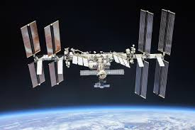

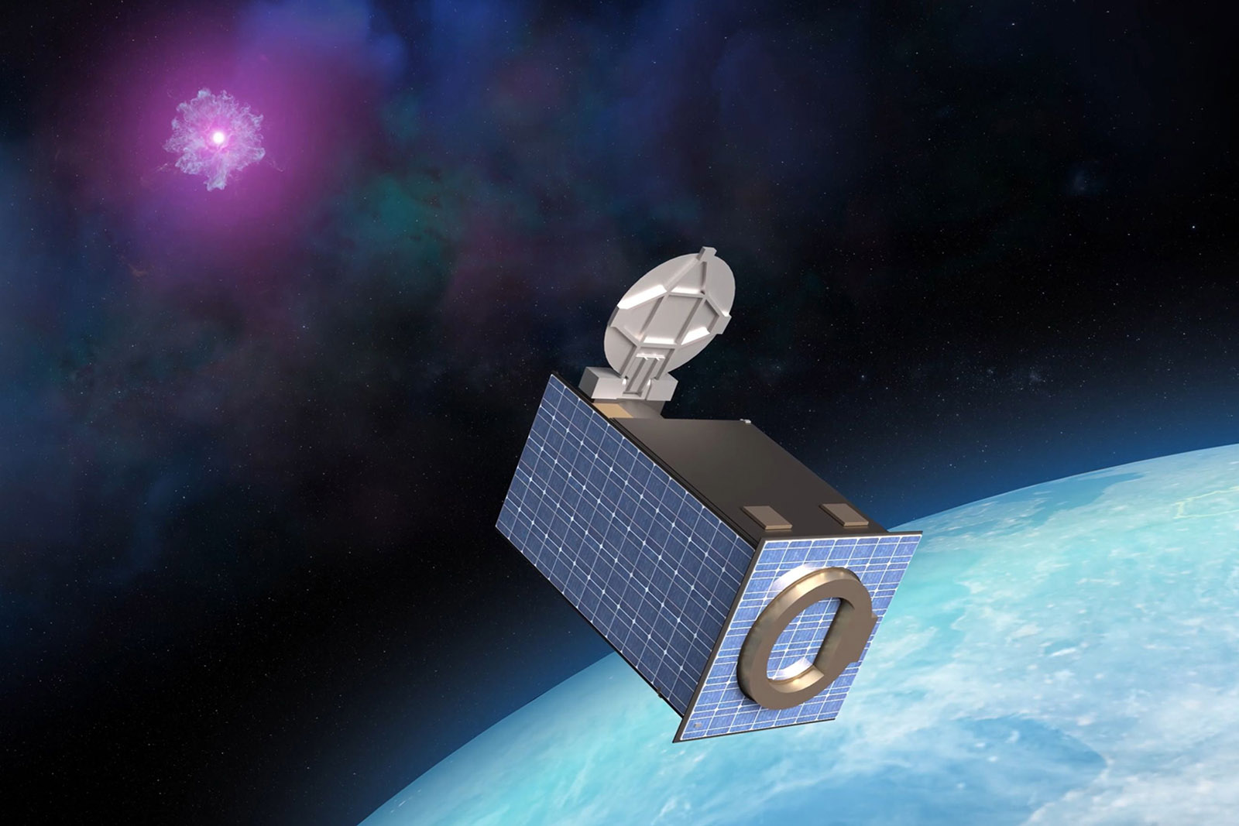
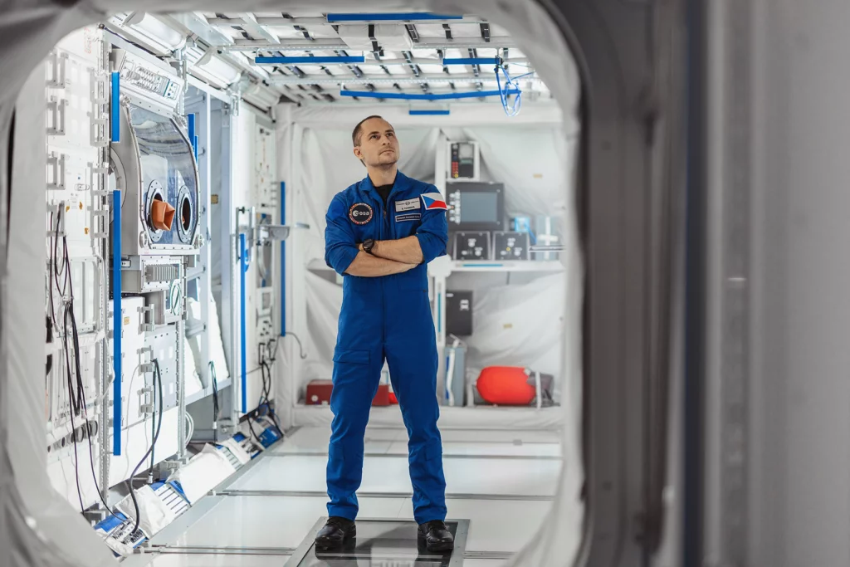
National space programme – Czech journey to space
Czech ambitious mission
Czech astronaut
QUVIK
Quick Ultra-Violet Kilonovae surveyor
Aleš Svoboda in the ESA astronaut reserve team, Czech mission to ISS

Slide 15
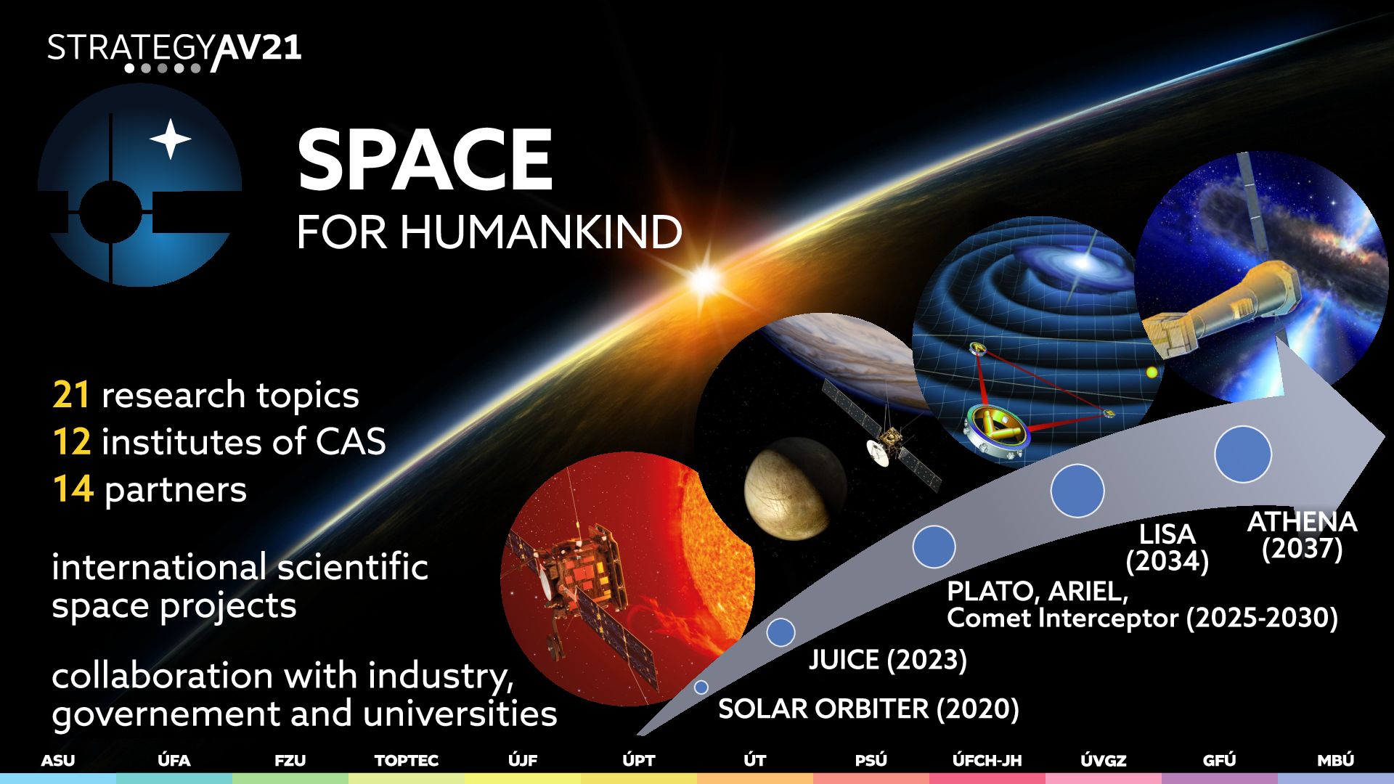

Slide 16
Thank you for your attention and enjoy the conference!
13:00 Conference on Czech-Italian Collaboration in Space Projects
15:15 Award Ceremony:
Ernst Mach Medal for Prof. Enrico Costa
A journey to the X-ray Polarimetry

