Slide 1
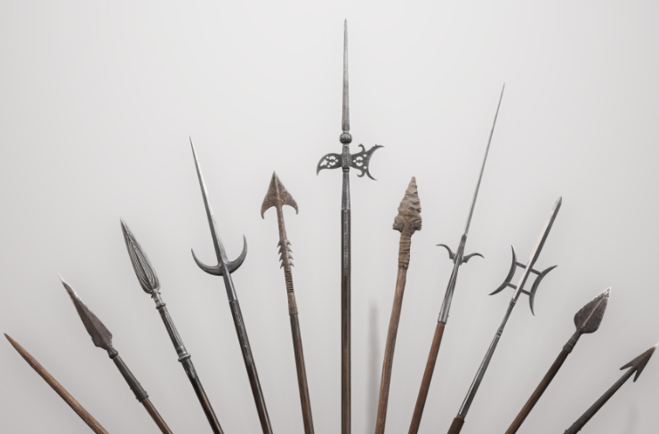
Paolo Soffitta
INAF-IAPS
Conference on Czech-Italian Collaboration in Space-Based High-Energy Astronomy and Enrico Costa Award
24th November 2025
Beyond IXPE: Future Directions in X-ray Polarimetry

Slide 2
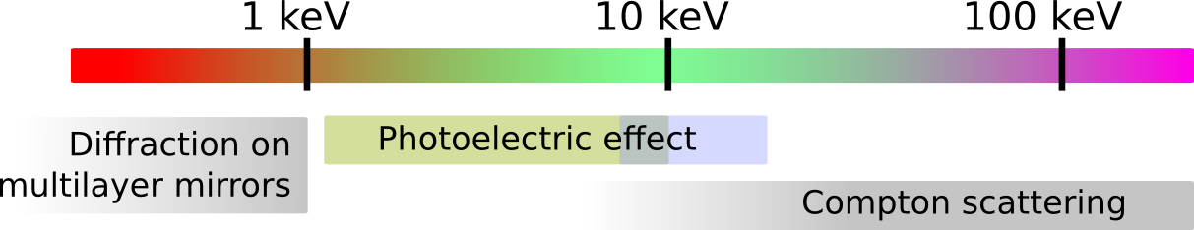
Different energy band for sensitive X-ray polarimetry
Scientific goal | Sources | < 1keV | 1-10 | > 10 keV
Acceleration phenomena | PWN | yes (but absorption) | yes | yes
 | SNR | no | yes | yes
 | Jet (Microquasars) | yes (but absorption) | yes | yes
 | Jet (Blazars) | yes | yes | yes
Emission in strong magnetic fields | WD | yes (but absorption) | yes | difficult
 | AMS | no | yes | yes
 | X-ray pulsator | difficult | yes (no cyclotron ?) | yes
 | Magnetar | yes (better) | yes | no
Scattering in aspherical geometries | Corona in XRB & AGNs | difficult | yes | yes (difficult)
 | X-ray reflection nebulae | no | yes (long exposure) | yes
Fundamental Physics | QED (magnetar) | yes (better) | yes | no
 | GR (BH) | no | yes | no
 | QG (Blazars) | difficult | yes | yes
 | Axions (Blazars, Clusters) | yes ? | yes | difficult

Slide 3
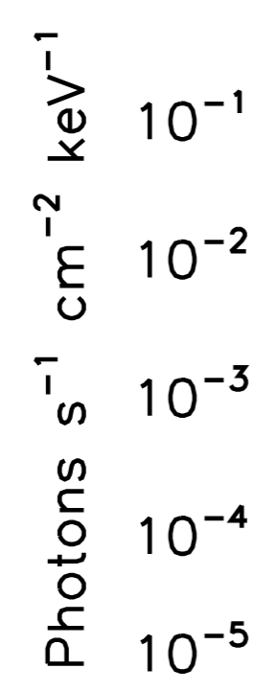
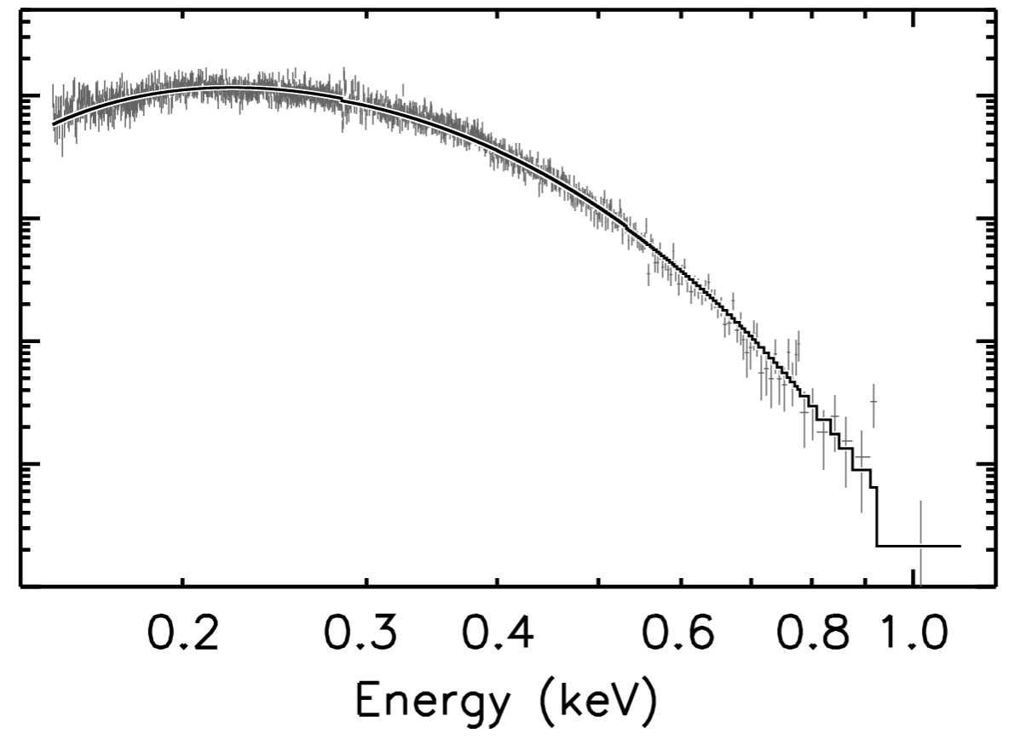

Energy < 1 keV
Isolated neutron stars are characterized by:
Black-body emission
Large magnetic field 10¹²= gauss 10⁸ T
Black Body (thermal) emission is expected to be un-polarized but the presence of a large magnetic field polarized the radiation. So very soft X-ray polarization complements spectroscopy to derive physical parameter of NS atmosphere.

Slide 4
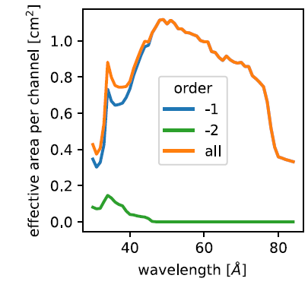
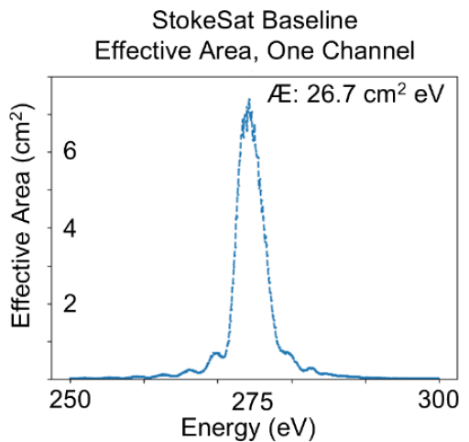
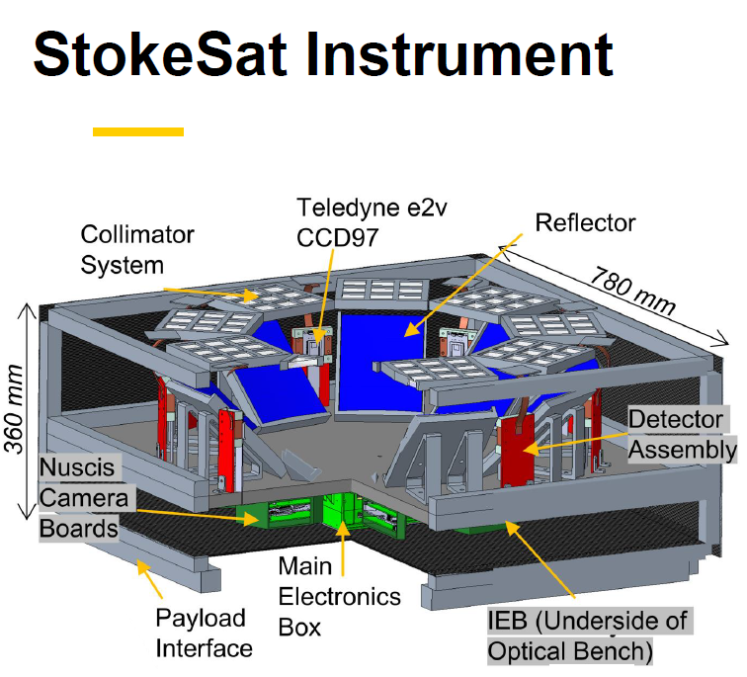
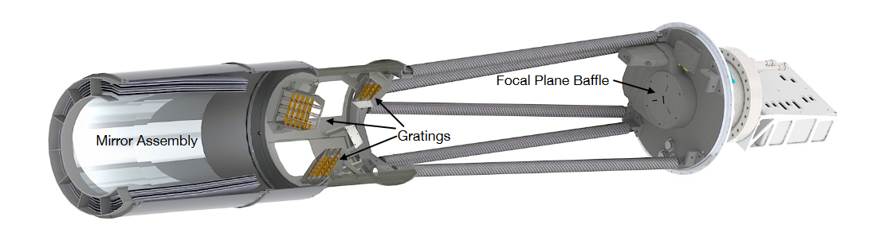
Two Competing Experiments
CFA approach
155-400 eV energy band
Marshall, H. 2023
Simpler experiment: Narrow-band large area
Complicate experiment. Red-SOX
Credit Casey DeRoo presentation @FiXP School GSSI-INAF-INFN (L’ Aquila)
Bragg diffraction generally works in a narrow energy band. To work in a large energy band a complicate experiment has being devised (left, RedSox). A much more simple albeit narrow band (but large are) is StokeSAT (IOWA University)

Slide 5
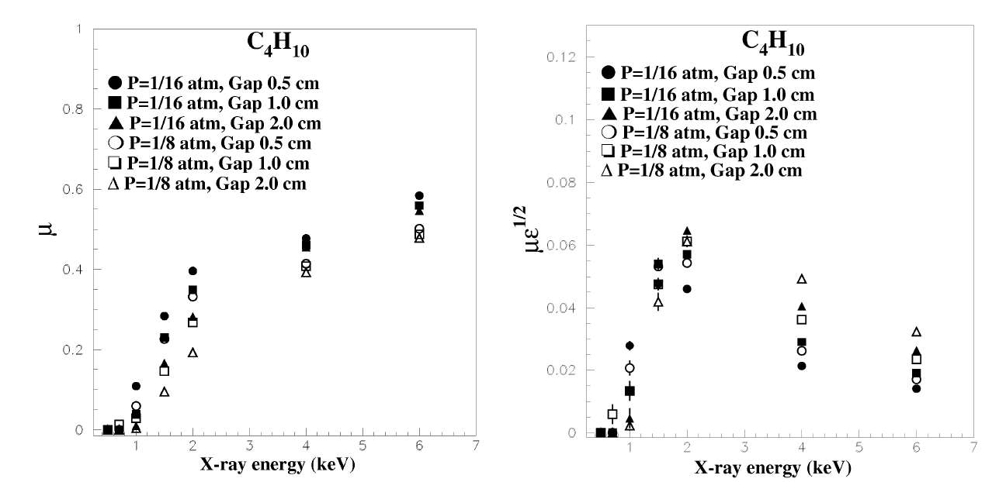
Photoelectric effect (IXPE style) below 2-keV
Pacciani et al., 2003
Pushing the photoelectric effect at low energy will not be able to make polarimetry below 800 eV-1 keV.
Low-pressure/small-drift length are required for low energy application: larger incomplete
low-energy tail is expected due to incomplete charge collection.

Slide 6
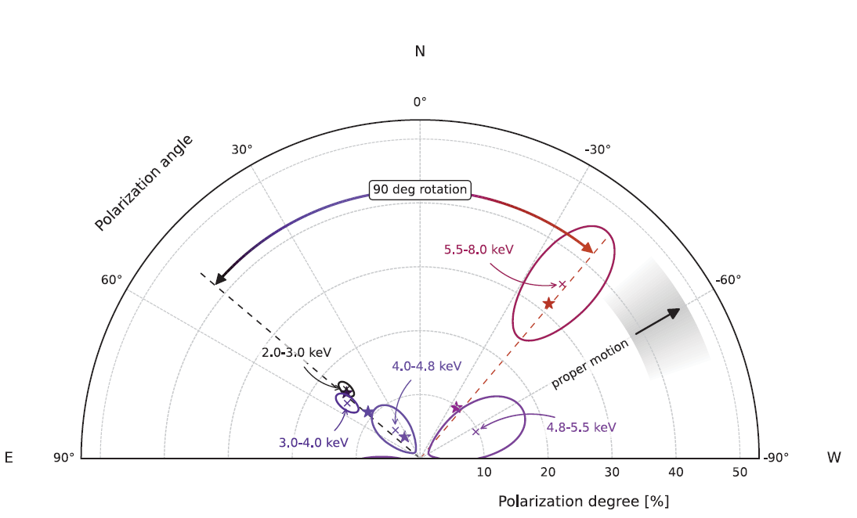
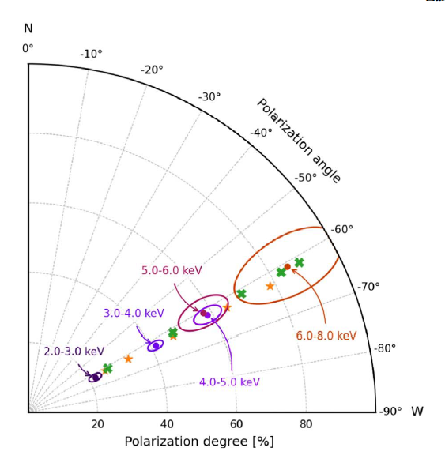
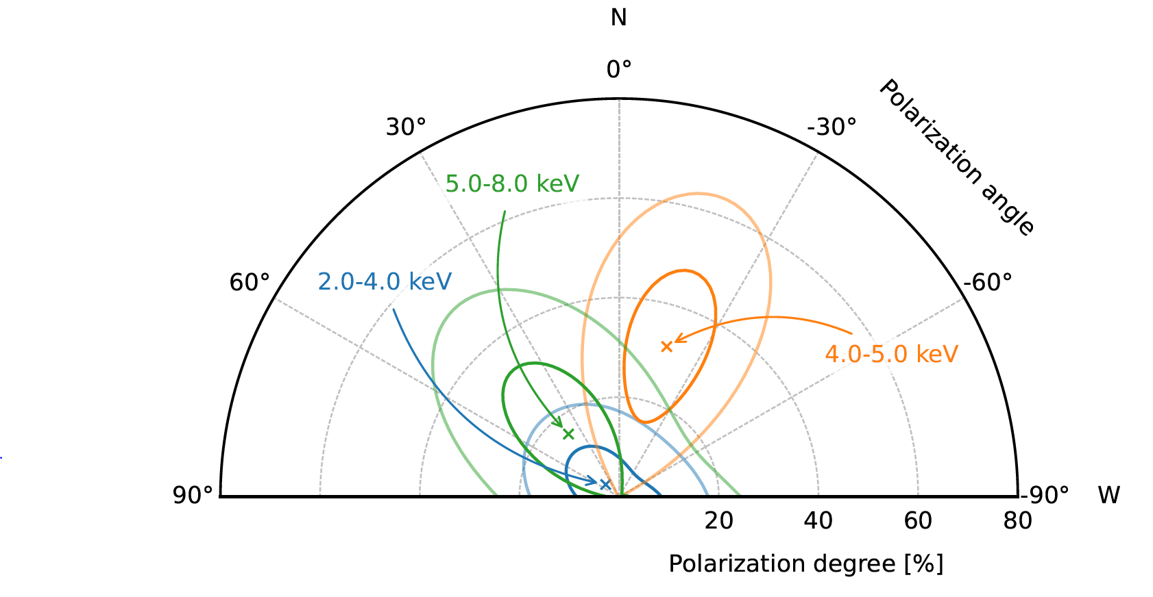
Magnetars 2-10 keV energy band
1RXS J170849.0-400910
SGR 1806-20
4U 0142+61
2.5 mCrab
1.7 mCrb
0.46 mCrab
Zane et al., 2023
Turolla et al., 2023 (Submitted)
Taverna et al., 2022
Magnetars are dim and they showed each one different behaviors.
Needed a larger area to measure more!

Slide 7
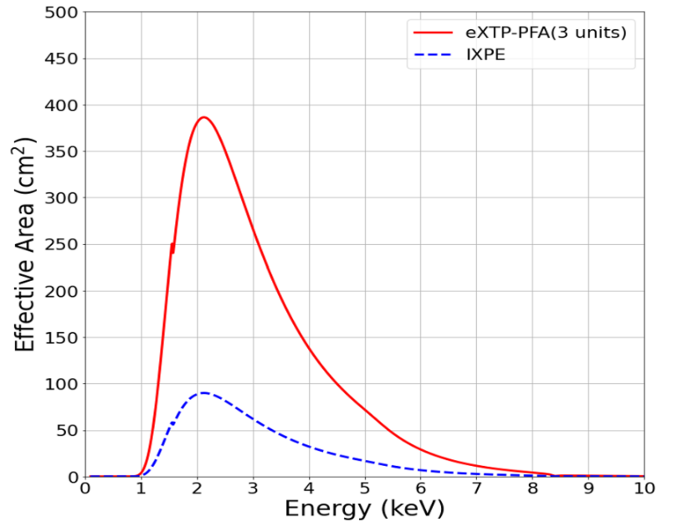
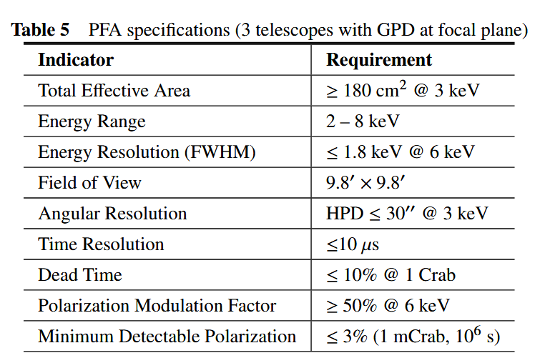
eXTP (CSNA, in 2030)
Same IXPE energy band -> Same IXPE sources but more.
Zhang et al., astro-ph 2025
3.7 times less time to get the same results of IXPE: A factor 3.7 increase on the number of sources for each class: better study of variability.

Slide 8
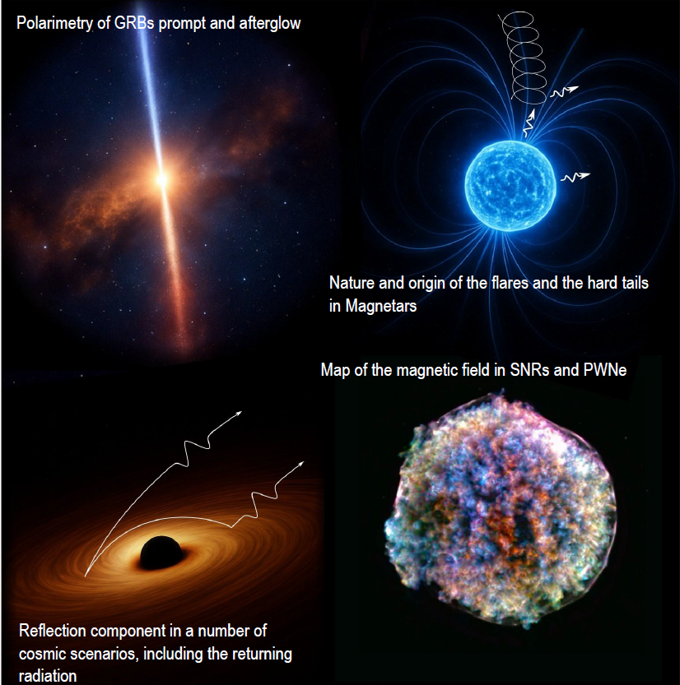
Why X-ray Astrophysical Polarimetry ?
Enhanced X-ray Polarimetry Observatory (EXPO)
Paolo Soffitta
(INAF-IAPS)
on behalf of EXPO Team

Slide 9
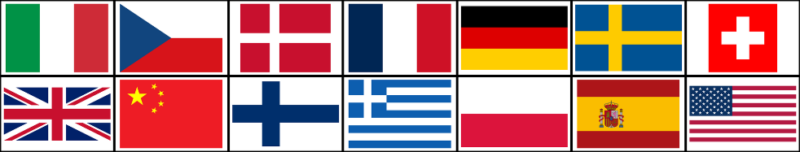
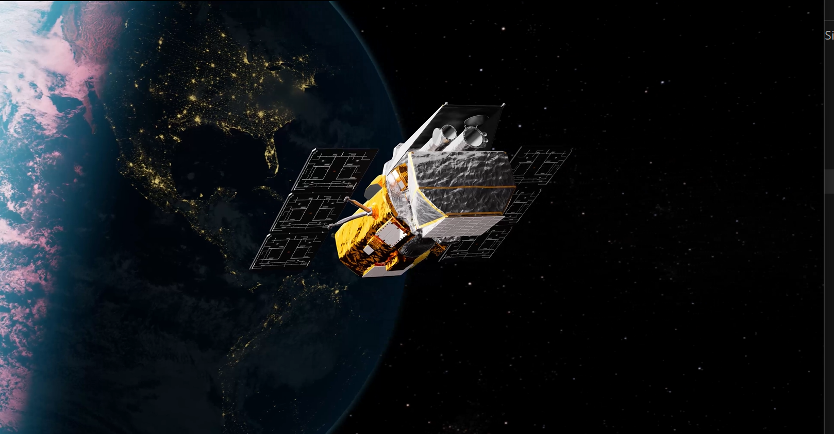

The Concept of EXPO merges the philosophy of two missions one still flying after 21 years and one proposed in 2012
NASA-SWIFT like (Fast repointing. Launched in 2004)
New Hard X-ray Mission proposed in 2012 ESA M-3
Tagliaferri et al., 2012
IXPE and eXTP work in a narrow band -> EXPO works in a large energy band
IXPE and eXTP are slow in repointing -> EXPO is fast in repointing
IXPE and eXTP need wide energy spectral coverage -> EXPO is autonomous
The quality factor of the LEP, MEP & HEP are well matched thus providing similar sensitivity at the focus of multi-layer optics.

Slide 10
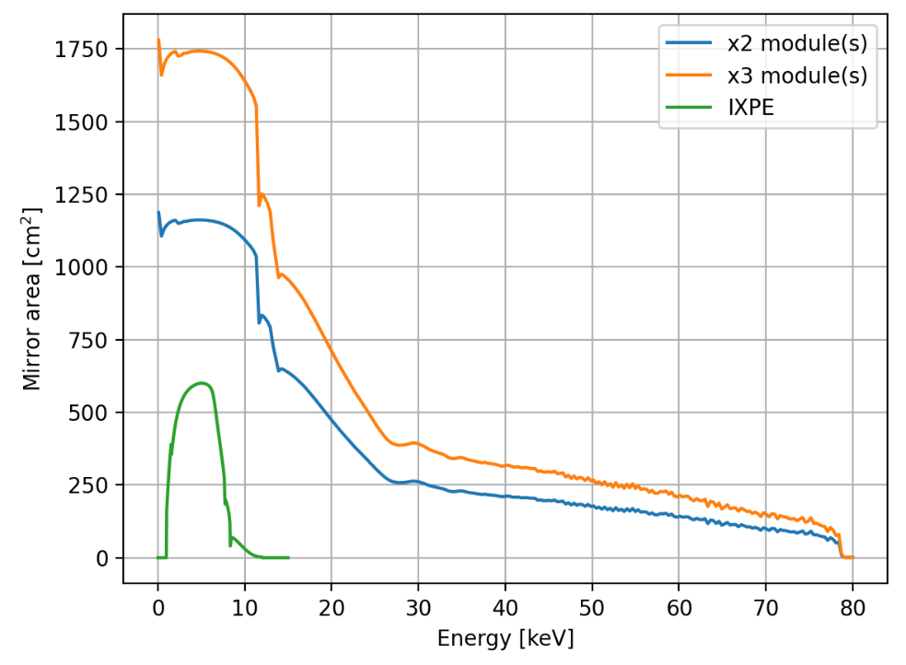
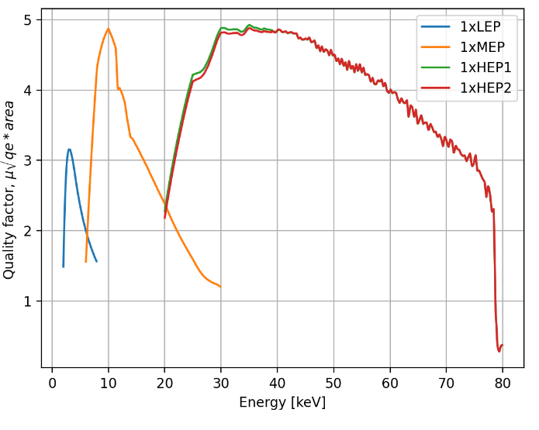


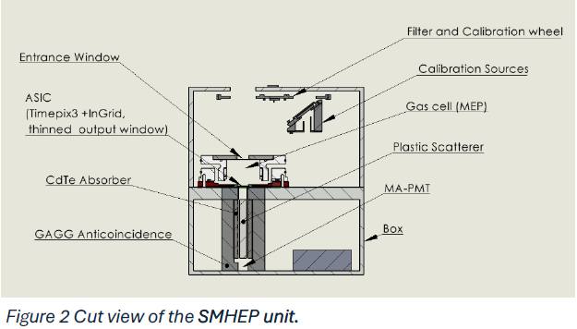
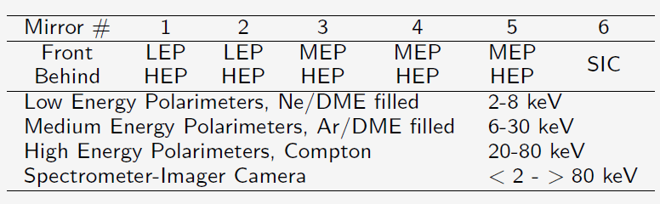
The detector’s Quality Factors
Fine
Imaging
Low back.
Coarse imaging 1-2 arcmin
or no-imaging.
Coincidence applied=Low-back
LEP
The quality factor of the LEP, MEP & HEP are well matched thus providing similar sensitivity at the focus of multi-layer optics.

Slide 11
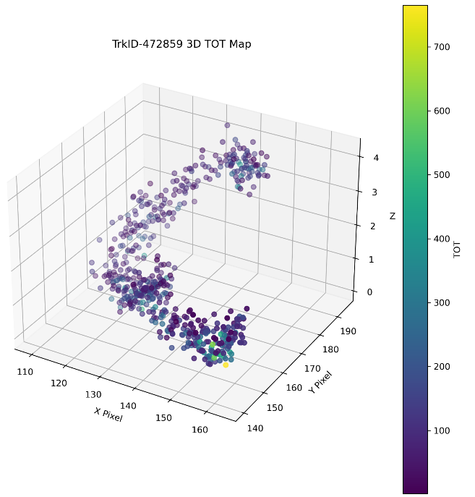
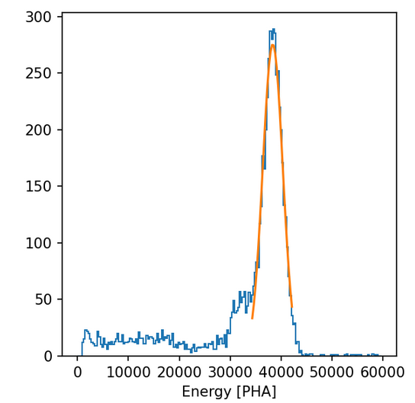
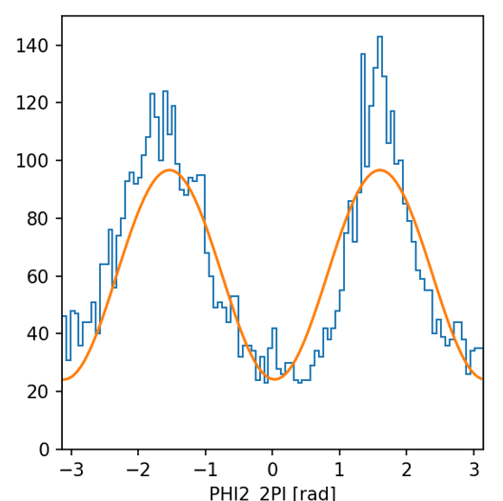
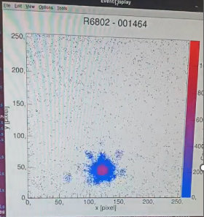
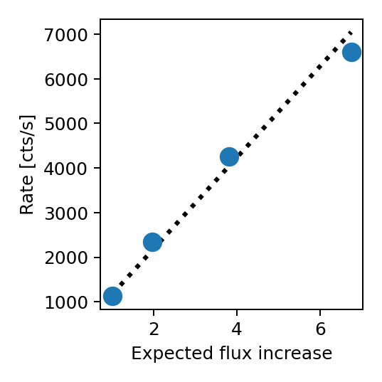
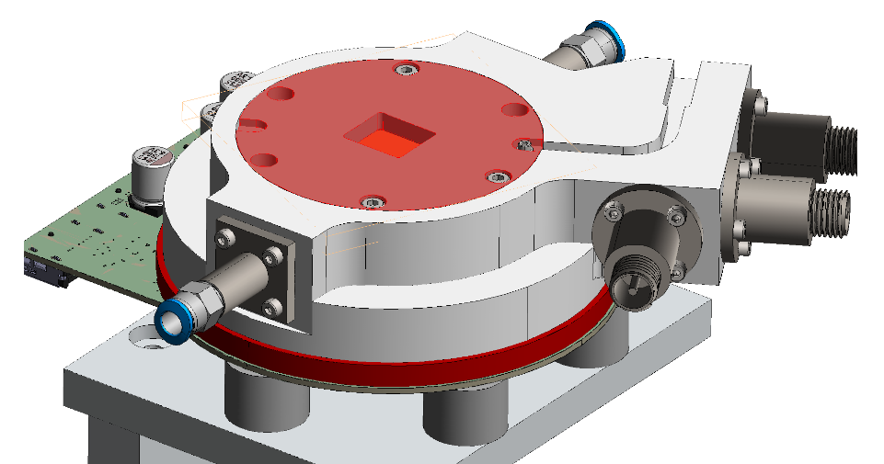
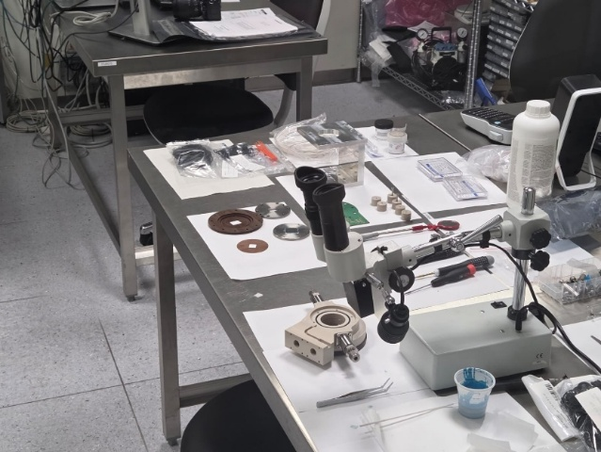
Real data from a Detector early prototype
Ar-DME 80-20
1 atm, 2 cm
E = 17.4 keV
FWHM = 12 %
μ = 60+/-1.7%
E = 17.4 keV
Nitrogen ions irradiation.
Ar-DME 80-20
1 atm, 2 cm
Real 3-D track from an Ar-DME based mixture at 17.4 keV
IXPE Crab counting rate 80 c/s
More advanced prototype in construction

Slide 12

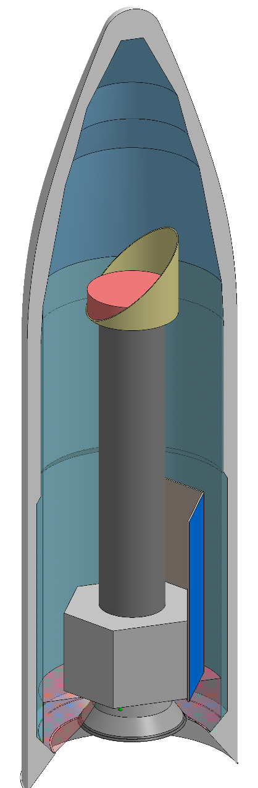
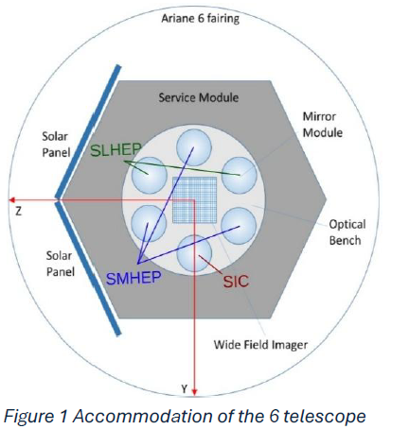
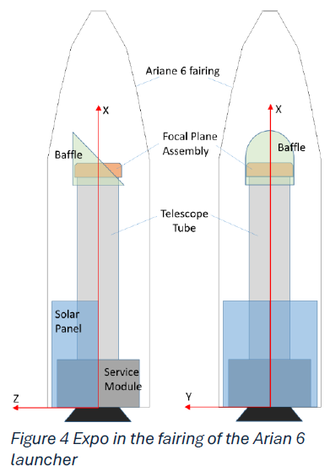
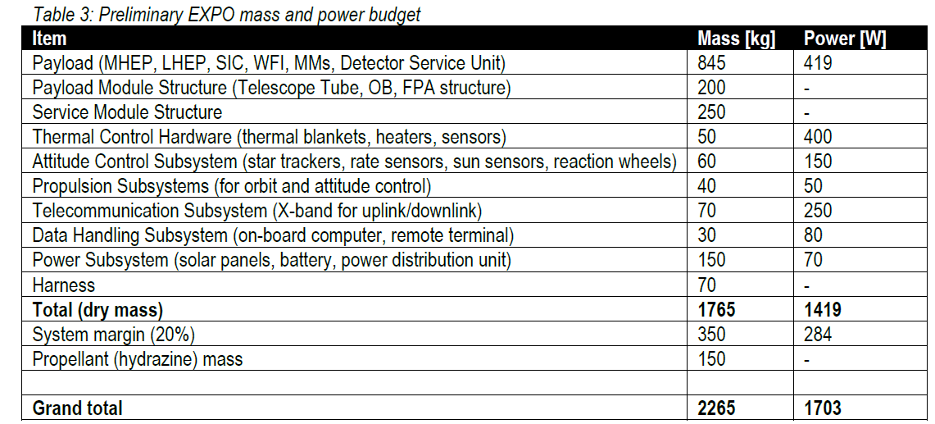
The EXPO mission overview

Slide 13
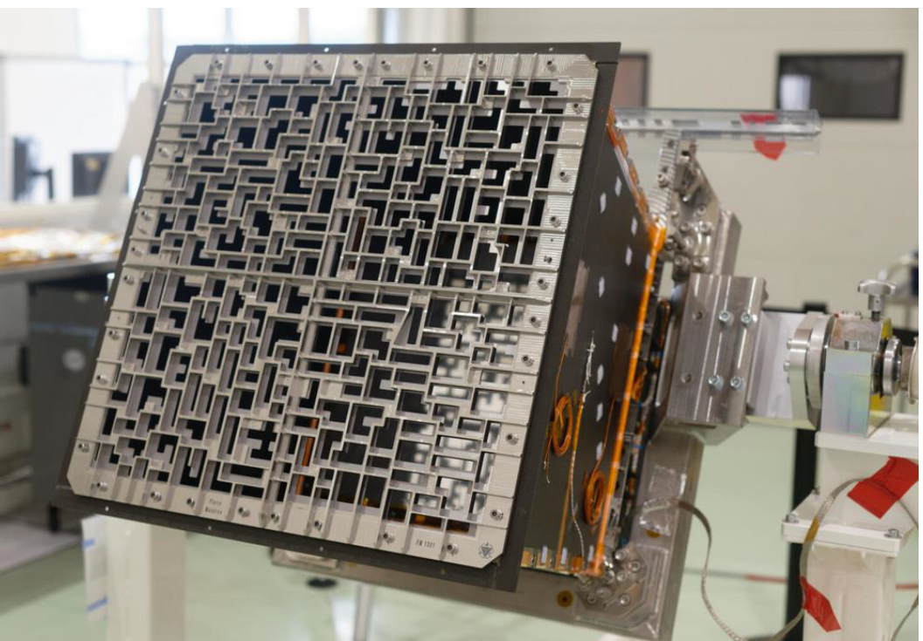
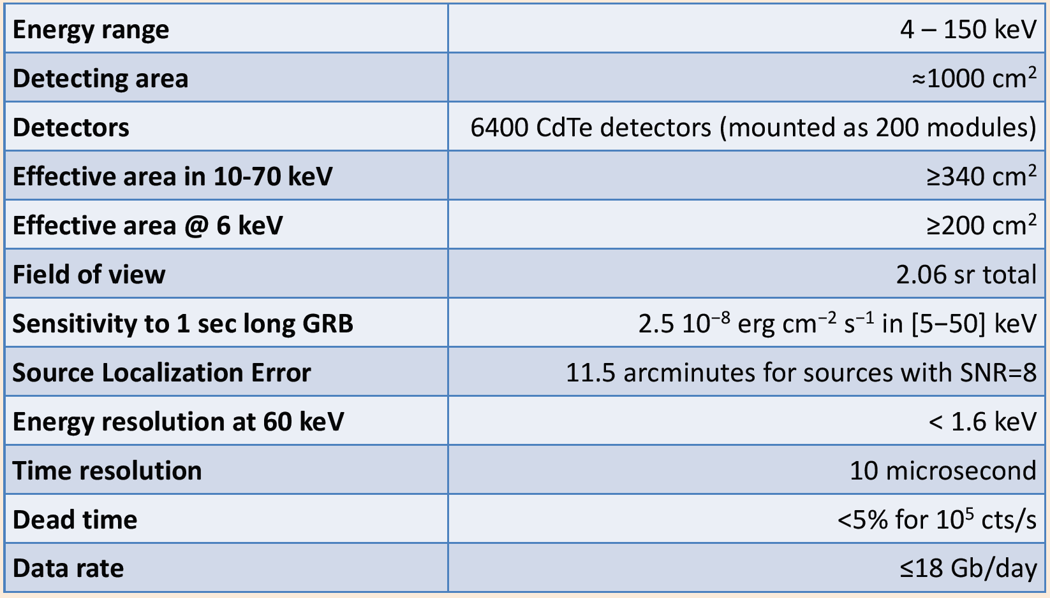
Localization on-board and Fast-Repointing
Repointing speed 1º/s
Propulsion system on board.
ECLAIRs/SVOM provided by IRAP/Toulouse
ECLAIRs/SVOM is a recurrent and its use appreciated by ESA

Slide 14
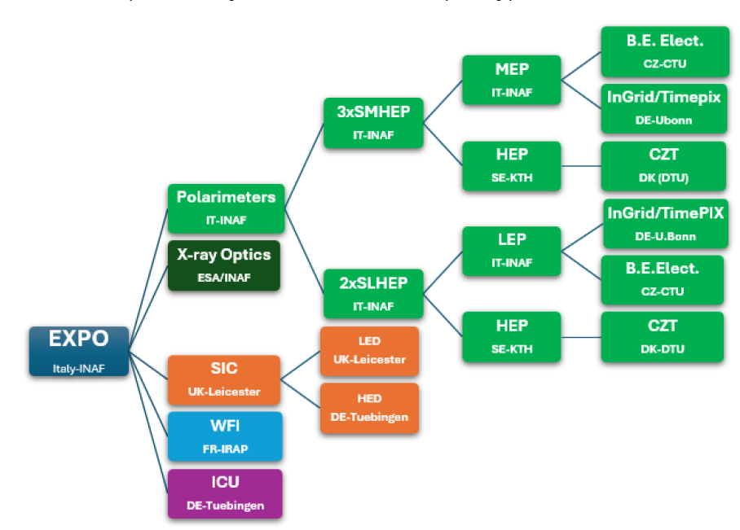
The proposed EXPO payload and consortium institution.
ITEMS | LEAD
POLARIMETERS | INAF-IAPS (P.I. Fabio Muleri)
OPTICS | ESA (Co-PI Daniele Spiga, INAF)
SPECTRAL-IMAGING CAMERA (SIC) | Leicester Univ. (P.I. Ian Hutchinson)
ÉCLAIR-SVOM | IRAP (PI S. Guillot)
INSTRUMENT CONTROL UNIT | Tuebingen (PI A. Santangelo)

Slide 15
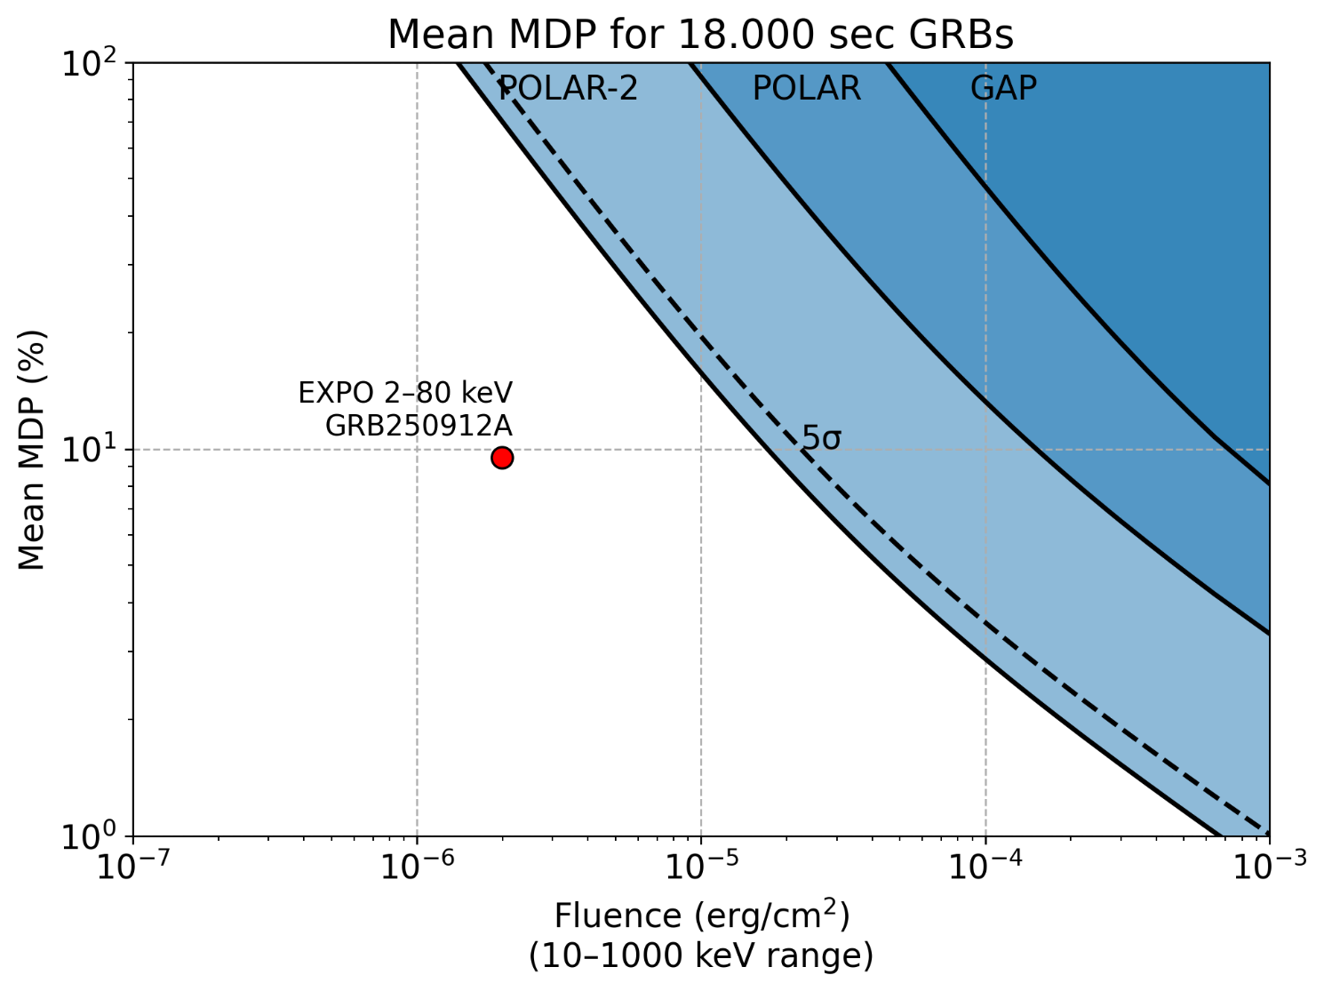
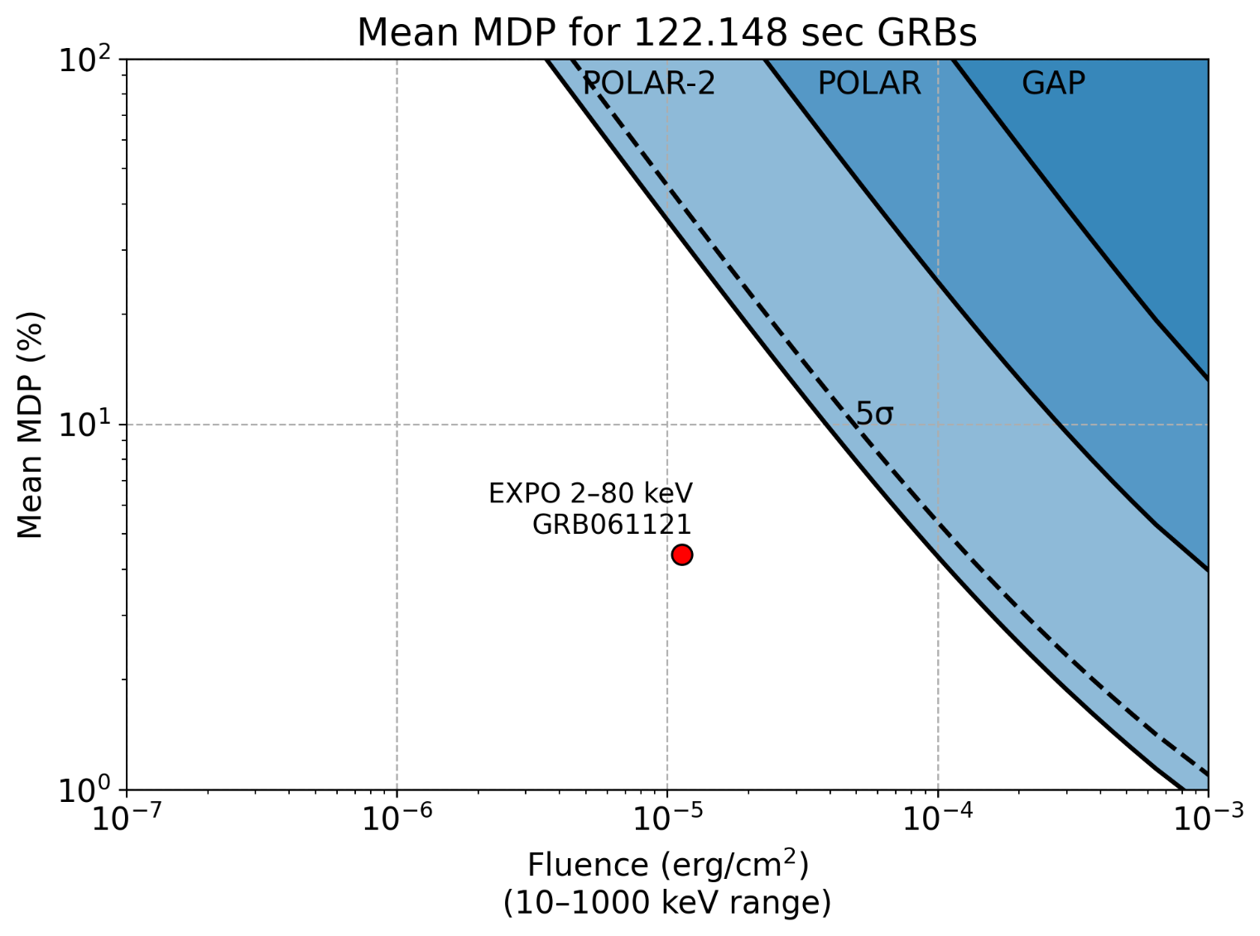
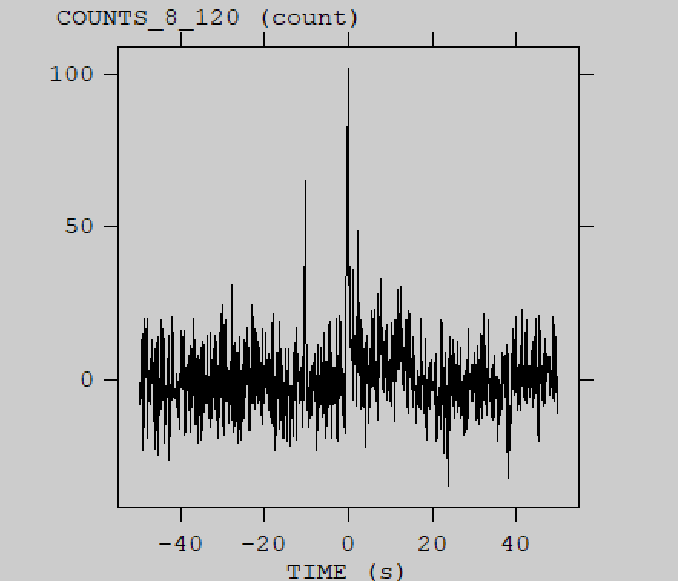
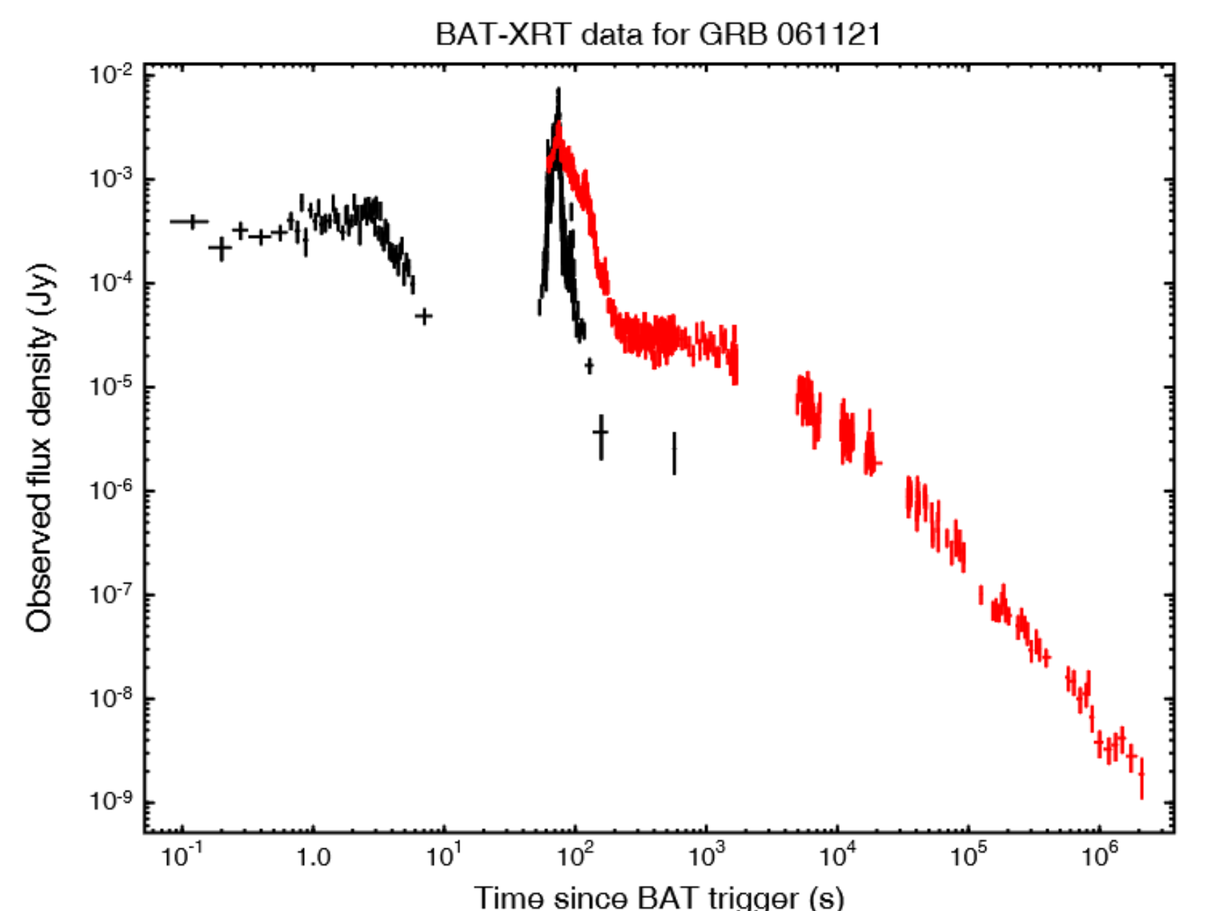
GRB prompt emission Sensitivity
Trigger from a precursor. From IXPE just corse upper limits on the brightest burst
In these plots EXPO is expected to trigger on a precursor of a GRB for both bursts, then slew (Swift-like), and finally pointing the main event.
10 s time interval from precursor
80 s time interval from precursor

Slide 16
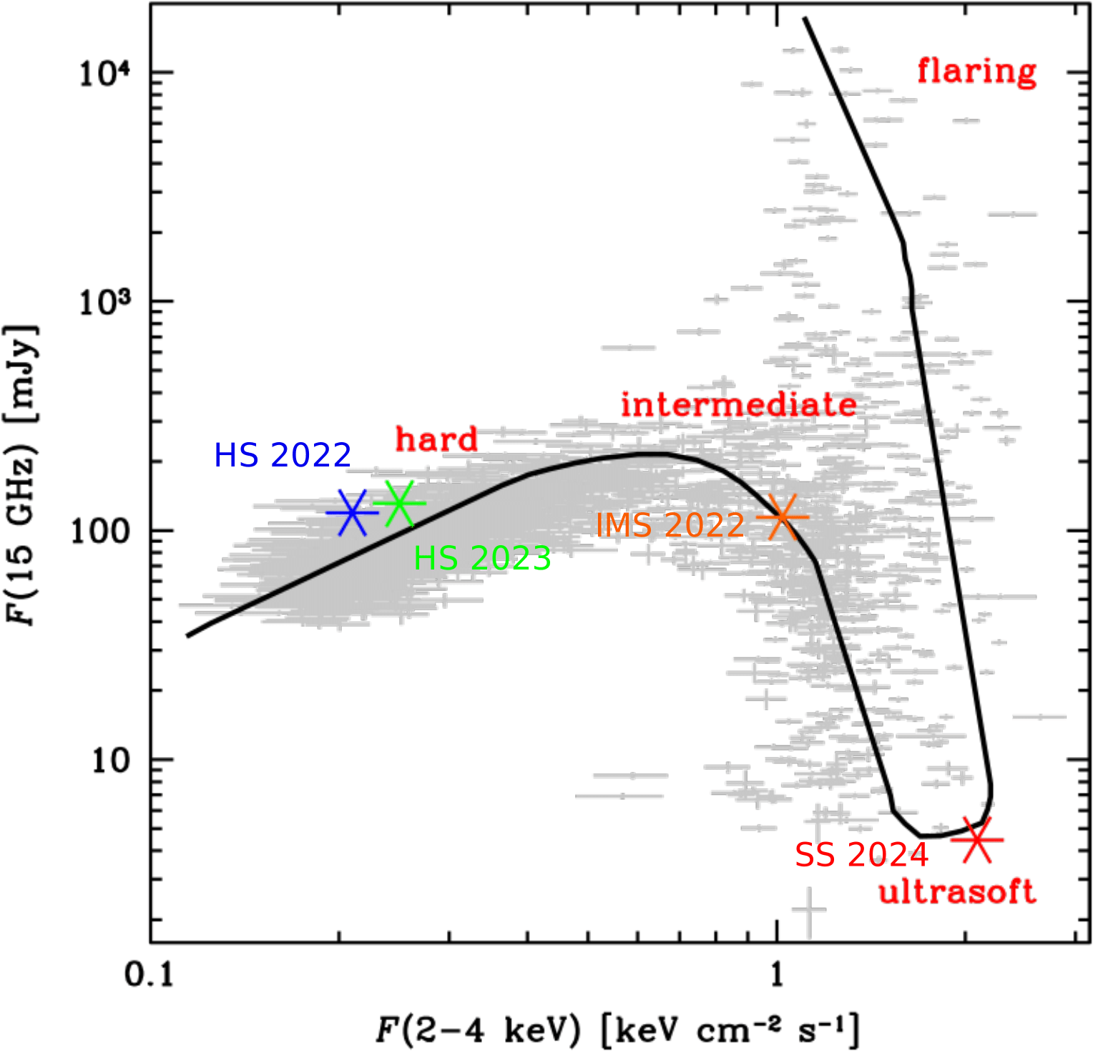
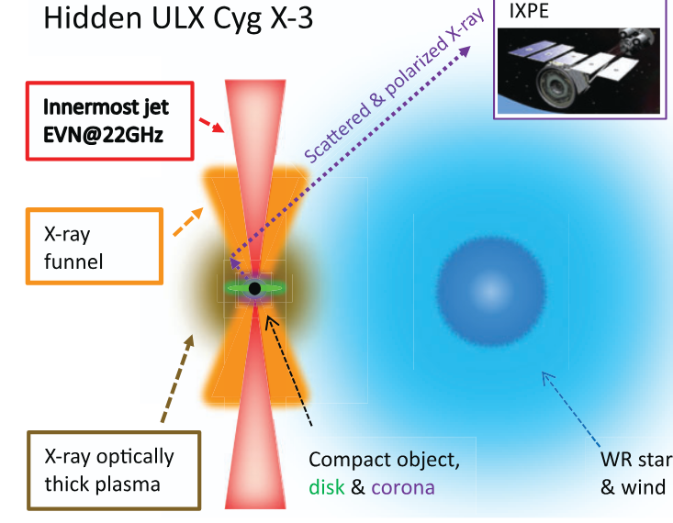
IXPE is very slow (> 3 days usually 1-2 weeks) in repointing.
Need of fast repointing (SWIFT-like)
Why X-ray Astrophysical Polarimetry ?
Mikusincova et. al, 2025
What is the interaction between the jet and the accretion disk ?‘
The polarization during the flaring state will be unknown with IXPE.
Need a fast repointing (hours)
Yang et al., 2023

Slide 17
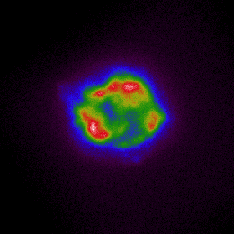
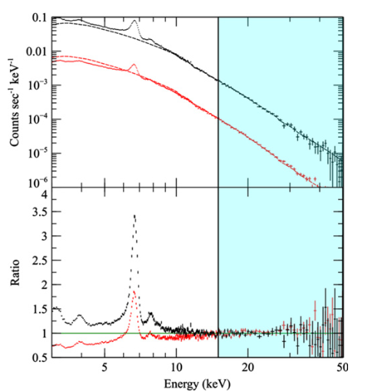
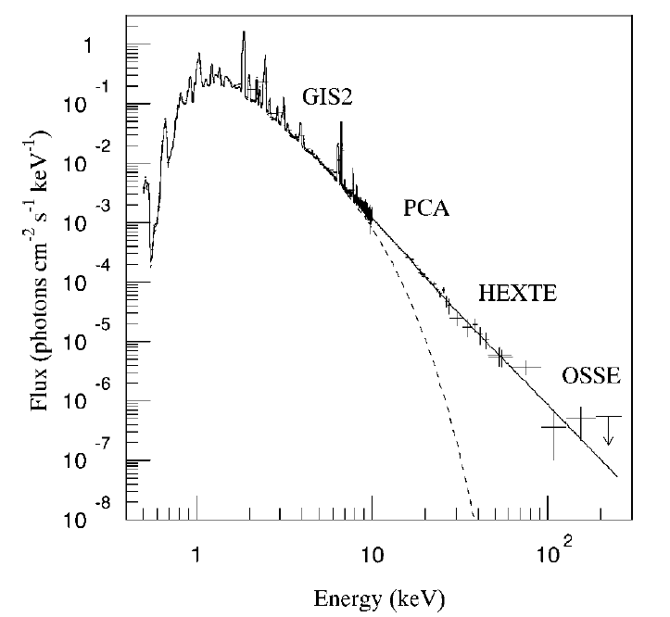
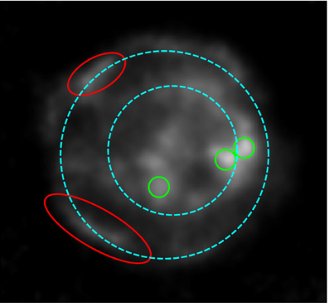
Photoelectric Imaging Polarimetry above 6 keV: In SNRs features are not simple extensions of low energy ones
IXPE
IXPE selects data between the Ca-line and the Fe-line.
Cas A IXPE Image
15–20 keV
Cas A NuStar image
The origin of E >15 keV is a mistery.
It is not dominated by forward or reverse shock but by filaments and knots.
Is the bright knots emission synchrotron (10-100 TeV electrons) or
non-thermal bremsstrahlung (10-100 keV electrons) ?
IXPE probes the non thermal emission diluted with thermal bremsstrahlung (blue)
Imaging Hard X-ray polarimetry of genuine non thermal emission (Orange 9-30 keV)

Slide 18
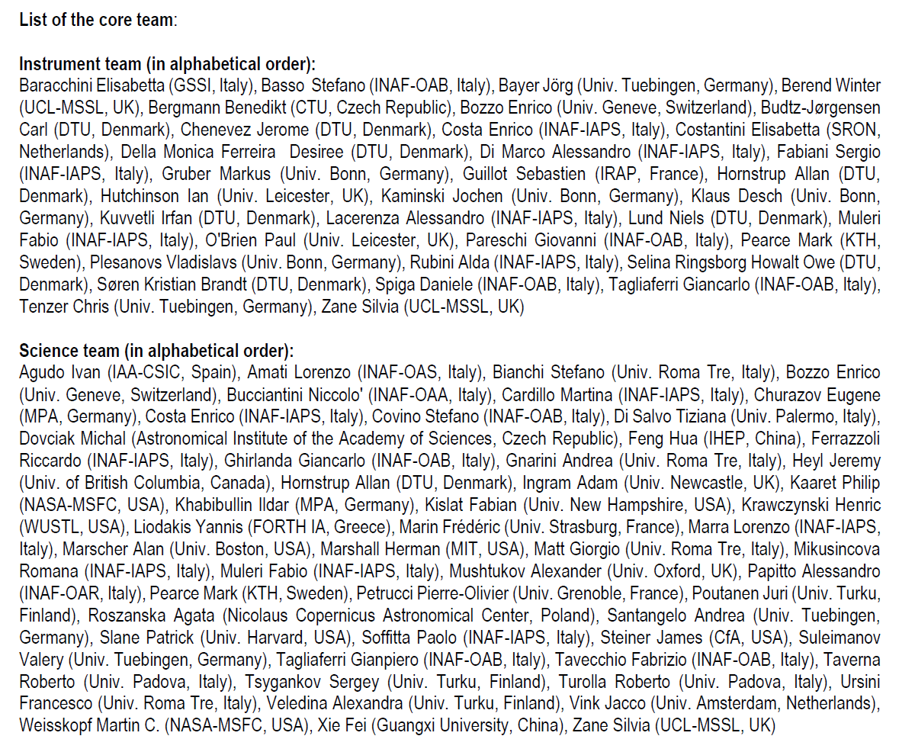
EXPO Collaboration

Slide 19
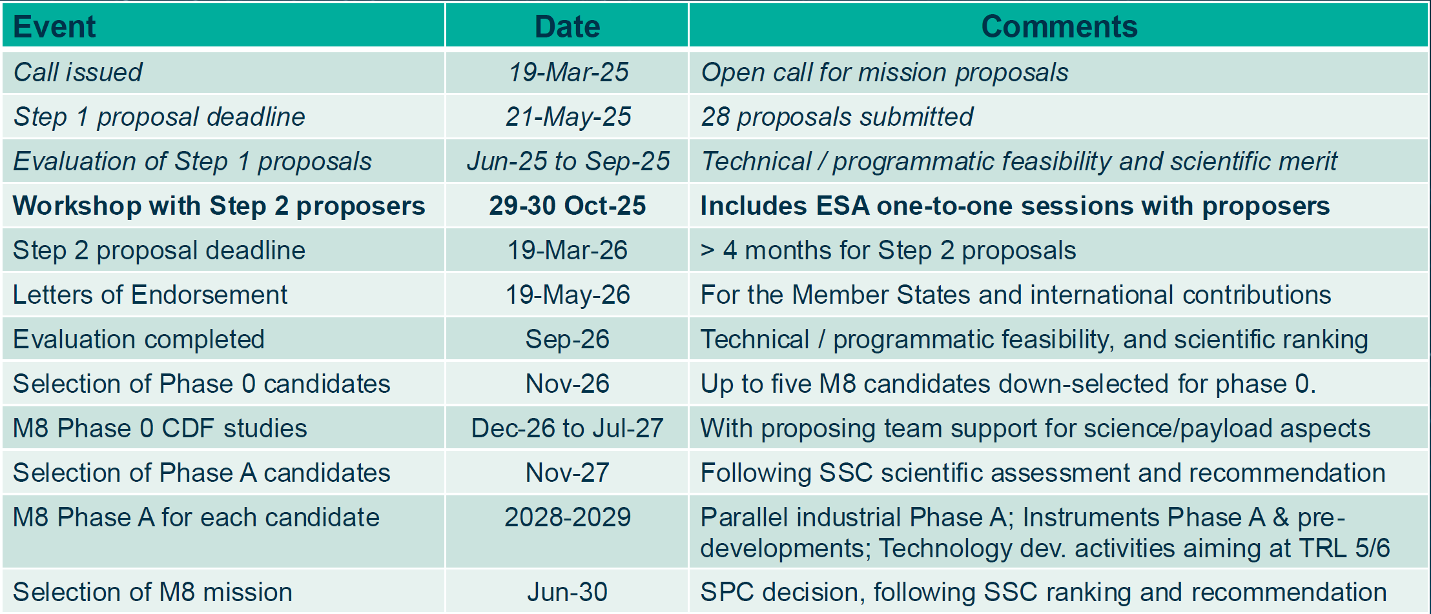
Time-line of M-8. Launch around 2041
28 missions applied for M-8. 9 mission selected plus 1 coming from Fast Mission call

