Slide 1


Slide 2
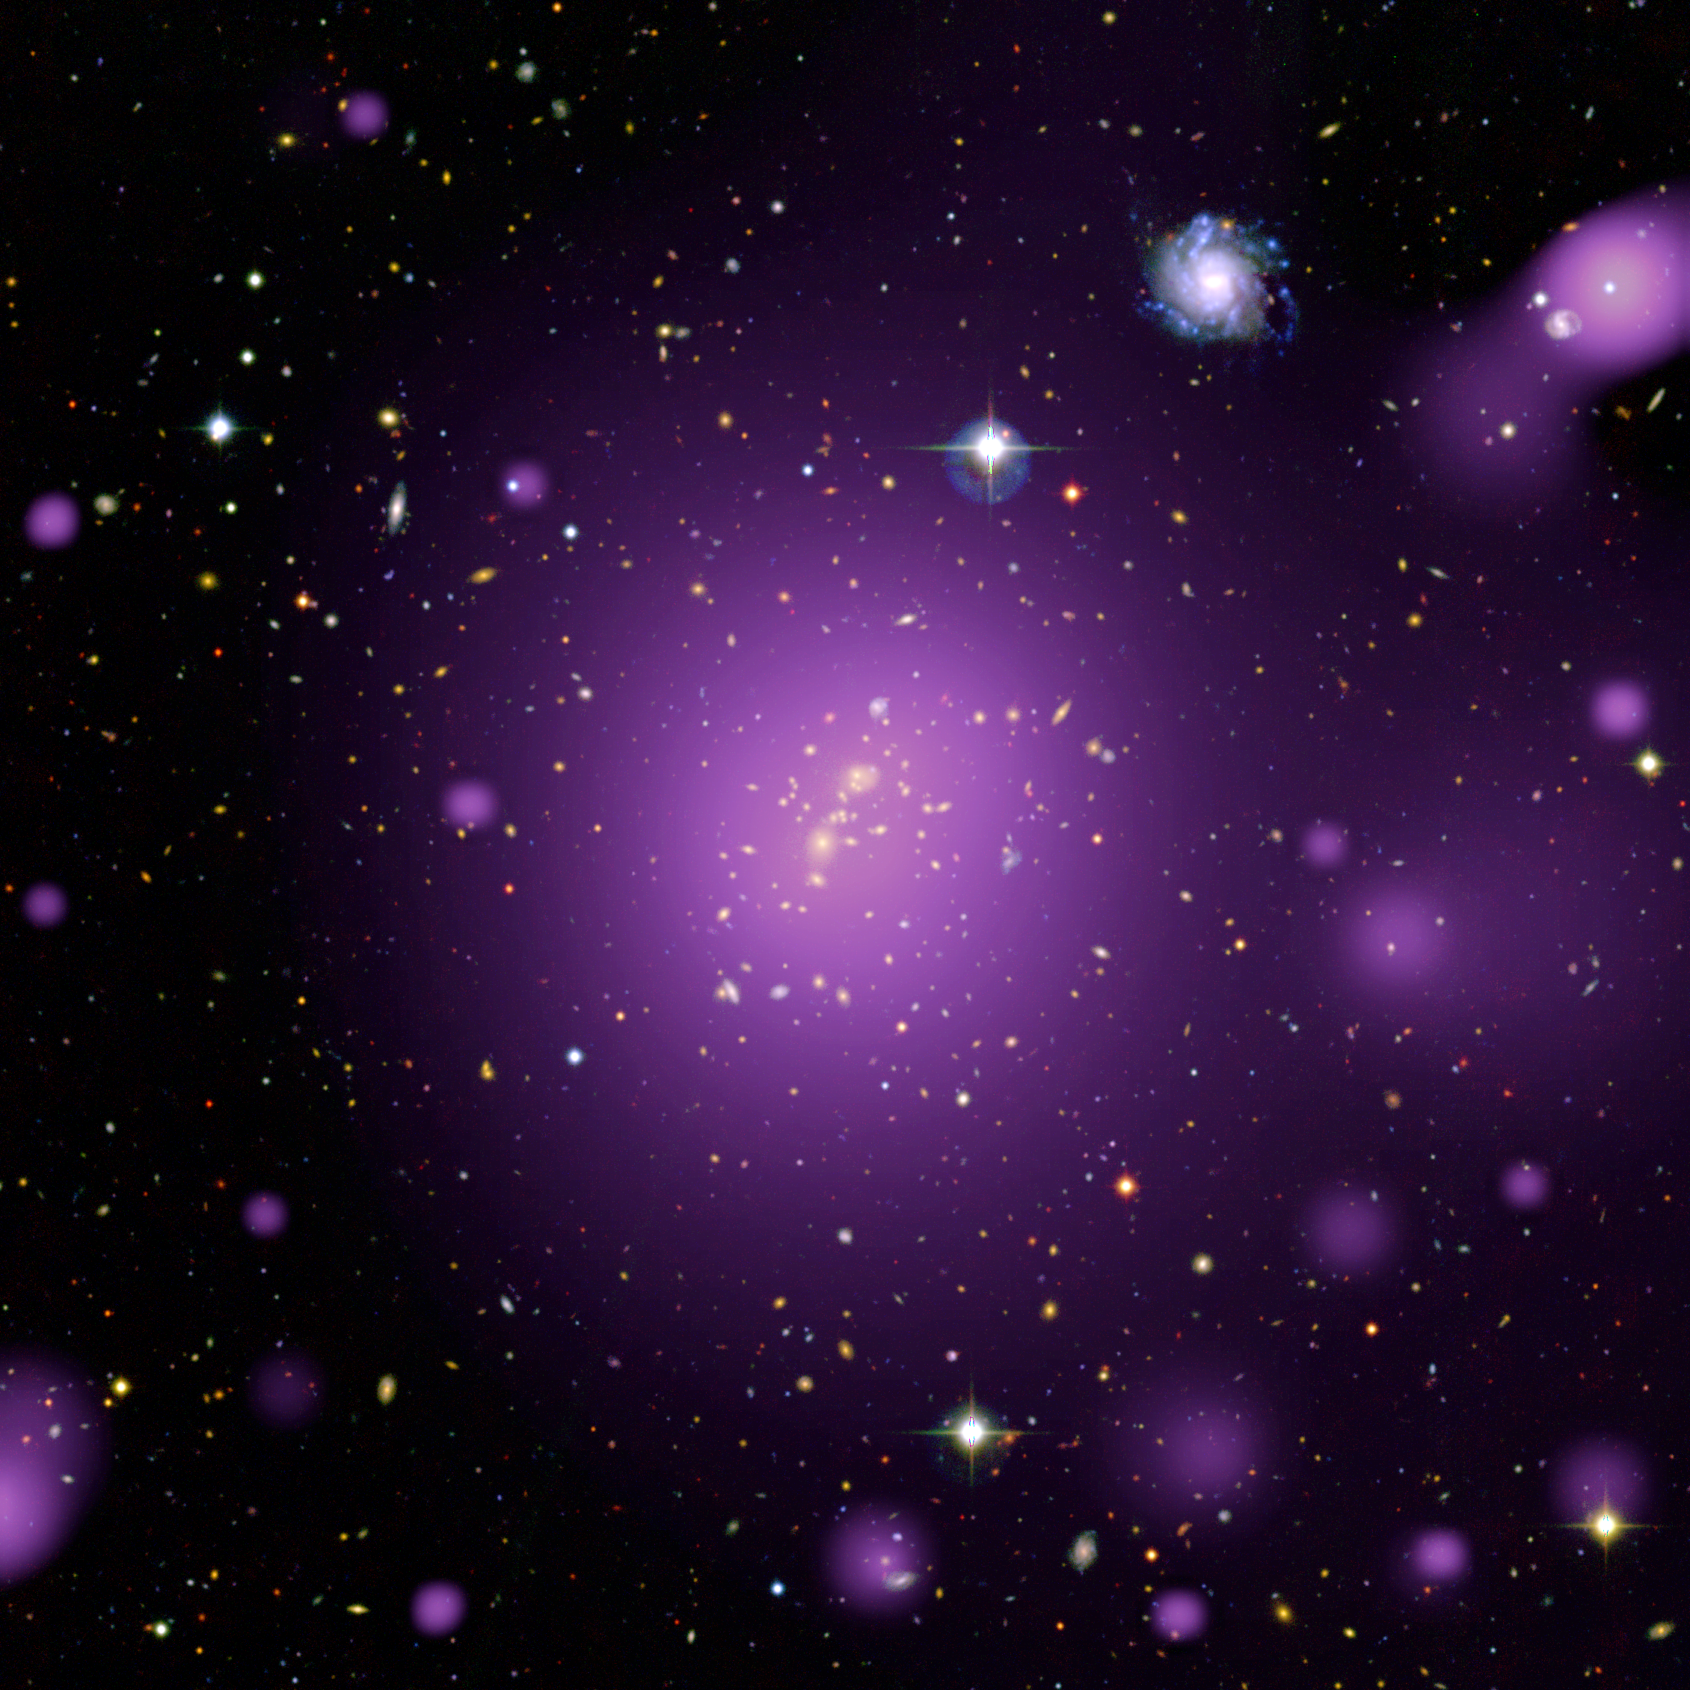
Galaxy Cluster XLSSC006
Special places in the Universe #1:
Galaxy Clusters
100-1000s of galaxies in a volume similar to that between the Milky Way and Andromeda
If you look with your eyes, you see the galaxies
If you look with X-ray eyes, you see diffuse gas with 10⁶⁻⁷ K degrees (85% of mass)
Credit: ESA/XMM-Newton (X-rays)
CFHT (optical), XXL Survey

Slide 3
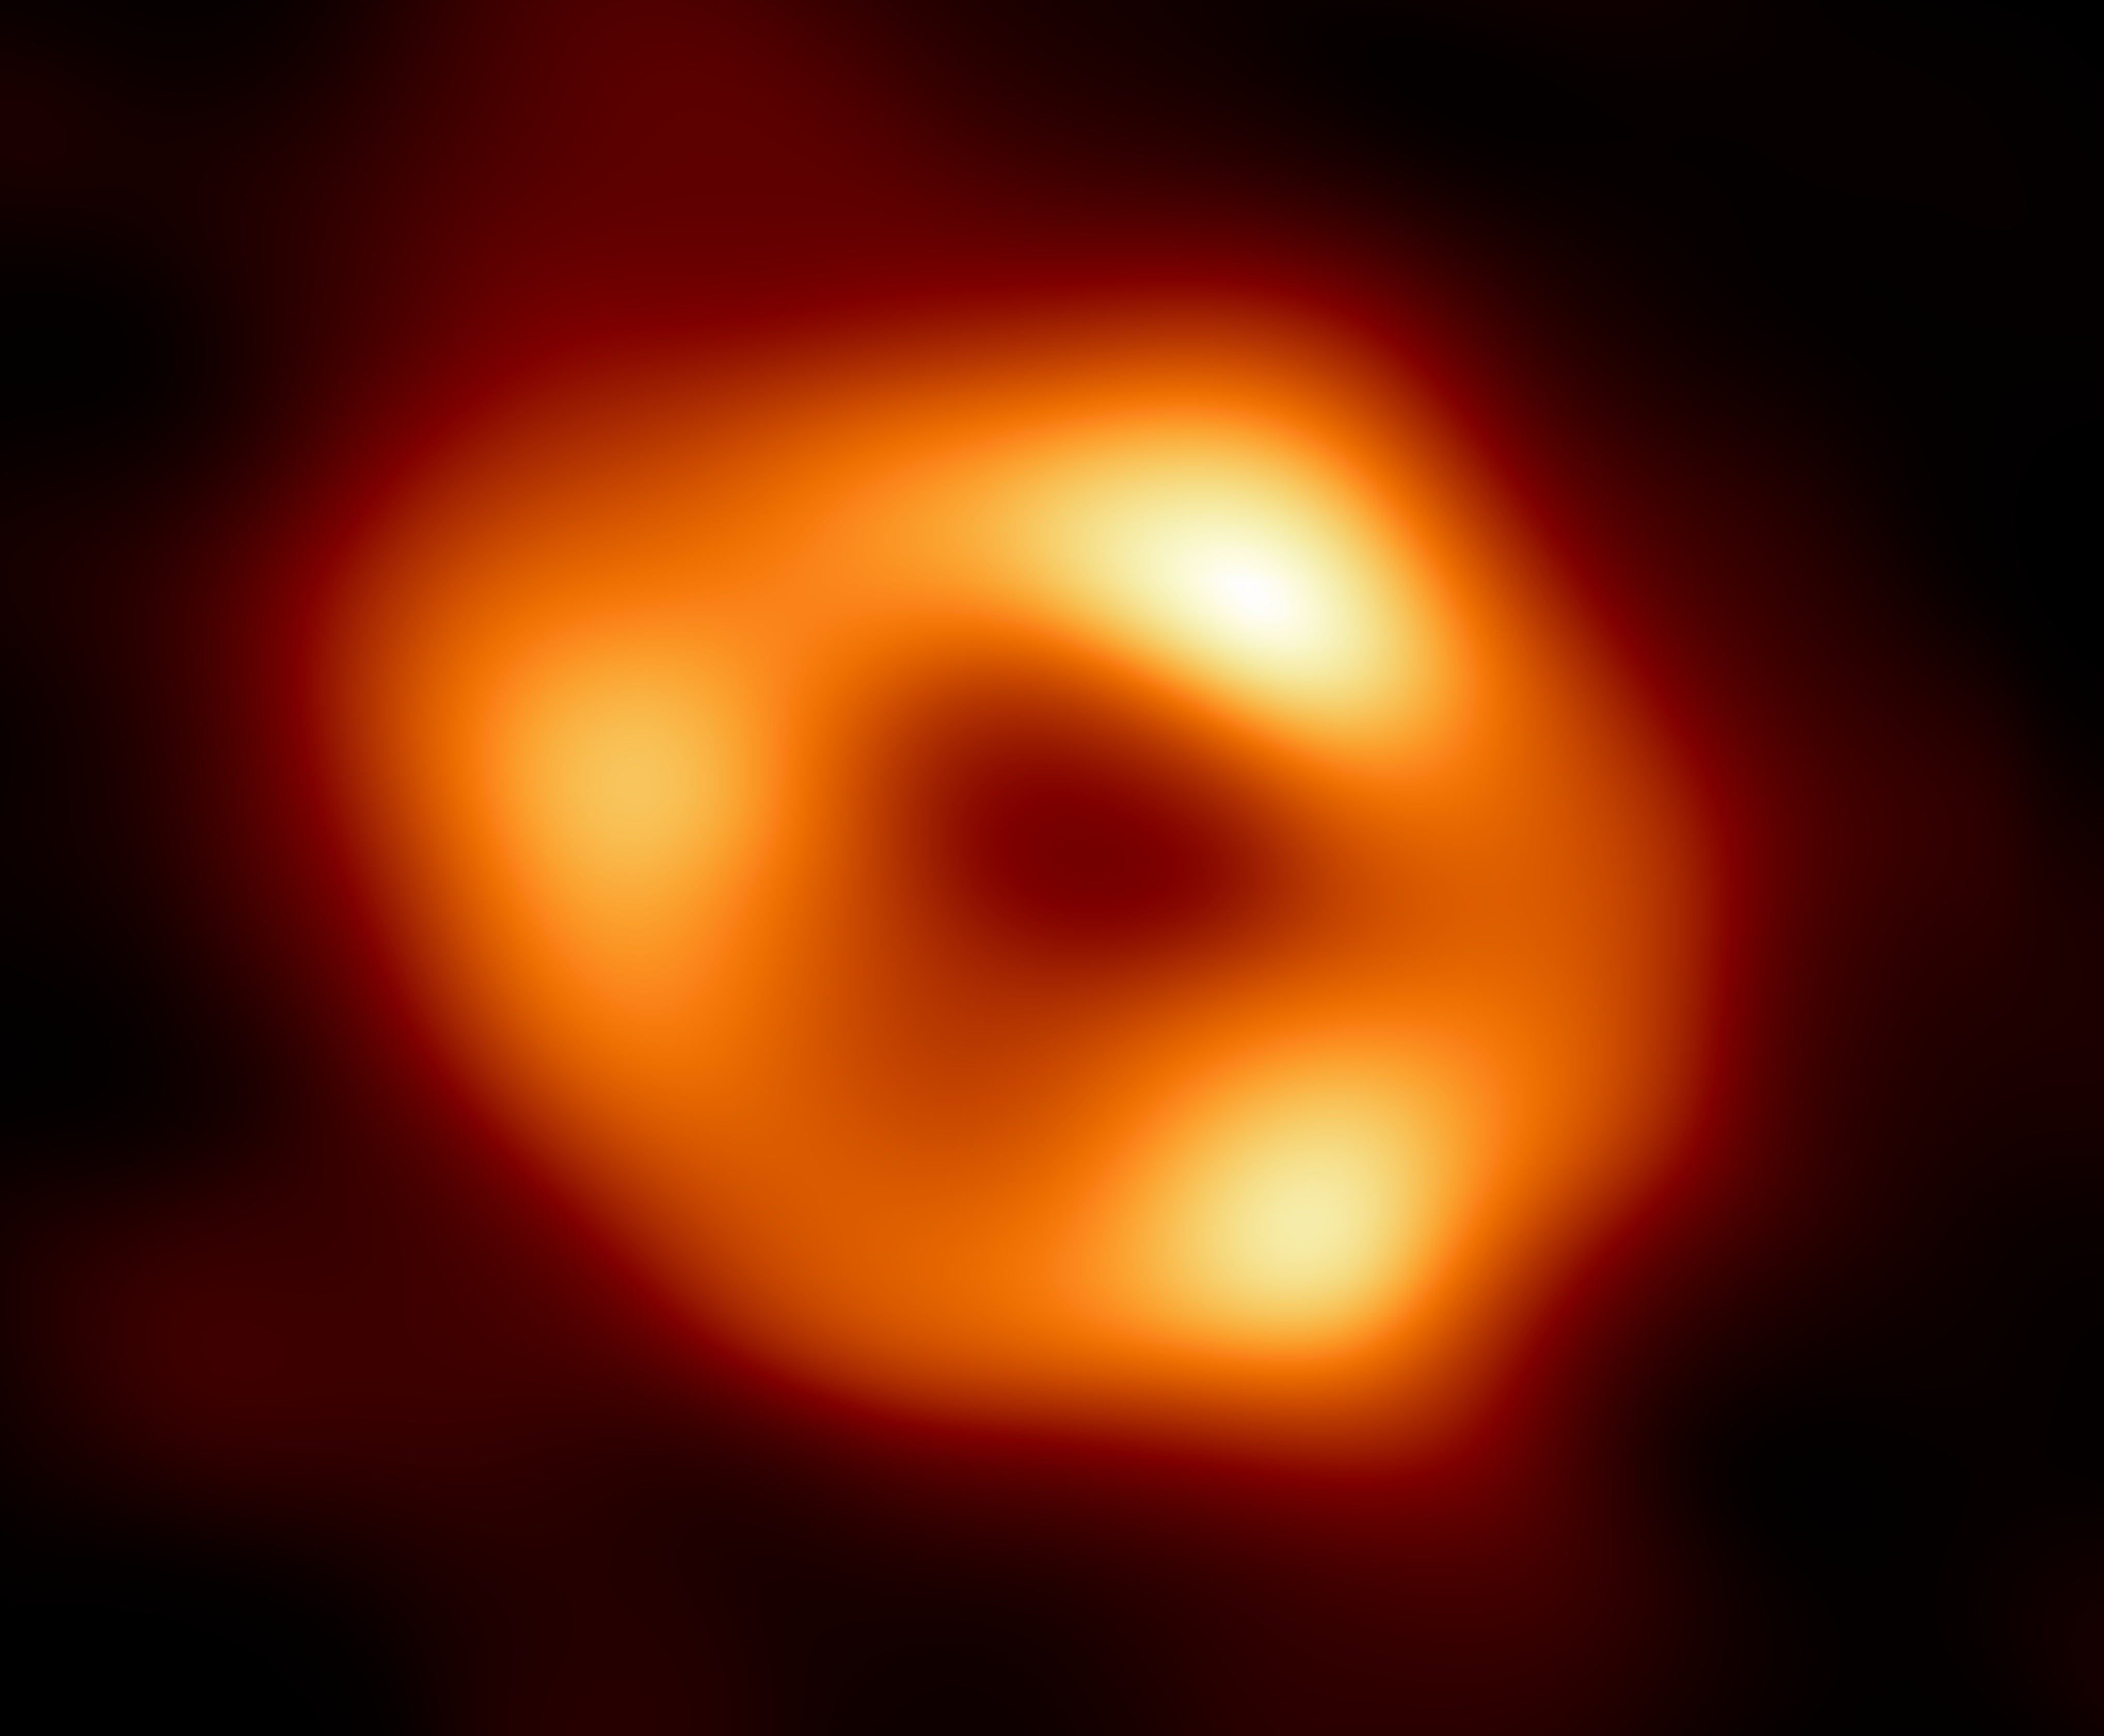

Most galaxies host a giant black hole at their centre
Mass: 1 million to 10 billion times the mass of the Sun
~10% of black holes are ”active”: emit more light than the stars in the galaxy
Black holes are laboratories of extreme physics and General Relativity
Particle with high velocities roam in their surroundings
Special places in the Universe #2
Black Holes
Image of the black hole at the centre of the Milky Way. Credit: EHT Collaboration

Slide 4
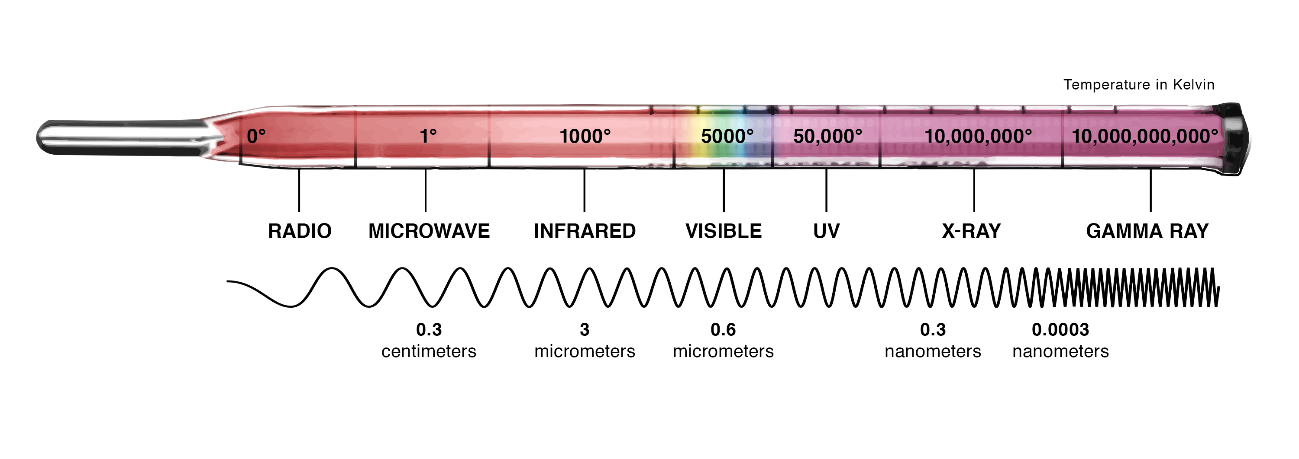
~25% of the speed of light

Slide 5
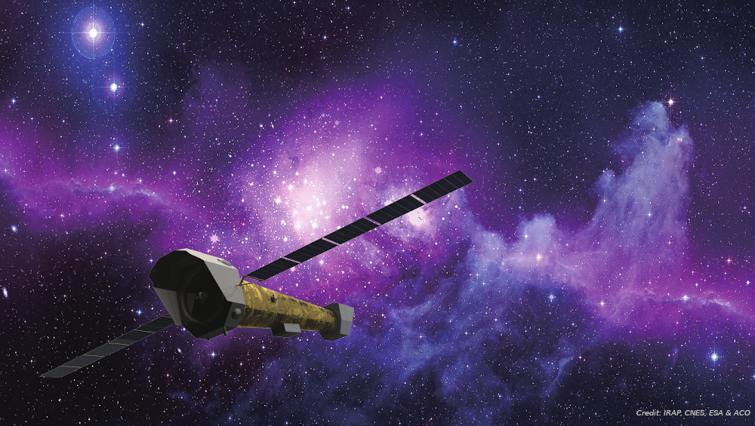
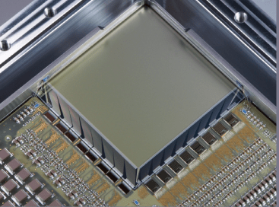

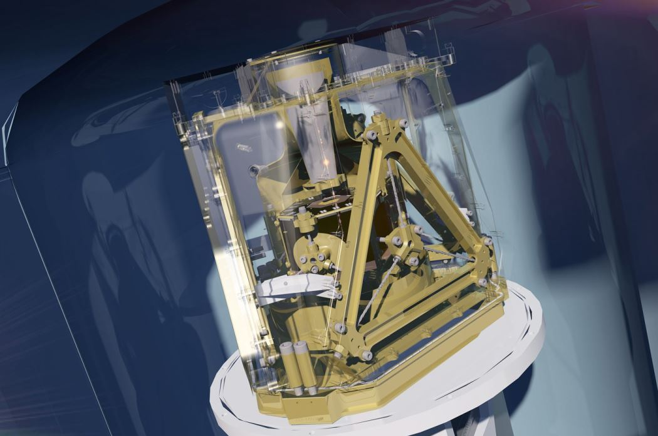
NewAthena is the future observatory of the European Space Agency to study of X-ray Universe
Wide Field Imager
[led by MPE, Germany]
Large-field-of-view
Images
Moderate resolution spectra
The largest X-ray mirror ever designed
[led by ESA]
2.5 m
Czech Republic contributes to sensitive space electronics for both instruments
X-Ray Integral Field Unit
[led by CNES/IRAP, France]
Images
High-resolution spectra
Bavdaz et al., 2021, SPIE, 11822, 1182205-1

Slide 6
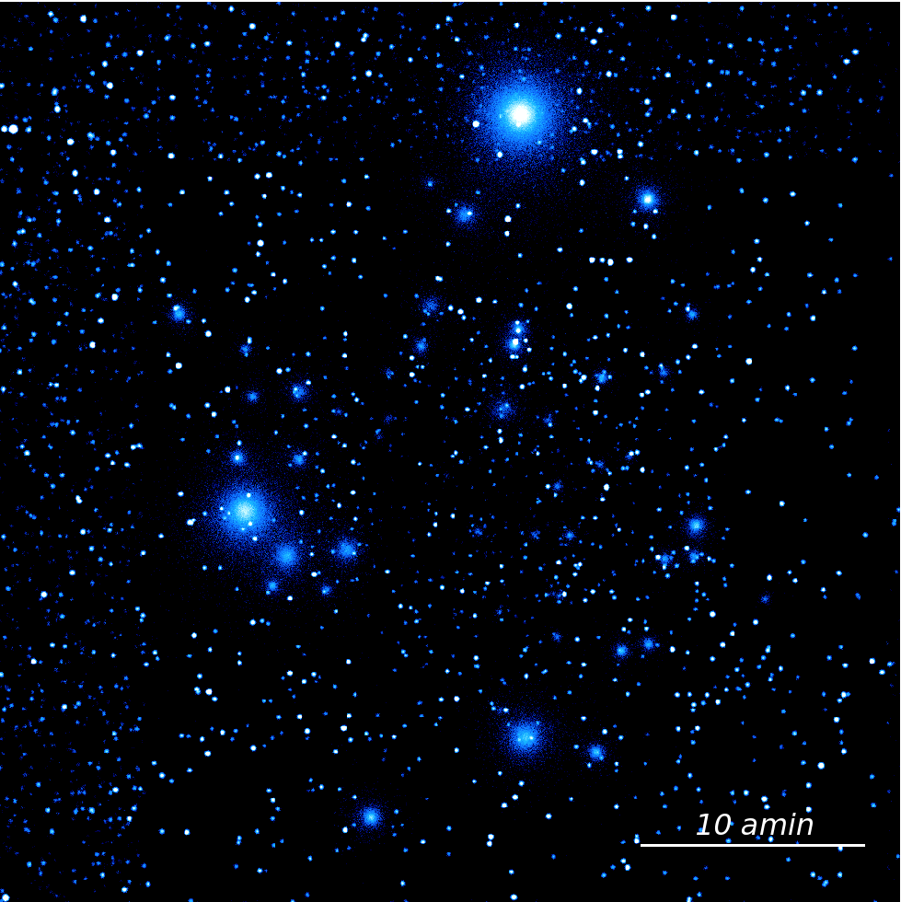
NewAthena/WFI deep image of the X-ray sky
NewAthena WFI will be the fastest X-ray source hunters ever
~10 times faster than Chandra (NASA) or XMM-Newton (ESA)
It will perform (astro)physical measurements of about half million sources in 5 years – most never seen before
It will identify black holes down to when the Universe was just ~5% of its age
Key measurements to understand how stars, galaxies and black holes (co)-evolve
Credit: WFI Consortium

Slide 7
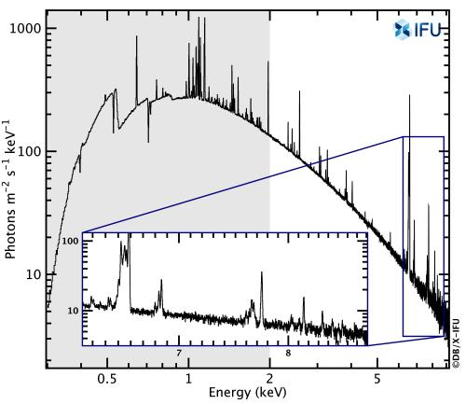
NewAthena X-IFU will have an unprecedented capability to spatially discriminate X-ray “colors”
[Astronomers call it “energy resolution”]
How are elements (metals) produced and distributed through the cosmos?
Spectrum of the Perseus galaxy cluster
What stars and black holes polulated the first galaxies?
This will allow us to answer questions such as:
By what process do stars explosively die?
To what extent and how do black holes determine the rate of stars produced in a galaxy?
… and many others

Slide 8
Echo of a black hole. Credit: M. Dovciak (Astronomical Institute of CAS, Prague)
Astrophysical black holes can be described by charge, mass, and spin
Only X-ray spectra can estimate the spin of massive black holes
The spin distrubution (over many galaxies) is remnant of the galaxy evolution
NewAthena will measure spins over tens of massive black holes in the Universe

