Slide 1
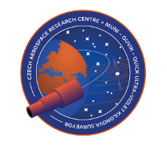

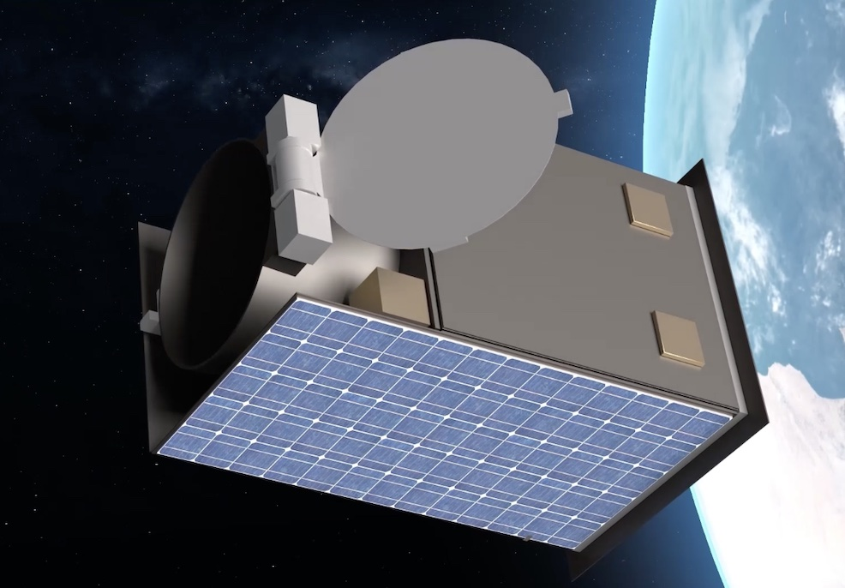
QUVIK - Quick Ultra Violet Kilonova surveyor
A Czech-led mission with a significant contribution from Italy
    Norbert Werner (Masaryk University) on behalf of the QUVIK collaboration
VZLU Aerospace (prime), Masaryk University (science PI)

Slide 2
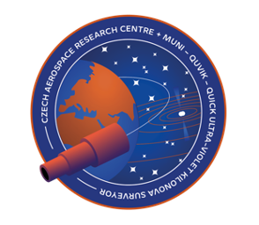
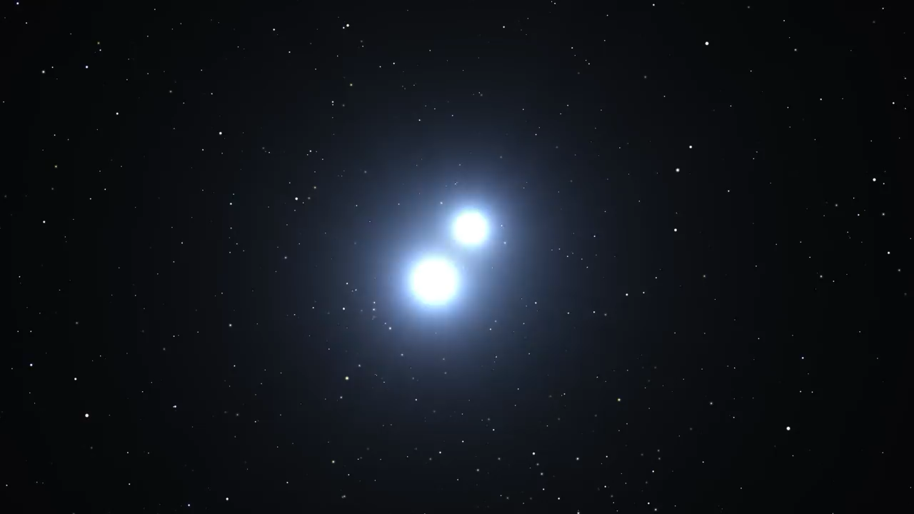
QUVIK mission objectives
The mission shall observe the sources of gravitational waves discovered
by LIGO/VIRGO/KAGRA run O5 at the end of this decade.
The observations will reveal the UV emissions resulting from mergers of neutron stars and black holes, determine their role in the origin of heavy elements, and study physics under exceptionally extreme conditions, providing opportunities for new truly breakthrough discoveries.

Slide 3
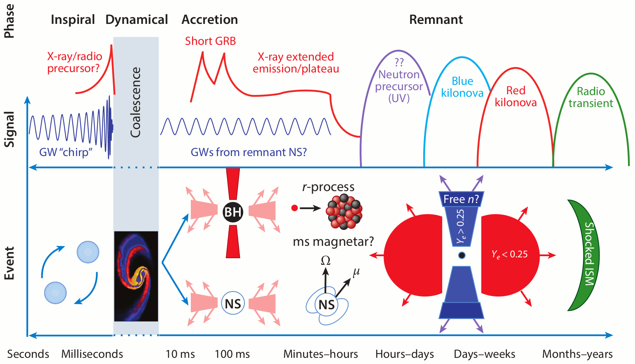
Fernandez and Metzger 2016

Slide 4
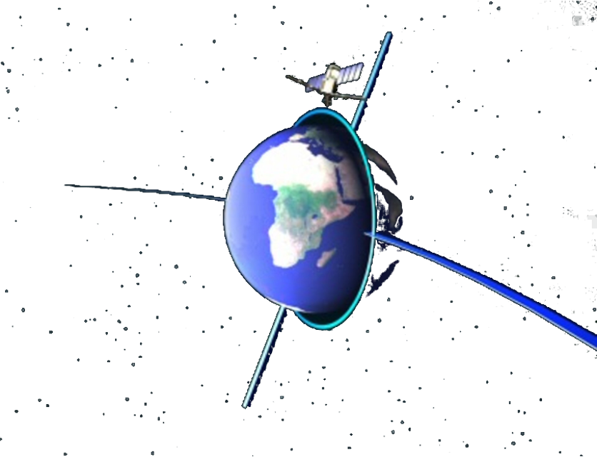
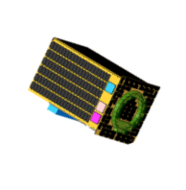
The QUVIK satellite (2 years ago)
Spacecraft is based on the Czech Advanced Platform (CAP).
Satellite parameters:
Mass: ~130 kg
Size: 0.7 x 0.7 x 1.1 m
Mission duration: 3 years
Status: B1 phase finished, approved for funding in 2023
Primary payload: 33cm aperture two-band UV space telescope
Fast repointing capability (15 min)
Near-real time communication
Orbit: Low Earth Orbit (LEO)
Sun Synchronous Orbit (SSO) Dawn/dusk orbit orientation
Ready for several launchers (including Vega C and Falcon 9)

Slide 5
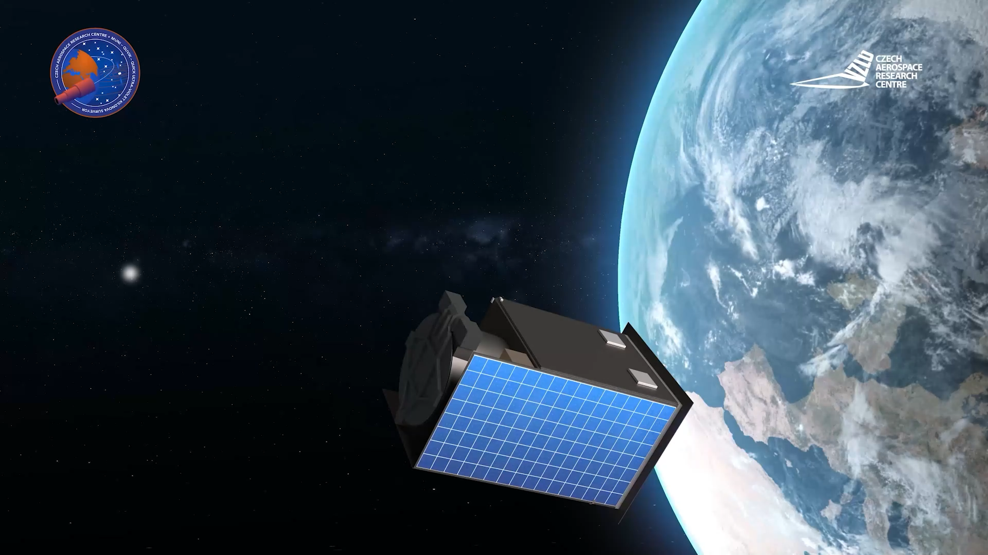

Slide 6
The QUVIK satellite
Spacecraft is based on the Czech Advanced Platform (CAP).
Satellite parameters:
Mass: ~200 kg
Size: 0.7 x 0.7 x 1.1 m
Mission duration: 3 years
Status: B1 phase finished, approved for funding in 2023
Past two years QUVIK is undergoing design consolidation, formal B2 expected to start in November
Primary payload: ~25cm aperture NUV (~260–360 nm) telescope with 1 deg² FoV
Secondary payload 1: ~25cm aperture FUV (~150–200 nm) telescope with 1 deg² FoV contributed by ASI & INAF (led by INAF Brera) in Italy
Secondary payload 2: GALI GRB detector from Technion & ISA in Israel
Fast repointing capability (15 min)
Near-real time communication
Orbit: Low Earth Sun Synchronous Orbit (SSO)
Ready for several launchers (including Vega C and Falcon 9)

Slide 7
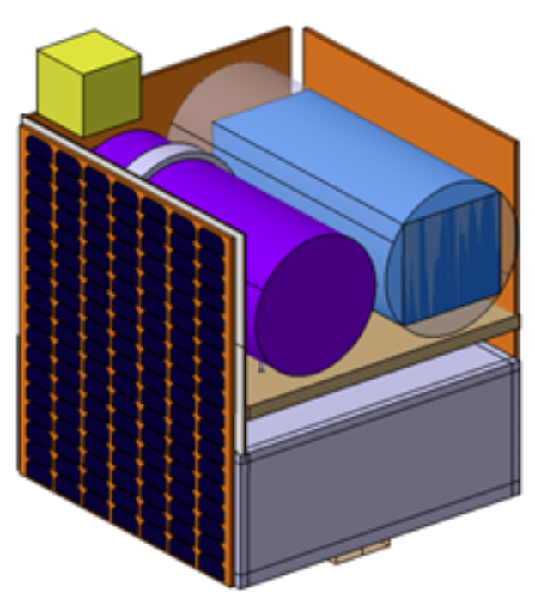
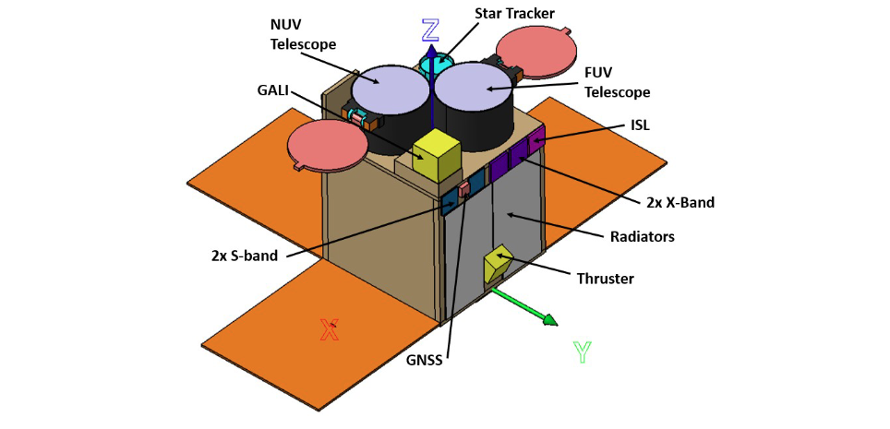
Payload accommodation is still open
The picture does not reflect the final configuration!

Slide 8
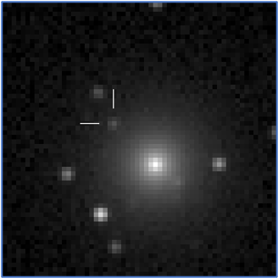
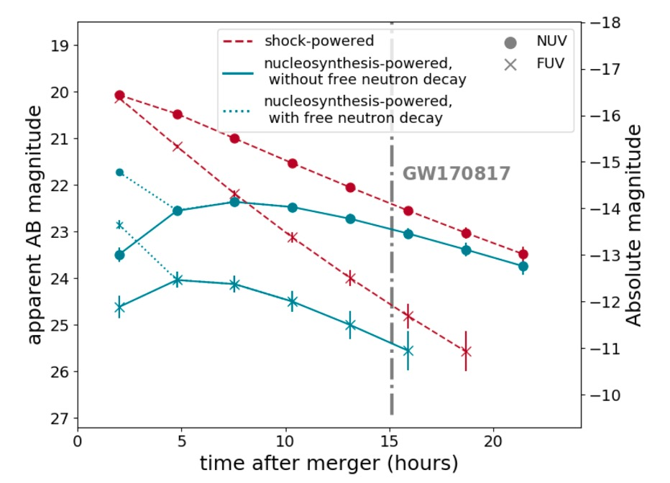
Detection of kilonovae
With a limiting magnitude 21.5, we expect to see 5 kilonovae per year, with 22nd mag 9 kilonovae per year
We designed the instrument to reach the 21.5 magnitude in a single orbit
To distinguish between kilonova models, observations shall be performed early after the explosion
Kulkarni et al. 2022

Slide 9
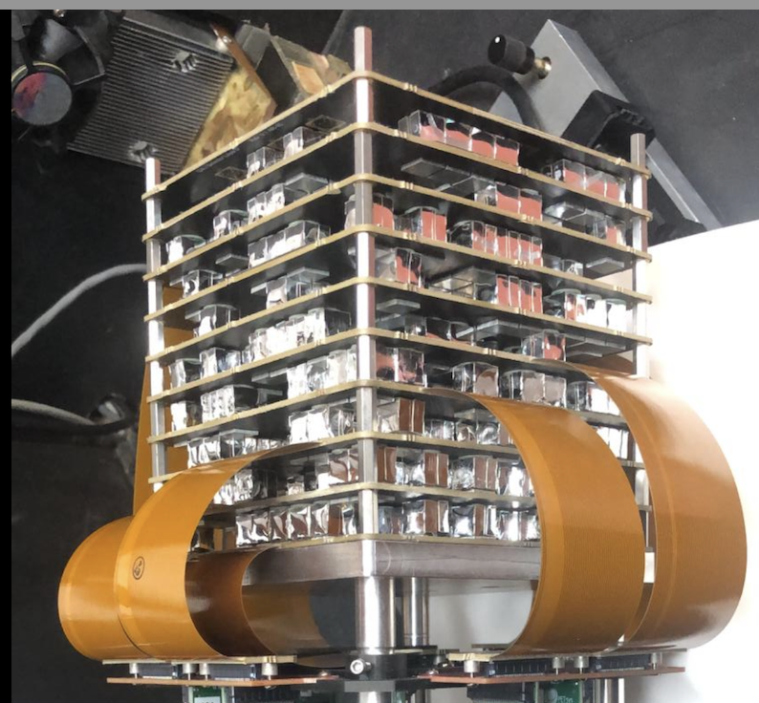
GALI - an innovative gamma-ray burst detector as hosted payload
New development of Technion Haifa
A compact array of many small scintillators - Detecting 3D coded mask
Localization comes from mutual masking, directionality is statistical, unique photon-count pattern for each burst direction, with high total statistics
Enabled by SiPM technology
Scalable detector

Slide 10
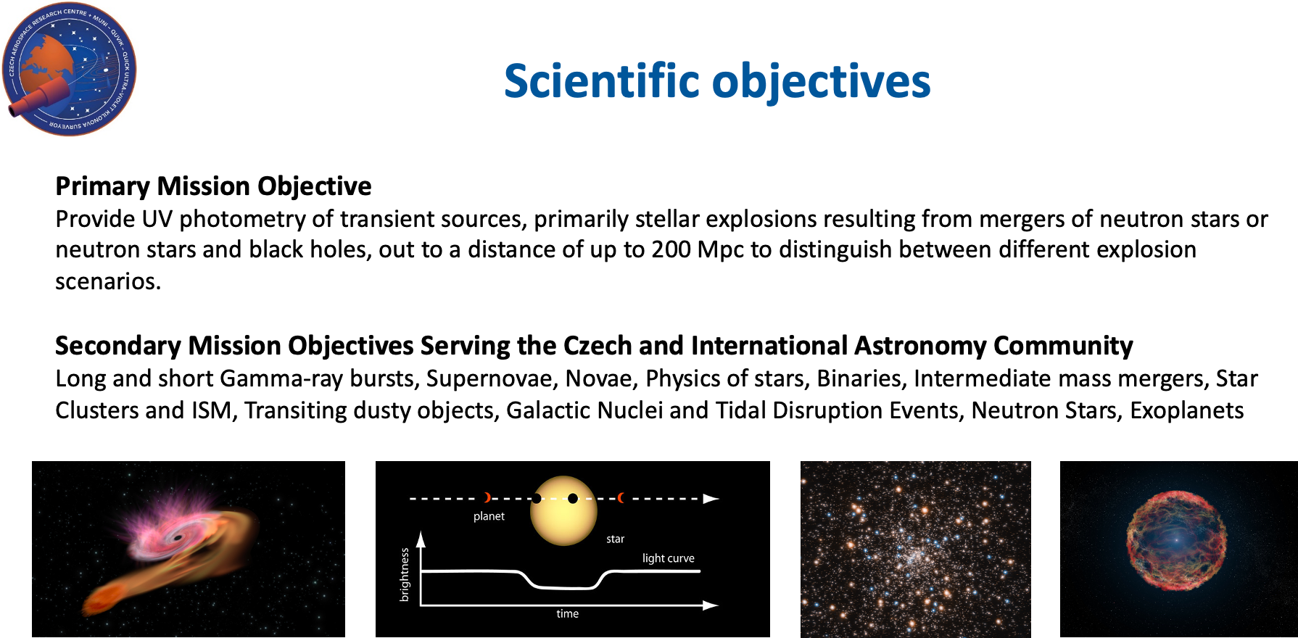
Mission objectives

Slide 11
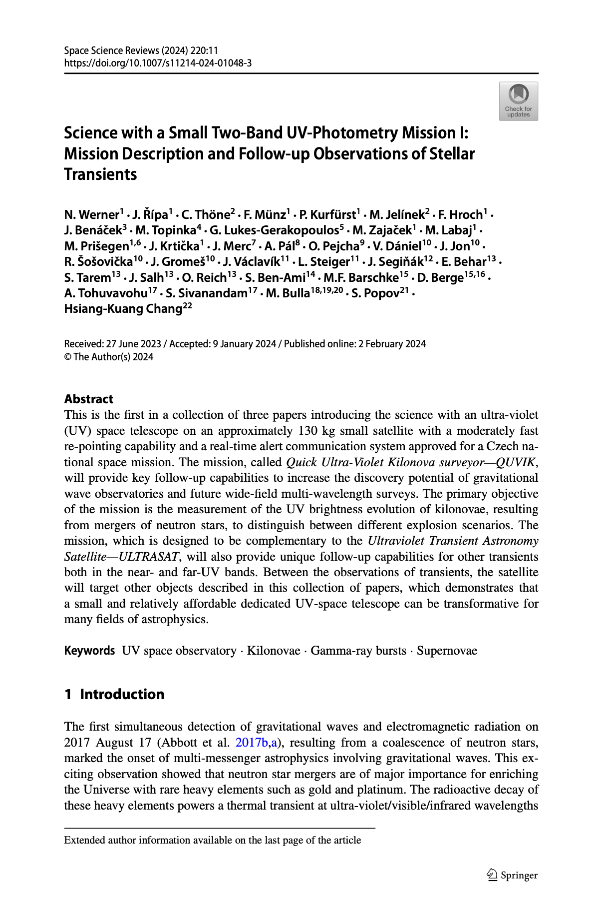
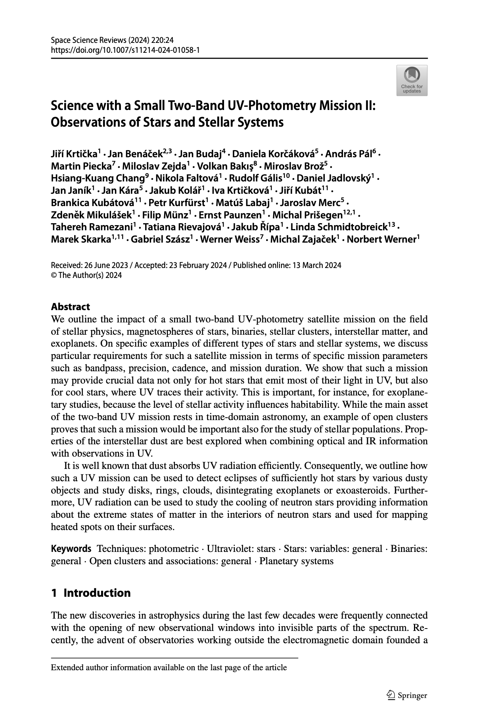
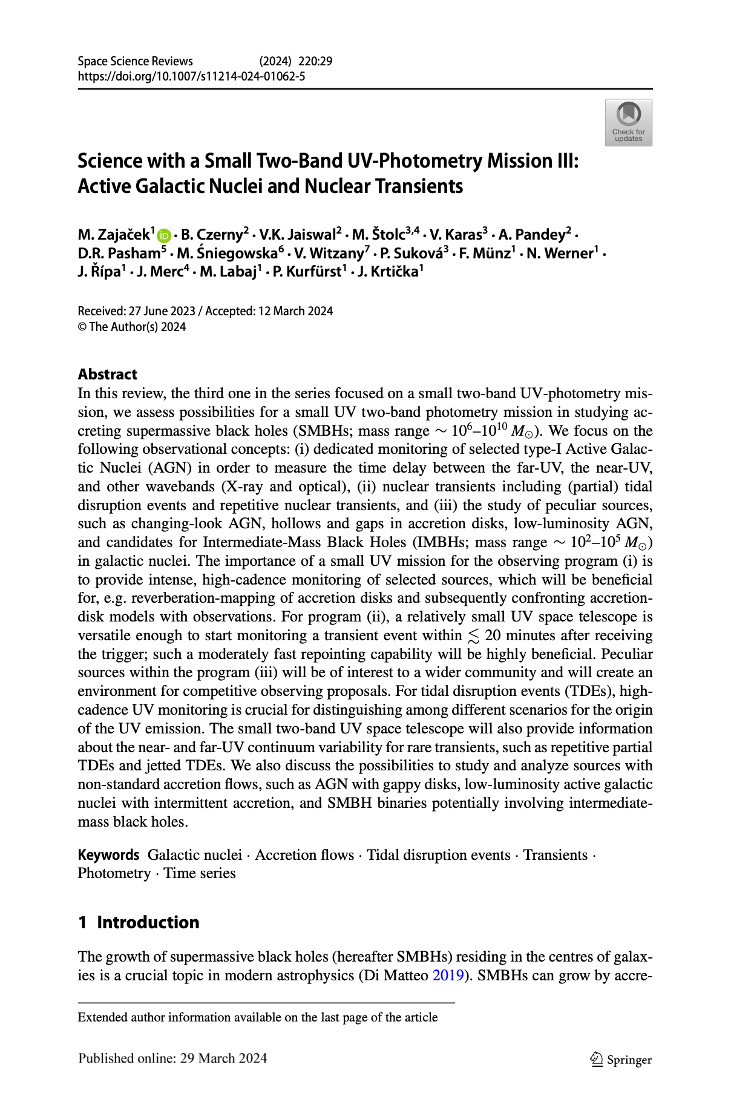
QUVIK papers in Space Science Reviews

Slide 12
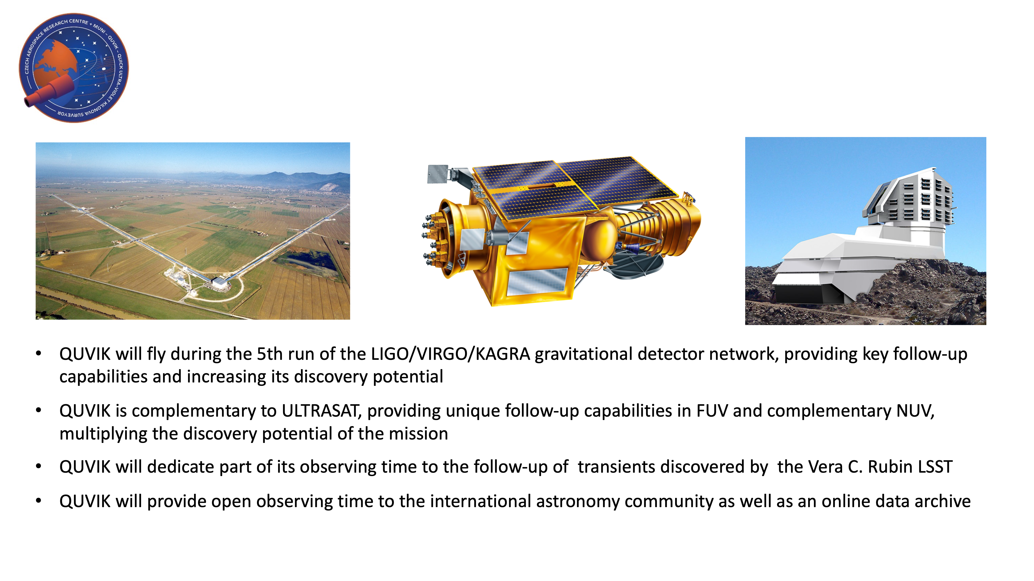
Synergy with other observatories
. QUVIK could also serve as a pathfinder for UVEX.

Slide 13
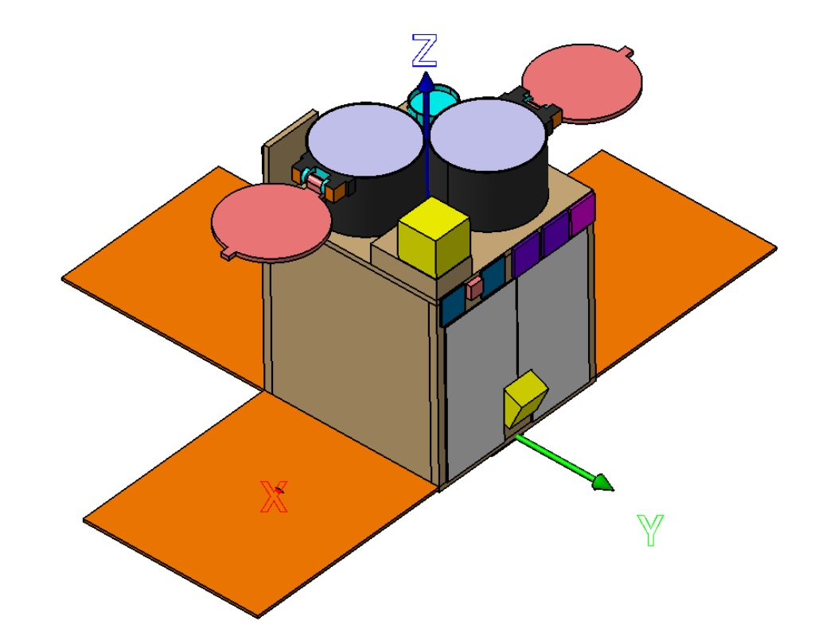
QUVIK summary
Mass: ~200 kg
Size: 0.7 x 0.7 x 1.1 m
Mission duration: 3 years
Status: B1 phase finished, approved for funding in 2023,
Primary payload: ~25cm aperture NUV (~260–360 nm) telescope with 1 deg² FoV
Photometric sensitivity in NUV: 21.5 mag (5 sigma in 3000 s) in an early type galaxy at 1.5 effective radii
Resolution: <5 arcsec
Detector: Developed by the Dunlap Institute, University of Toronto, based on CMOS (GSENSE4040) by GPIXEL
Secondary payload 1: ~25cm aperture FUV (~150–200 nm) telescope with 1 deg² FoV contributed by ASI & INAF (led by INAF Brera) in Italy
Secondary payload 2: GALI GRB detector from Technion & ISA in Israel
Observation start latency: <15 min
Near-real time inter-satellite communication for triggers
Data downlink: X-band (1600 images per day)
Orbit: Low Earth Sun Synchronous Orbit (SSO)
Launch: 2030
The picture does not reflect the final configuration!

