Slide 1
X-ray Polarimetry with the Imaging X-ray Polarimetry Explorer (IXPE) mission
Giorgio Matt (Univ. Roma Tre)

Slide 2

X-ray polarimetry
Information on celestial (extra-solar) sources are mostly provided by electromagnetic radiation.
They can be obtained by studying the spatial, spectral, timing and polarization properties of the observed radiation.
In particular, the polarization properties give us information on geometry (in a broad sense: geometry of the emitting matter but also of magnetic and gravitational fields, of space-time, etc.). The polarization degree depends on the level and type of symmetry of the system, the polarization angle indicates its orientation.
Our knowledge of the emission from a celestial source in any energy band is therefore incomplete without polarimetry.
However, polarimetric information were basically missing
in the X-ray band before IXPE!

Slide 3
X-ray polarimetry
Before IXPE, only one positive measurement (Crab Nebula: 19%) in the classic X-ray band, dating back to the 70s (OSO-8)
No X-ray polarimeters onboard X-ray satellites after OSO-8, due to lack of sensitive enough detectors
Now such detectors do exist (largely thanks to Enrico’s efforts), based on the photoelectric effect
The Imaging X-ray Polarimetry Explorer (IXPE) was selected by NASA in 2017 in the framework of the SMEX program, and launched in December 2021
IXPE is providing a wealth of diverse and often surprising results

Slide 4
IXPE mission description
A NASA/ASI mission within the NASA’s Small Explorer Program (SMEX)
Launch: December 9, 2021 on a Falcon 9 from KSC
600-km circular orbit at a nominal 0° inclination
2-year baseline mission, now extended with GO program
Point and stare (with dither) at pre-selected targets
Malindi ground station - primary (Singapore - secondary)
Mission Operations Center (MOC) at the University of Colorado, Laboratory for Atmospheric and Space Physics (LASP)
Sciences Operations Center (SOC) at MSFC
Data archiving at NASA's HEASARC – No proprietary rights, neither in the baseline
phase nor in the present GO phase

Slide 5
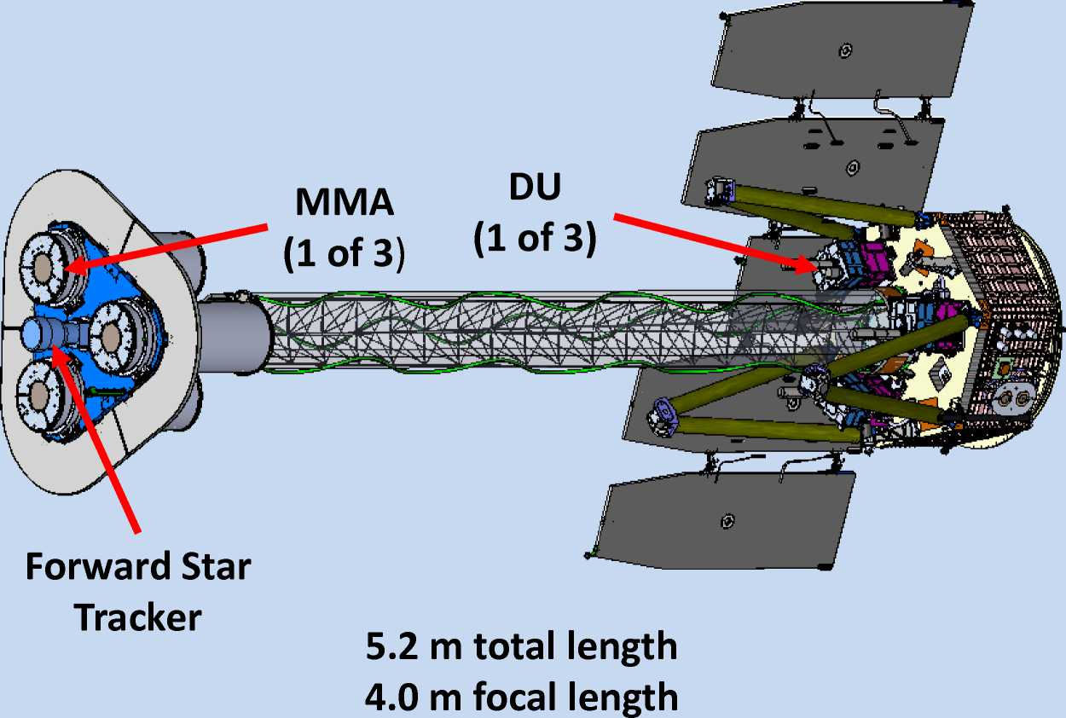
IXPE in a nutshell
Energy range: 2-8 keV
Spatial resolution: 30’’ (FWHM)
FOV=13’
Energy resolution: 0.57 keV @ 2 keV (FWHM)

Slide 6
IXPE Team
PI: Phil Kaaret, MSFC
(formerly Martin Weisskopf)
M. Weisskopf, P. Soffitta and the IXPE team were awarded the 2024 Rossi Prize for High Energy Astrophysics
The Scientific Team includes > 100 scientists from 12 countries. V. Karas and M. Dovciak participated
from the start, J. Svoboda and several students and post-docs joined later on

Slide 7
Science Advisory Team
Chairs: Giorgio Matt and Roger Romani
PWN and Radio Pulsars Niccolò Bucciantini (Italy)
SNR Pat Slane (USA)
Accreting stellar-mass BH Michal Dovciak (Czech Rep.)
Accreting WD and NS Juri Poutanen (Finland)
Magnetars Roberto Turolla (Italy)
Radio-quiet AGN and Sgr A* Frederic Marin (France)
Blazars and radiogalaxies Alan Marscher (USA)
Notes:
7
7
7
7
7

Slide 8
Science Advisory Team
Chairs: Giorgio Matt and Roger Romani
PWN and Radio Pulsars Niccolò Bucciantini (Italy)
SNR Pat Slane (USA)
Accreting stellar-mass BH Michal Dovciak (Czech Rep.) (see next talk)
Accreting WD and NS Juri Poutanen (Finland)
Magnetars Roberto Turolla (Italy)
Radio-quiet AGN and Sgr A* Frederic Marin (France)
Blazars and radiogalaxies Alan Marscher (USA)
Notes:
8
8
8
8
8

Slide 9
Summary on IXPE results
Pulsar Wind Nebulae: The magnetic field is very ordered even at large distances from the pulsar. Polarization degrees close to the Synchrotron limit !
Vela PWN (Xie et al. 2022)

Slide 10
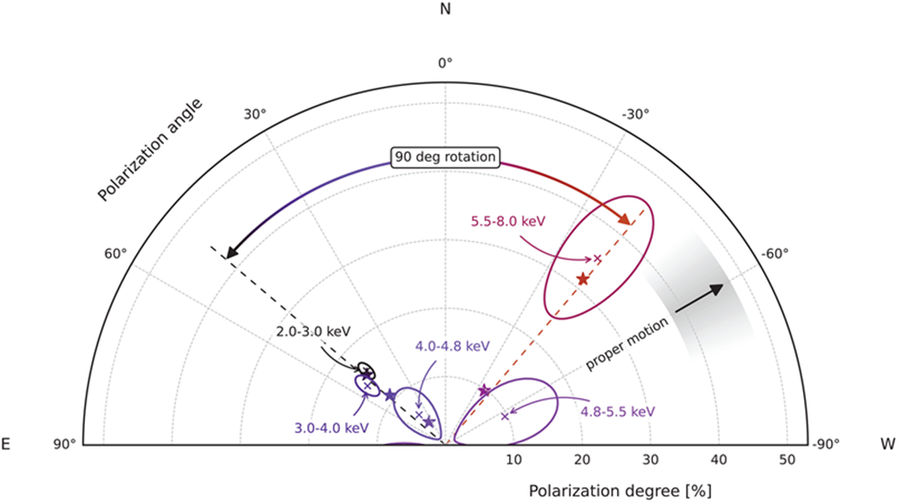
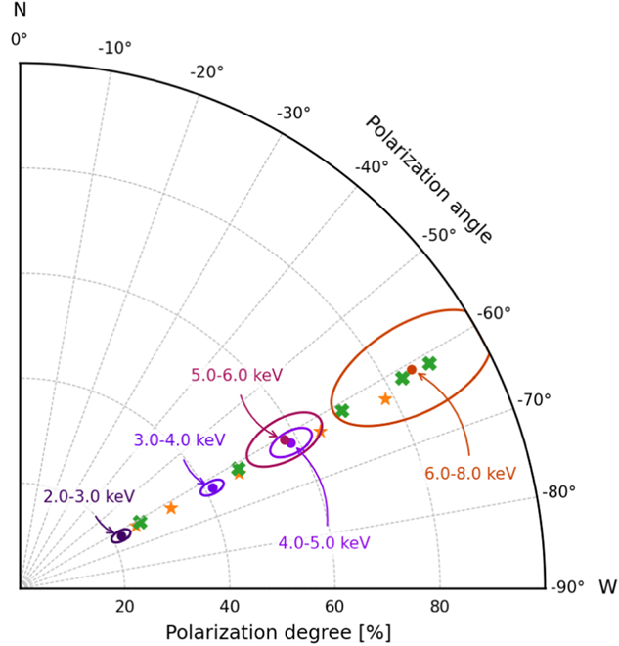
Summary on IXPE results
Magnetars: Different magnetars show different behavior on the polarization degree and angle. PD even close to 100% !
4U 0142+61 (Taverna et al. 2022)
1RXS J170849.0-400910 (Zane et al. 2023)

Slide 11
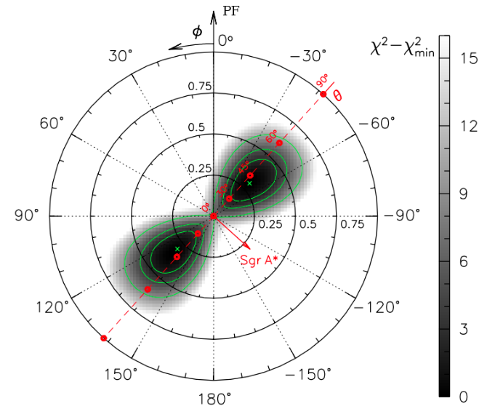
Summary on IXPE results
Galactic Center: Molecular clouds points to Sgr A* as origin of their reflected emission. The supermassive black hole in the center of the Galaxy was active a couple of centuries ago!
Marin et al. (2023)

Slide 12
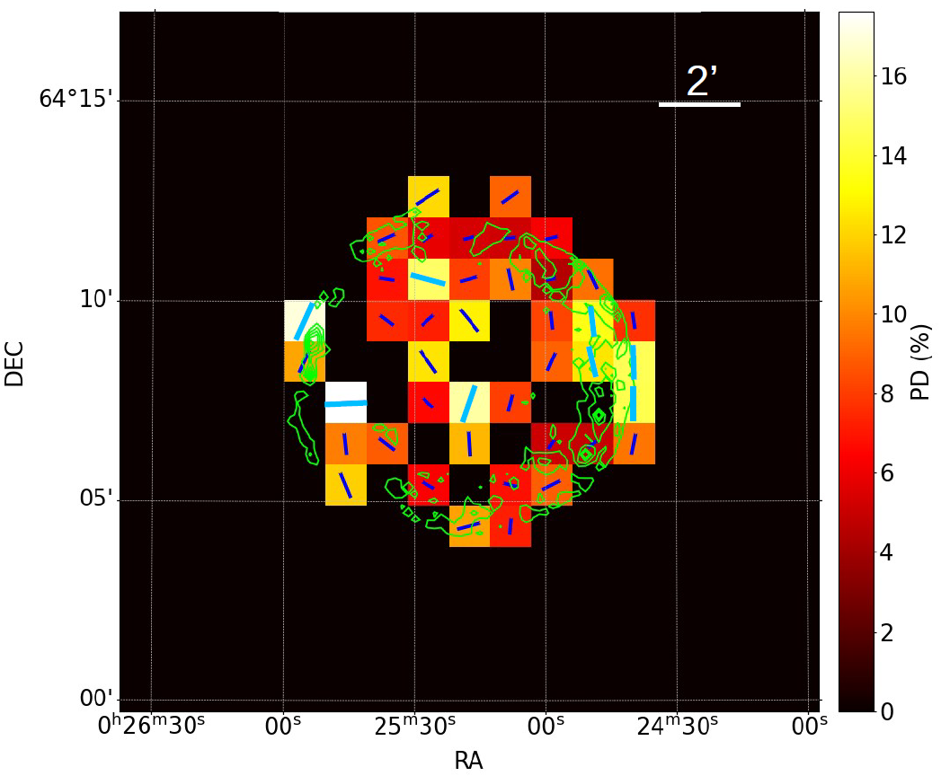
Summary on IXPE results
Supernova Remnants: The magnetic field is, in most cases, radially directed even in the vicinity of the shock.
Tycho SNR (Ferrazzoli et al. 2023)

Slide 13
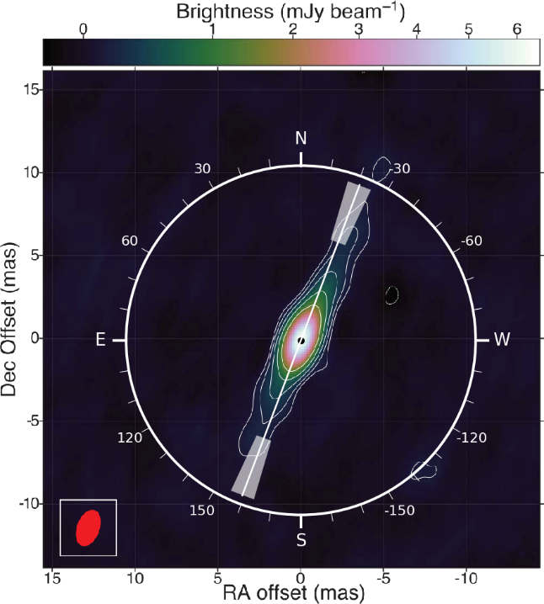
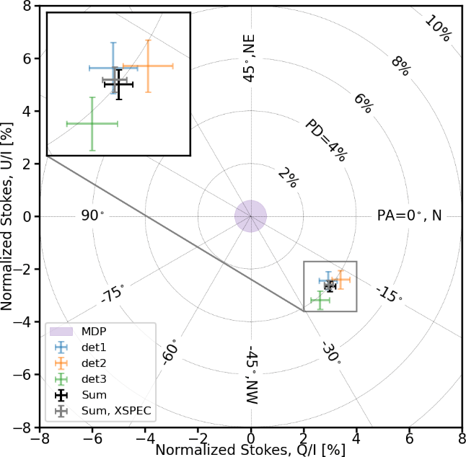
Summary on IXPE results
Accreting stellar-mass Black Holes: A radially extended hot corona is favoured. Standard disc model does not work in at least one source. Estimate of the black hole spin in a few cases.
Cyg X-1
(Krawczyinski et al. 2022)

Slide 14
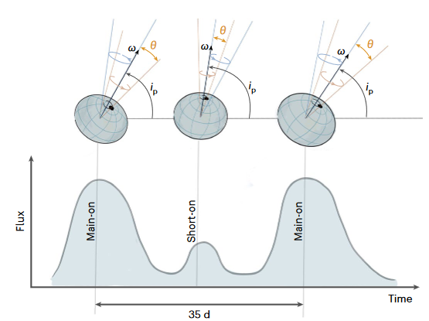
Summary on IXPE results
Accreting Neutron Stars: The rotating vector model for X-ray pulsars works in X-rays. The degree of polarization is 5-6 times smaller than expected by simple models. Neutron star precession observed in Hercules X-1. Weakly magnetized accreting neutron stars typically polarized at a few percent level (more than expected).
\
Hercules X-1 (Heyl et al. 2023)

Slide 15
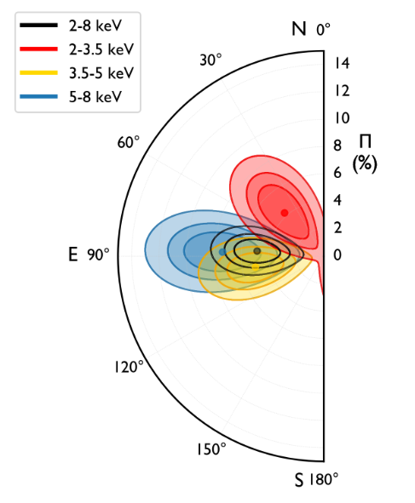
Summary on IXPE results
Radio-Quiet AGN: A radially extended hot corona is favoured, as in Galactic Black Holes. High polarization confirms obscuring torus in Compton-thick AGNs.
NGC 4151 (Gianolli et al. 2023, 2024)

Slide 16
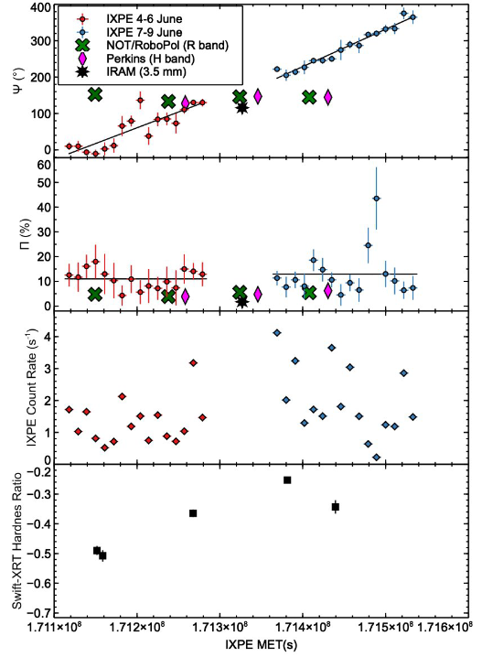
Summary on IXPE results
Blazars and Radio Galaxies: Energy stratified shock acceleration is confirmed. Fast rotation of the X-ray polarization vector is observed in some Synchrotron dominated blazars. Inverse Compton dominated blazars are much less polarized.
Mrk 421 (Di Gesu et al. 2022)

Slide 17
Conclusions
IXPE has really (re-)opened a new observing window!
As expected, significant polarization is rather common in X-ray sources
Not surprisingly, most of the detections are related to strong Magnetic Fields (PWN, SNR, Magnetars, X-ray Pulsars, Blazars)
But scattering polarization is also very often detected! (e.g. coronal emission in X-ray binaries and AGN, reflection in obscured AGN, Sgr A*, …)
In many cases, results (even upper limits) are discriminating between competing models, or challenging popular ones

Slide 18
Thanks for your attention

