Slide 1











CZECH SPACE ALLIANCE
03/2026

Slide 2






















Industrial association of 22 members

Slide 3
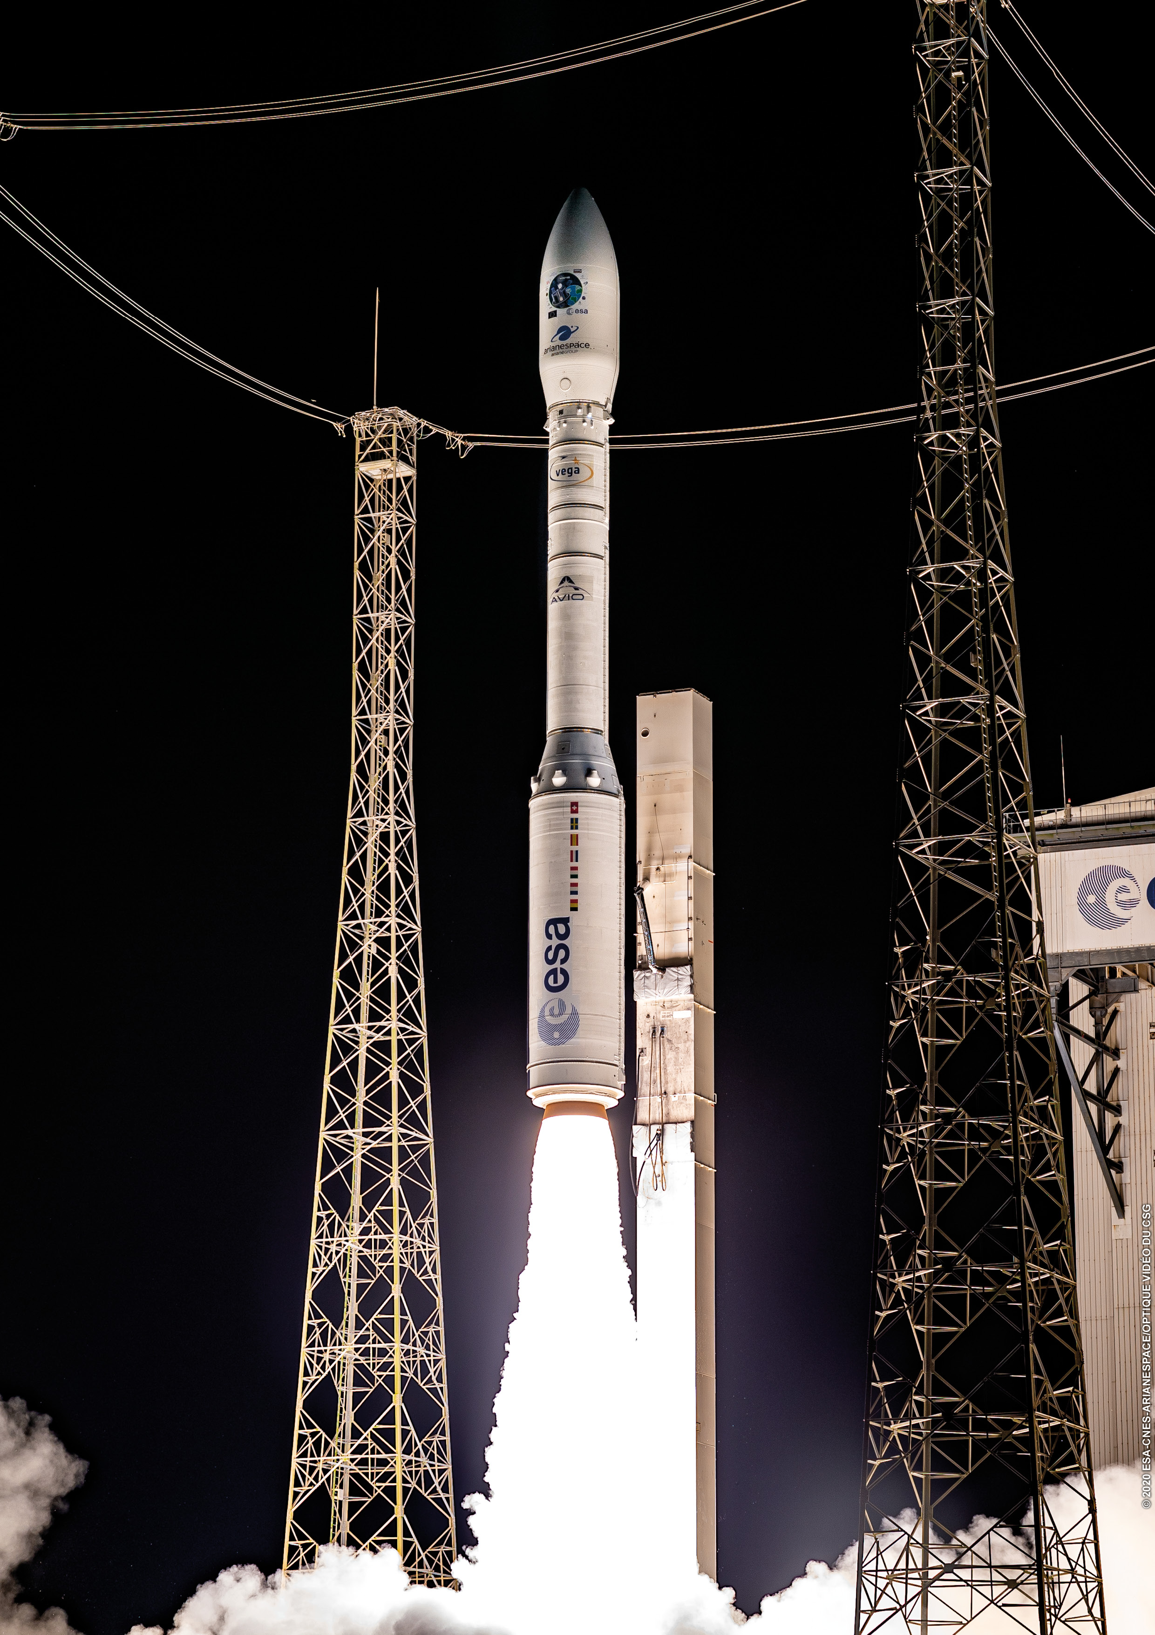
Goals and activities
Presentation at national and international events
Dialogue and relationship with space agencies
Cooperation with similar associations
Development of business relationships
Presentation of interests to the national decision makers
Cooperation with Ministry of Transport and other official entities in the formulation of Czech space policy
Cooperation with academia
Support of student activities

Slide 4



Collaboration on Czech Space Policy
Drafting and commenting on the industry sections of the National Space Plan
Participating in the Space Coordination Board of the Minister of Transport and chairing its Industry and Application Committee
Consultation with delegation of Czech Republic into European Space Agency (ESA) and European union (EU)

Slide 5
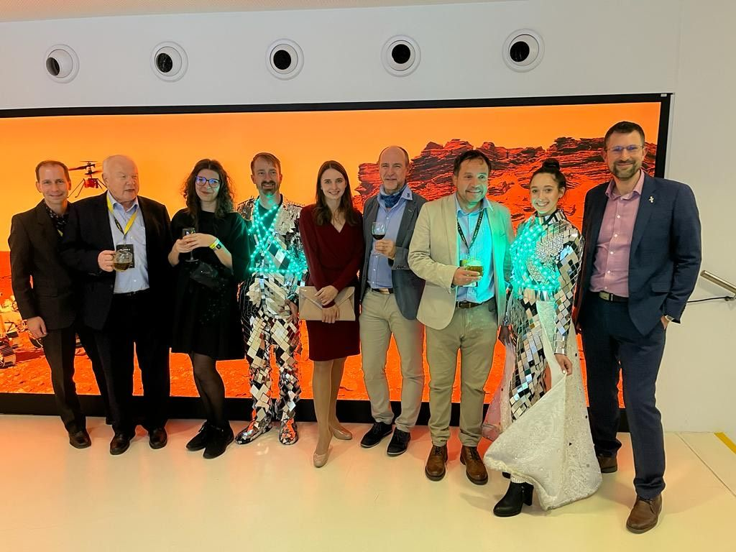
Organizing and coorganizing industrial missions
Europe: UK, Spain, France, Germany, Luxembourg, Italy
World: Brasil, Japan, Canada, USA, Thailand

Slide 6


Participation at foreign visits and major events in Czech Republic
Agencies: ESA, ISRO, JAXA, GISTDA
Companies: Airbus Defence & Space, Thales Alenia Space, VAST Space, AXIOM Space
Events: Czech Space Week

Slide 7
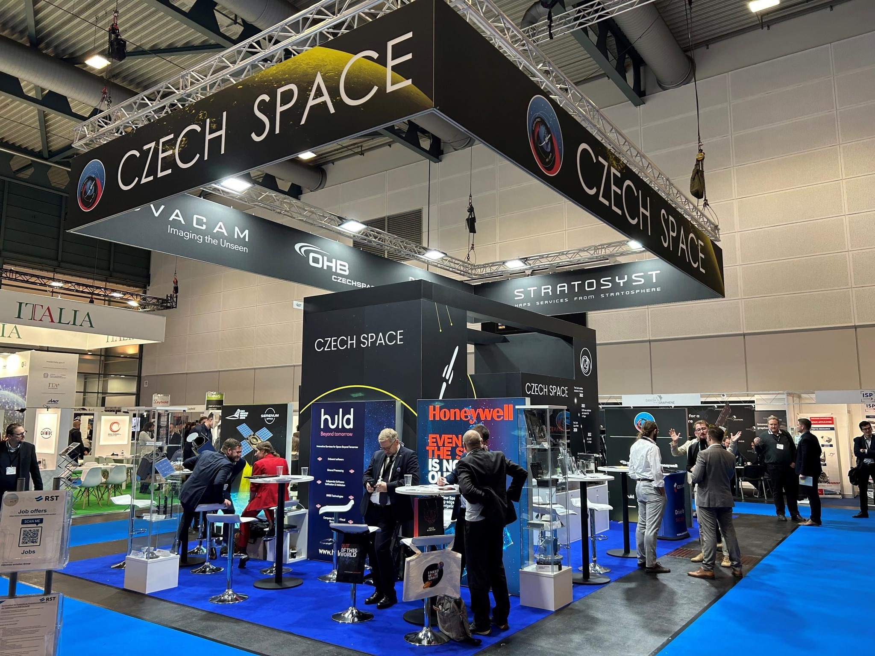
Participation at international conferences, exhibitions and fairs
International astronautical congress IAC, Japan International Aerospace Exhibition
EU Space Week, SpaceTech Expo Europe, ILA Berlin, Paris Space Week

Slide 8
Members’ technical capabilities
MAIT – Frentech Aerospace, OHB Czechspace, SAB Aerospace, 5M, Streicher
Design – L.K. Engineering, OHB Czechspace, SAB Aerospace, Stratosyst, Streicher, Uptim AI
Manufacturing of structures and mechanisms – Frentech Aerospace, 5M, Streicher
Electronics – Advacam, BD Sensors, ESC Aerospace, HULD, UNITES, Spacemanic, TTS
G/S and flight Software - Iguassu Software Systems, ESC Aerospace, HULD, Spacemanic, Uptim AI
Material development – TOSEDA, TTS, 5M
Scientific instruments – Advacam, BBT Materials Processing, Rigaku Innovative Technologies
Testing – EGGO Space, Frentech Aerospace, OHB Czechspace, TOSEDA, 5M, Streicher
GSE – TERMA, L.K. Engineering, OHB Czechspace, SAB Aerospace, Streicher, UNITES
Space applications – CGI
Security consulting – CGI
Mission provision & operations – Spacemanic

Slide 9
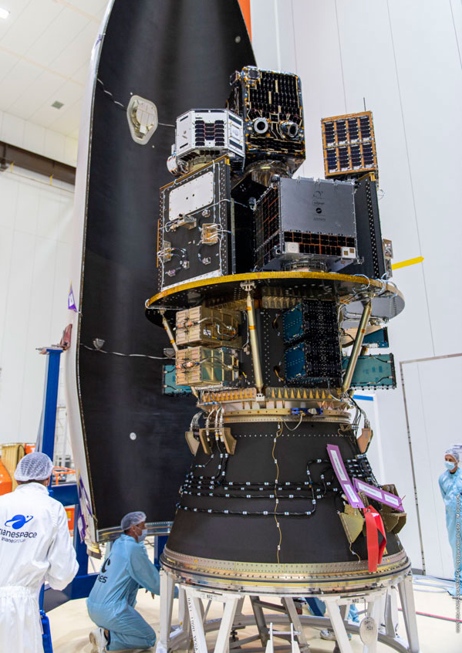
product portfolio →
Systems a subsystems
Platforms for satellites
(built to spec)
Launcher dispensers for multiple satellite launch
Solar arrays
Deployable booms
Satellite radiation shielding
Stratospheric balloons

Slide 10
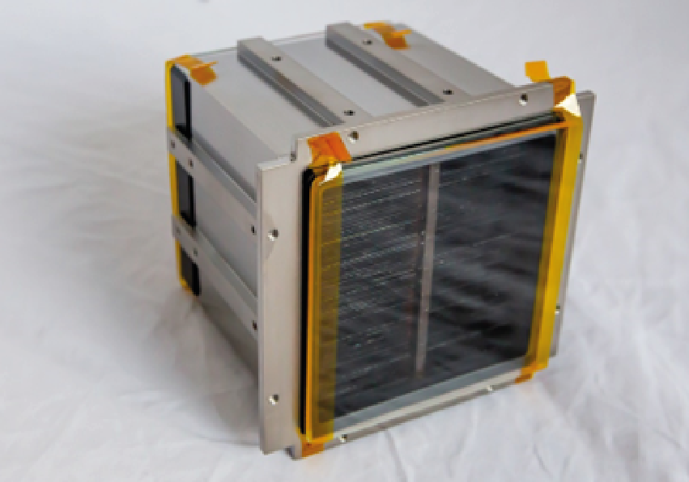
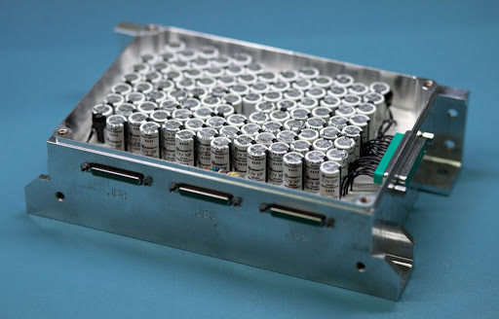
product portfolio →
Components and assemblies
On-board Computers, avionics
GNSS SW for navigation
Sensors – radiation, moisture, temperature and pressure
Electronics and harness
X-ray and IR optics
Supercapacitors and batteries
Composite structures and assemblies
Hinges for solar arrays end booms
Landing legs
Mechanisms for cargo doors
MGSE and EGSE
Thermal-vacuum chambers

Slide 11
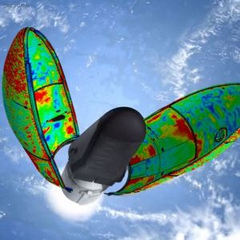
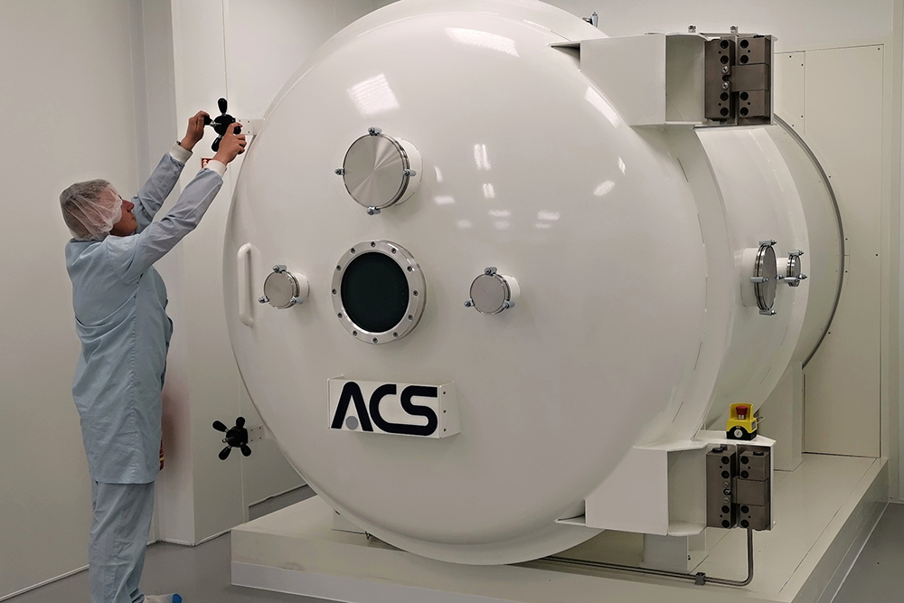
product portfolio →
Services
Design activities: structural, thermal design, kinematics
Material development: adhesives and composites
Qualification of materials
Testing activities: mechanical testing in relevant environment, TVC, precise measurements, molecular contamination, electrical tests etc.

Slide 12
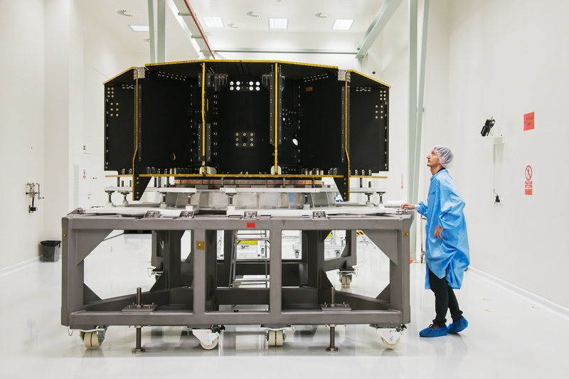
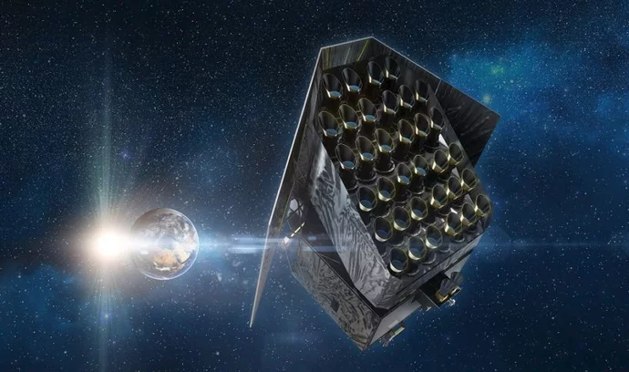
Examples of collaborative projects
Service module for Plato exoplanet observatory
SAB Aerospace, 5M, OHB Czechspace, VUT Brno, Frentech Aerospace → OHB-DE / ESA
Design, manufacturing, AIT
Contract 2018, PFM 2023

Slide 13
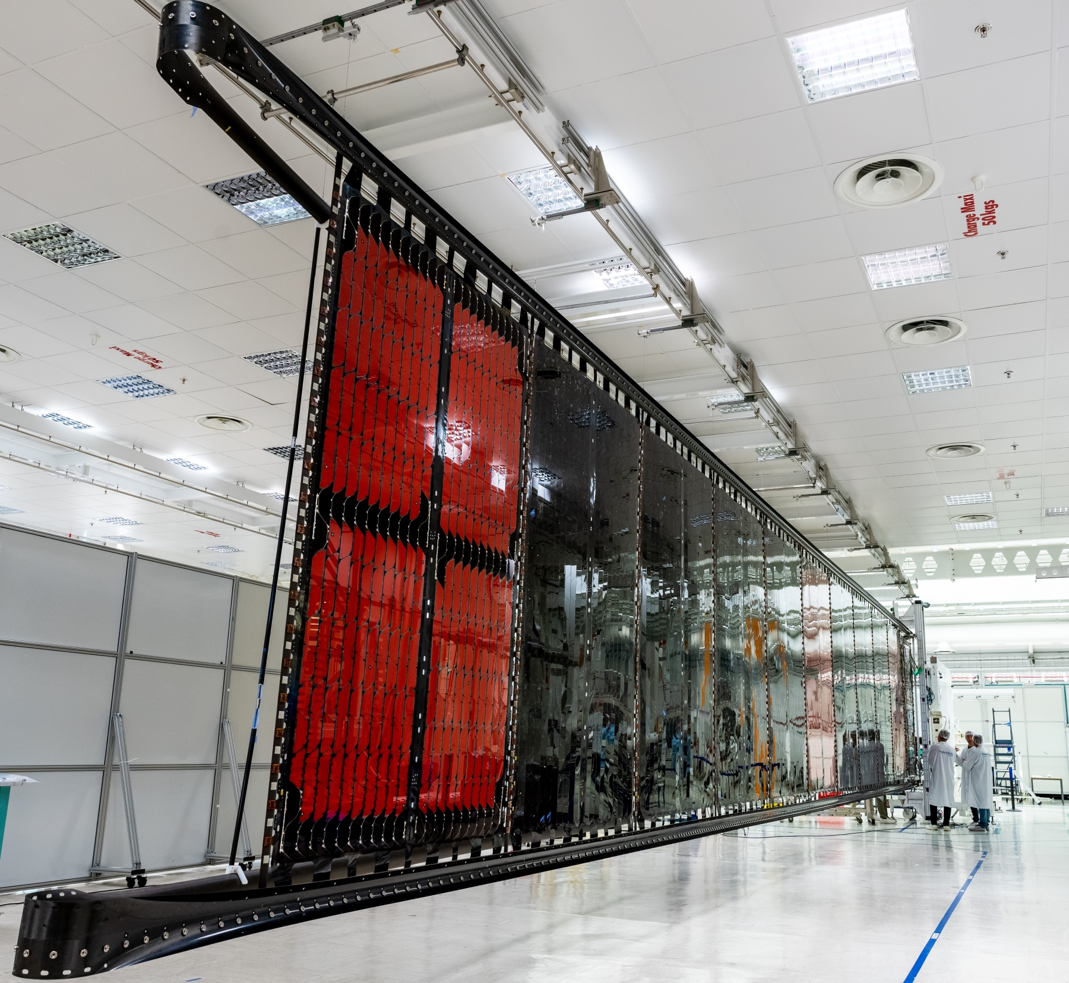
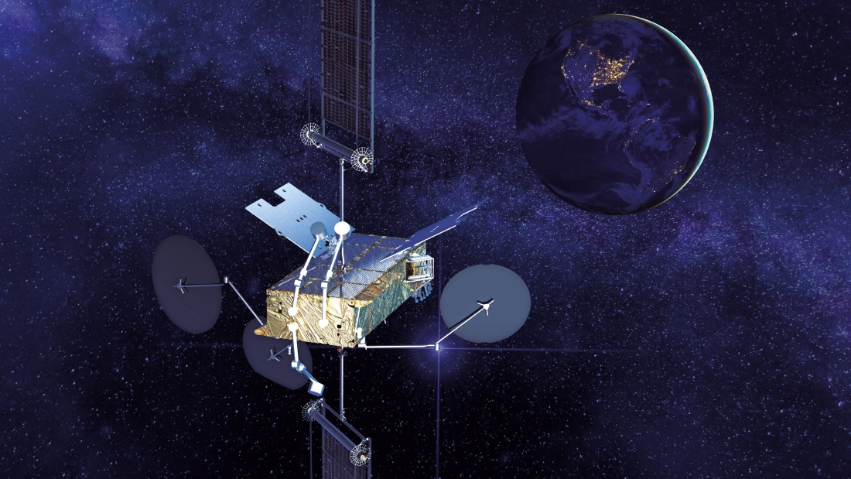
Examples of collaborative projects
Flexible solar panels for Space Inspire communication satellites – mech. subsystem
5M, Frentech Aerospace, L.K. Engineering, BD Sensors, VZLÚ → TAS-FR / ESA
Components design since 2013, subsystem development since 2019, ESA ARTES Novacom II

Slide 14

Customers and partners

Slide 15
CSA members’ websites
company name | website | company name | website
5M | https://www.5m.cz/en | OHB Czechspace | https://www.ohb-czech.cz/
Advacam | https://advacam.com/ | Rigaku Innovative Technologies Europe | https://www.rigaku.com/
BBT Materials Processing | https://www.calomel.cz/ | SAB Aerospace | https://www.sabaerospace.cz/en/
BD Sensors | https://www.bdsensors.cz/en/ | Spacemanic | https://spacemanic.com/
CGI IT Czech Republic | https://www.cgi.com/ceska-republika/cs | Stratosyst | https://www.stratosyst.com/
EGGO Space | https://www.eggo.cz/en/about-us/ | Streicher | https://www.streicher.cz/
ESC Aerospace | https://www.esc-aerospace.com/ | TERMA | https://www.terma.com/
Frentech Aerospace | https://frentech.eu/en/ | Toseda | https://www.toseda.cz/en/
HULD | https://huld.io/ | TTS | https://tts-co.eu/en/main/
Iguassu Software Systems | http://iguassu.cz/ | Unites | https://unites-systems.com/
L.K.Engineering | https://www.lke.cz/en/ | UptimAI | https://uptim.ai/

Slide 16
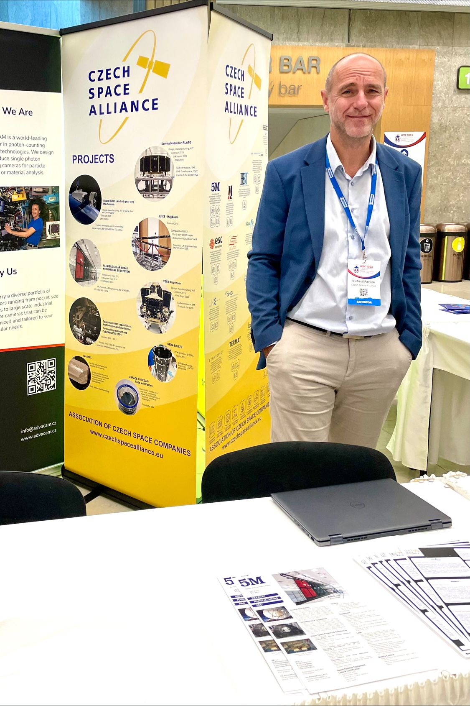
Contact
Prezident: Richard Pavlica – richard.pavlica@5m.cz
Secretary: Josef Šobra – tajemnik@czechspacealliance.eu
Info: Vendula Doubravská – info@czechspacealliance.eu
Czech space alliance, Evropská 657/120, 160 00 Praha 6

